Slide 1
Learning intention: to stay safe near railway / metro lines.

Slide 2
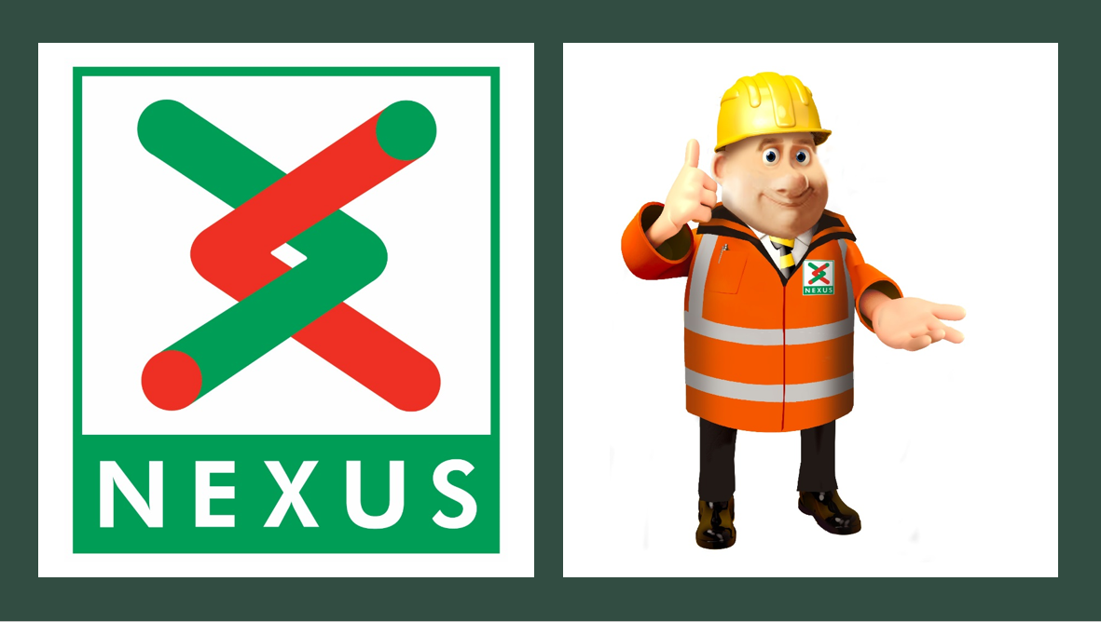
Engineer- a person who designs, builds or maintains engines, machines or structures.

Slide 3
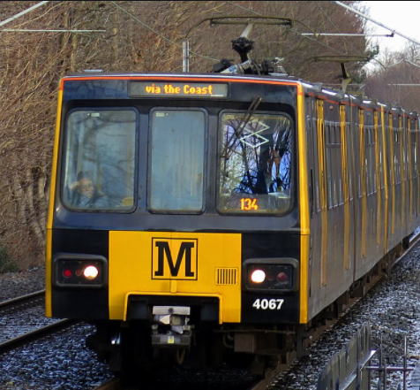
What are railway lines or metro lines?
Metro or railway lines are the tracks that metros or trains run on.
In the North East there are 90 trains/metros run on the track everyday.
Each train weighs 40tonnes, that’s the same weight as 6 elephants!
A train travel 50m.p.h, that’s the same speed as a car on the motorway.
It takes a metro 150meters to stop in an emergency- that’s the length of one and a half football pitch.
To make a metro move, it takes over 1500volts of electricity, that’s the same power as 125 car batteries!

Slide 4
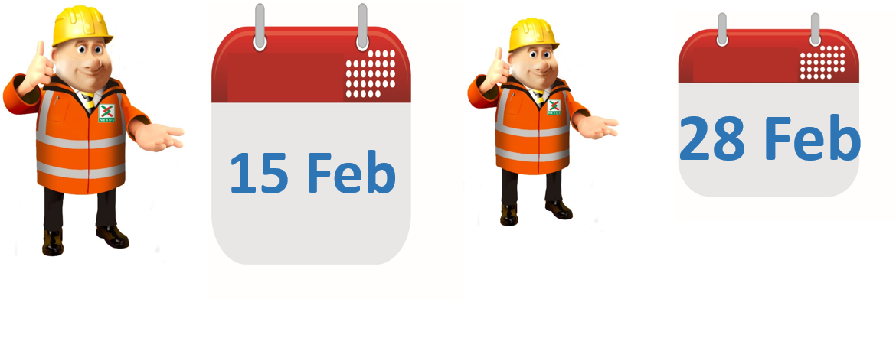
For two weeks starting the 15th February, engineers will be working to fix the over head power cables.

Slide 5
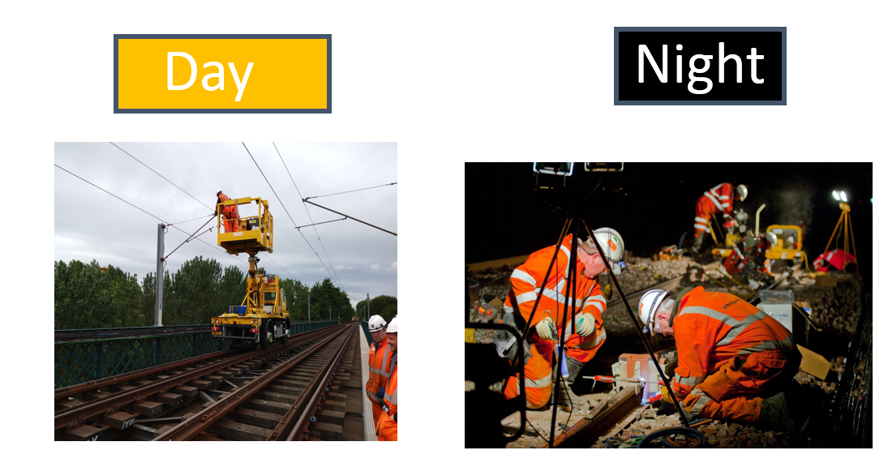
They will be working….

Slide 6
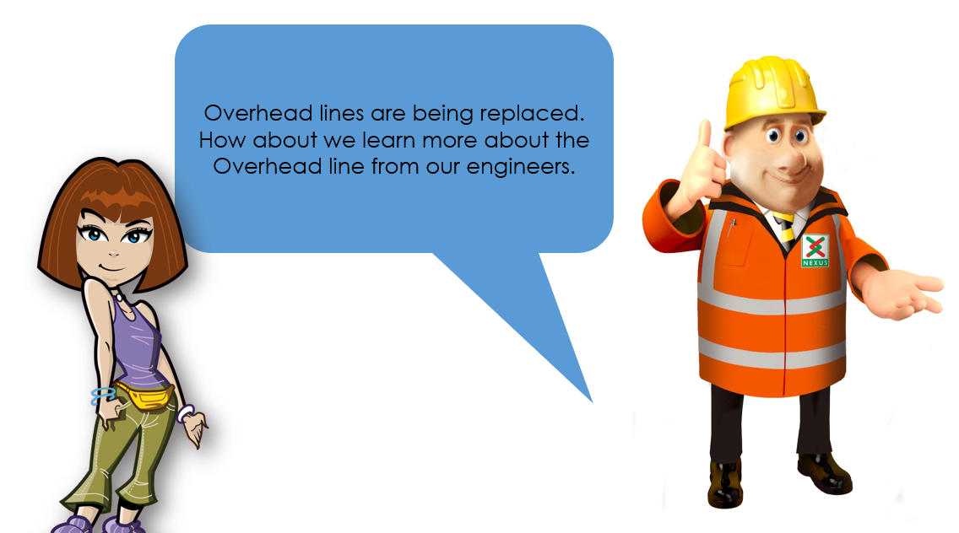

Slide 7
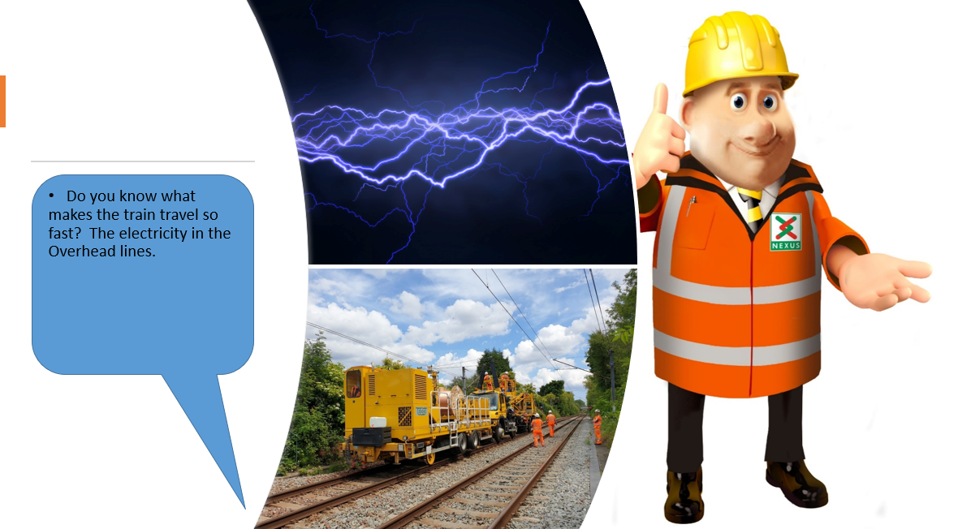
This machine helps our engineers to tighten the overhead line. We called it WIWO which stands for Wind In and Wind out.(real name is Catenary Installation Unit).

Slide 8
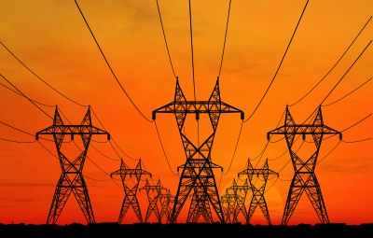
How powerful are electric overhead lines?
A
100 times greater voltage than the power supply in the average home
7 times greater voltage than the power supply in the average home
C
The same as the power supply in the average home
7 times

Slide 9
How powerful are electric overhead lines?
A
100 times greater voltage than the power supply in the average home
7 times greater voltage than the power supply in the average home
C
The same as the power supply in the average home
7 times

Slide 10
What happens when you get electrocuted?
A. A tingling or painful sensation.
B. A painful shock, muscles contract and grip the electrical source so you’re unable to let go.
C. The heart ‘flutters’ (ventricular fibrillation). Burns at entry and exit points and internal damage.
D. Prolonged exposure or strong muscular contractions stop the heart. Internal organs, tissue and skin burn.
Answer: All of the above!
The effects vary depending on the electric current and frequency, but they affect the whole of the body…

Slide 11
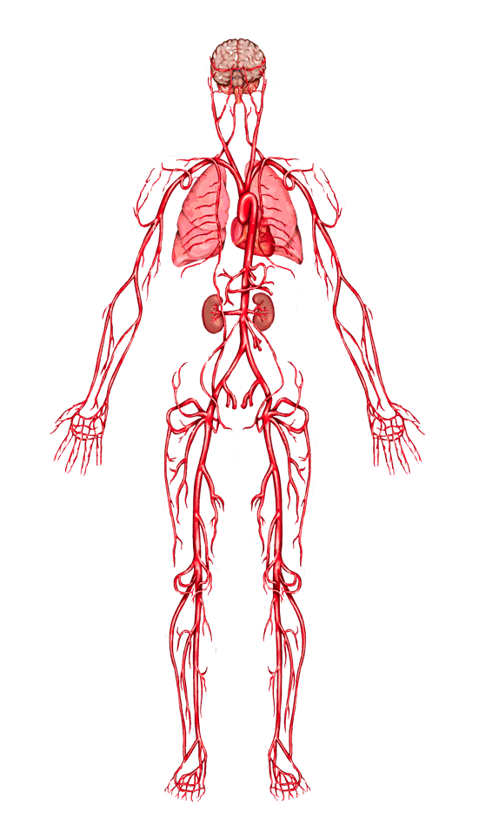
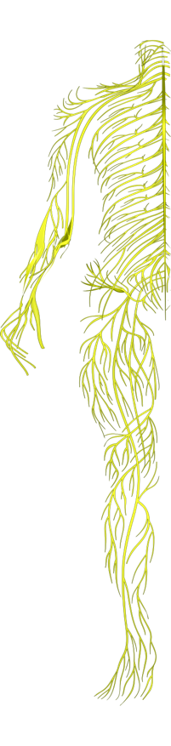
When you get electrocuted…
Lungs: breathing is paralyzed.
Hands, heels, head: points of contact with the electrical source and the ground receive the most severe burns.
Nervous system: disrupts the tiny electrical impulses that enable you to sense, move, think, respond and remember.
Heart: ‘flutters’ and fails to pump blood properly. Goes into cardiac arrest, resulting in death.
Electricity seeks the easiest path to the ground. Human bodies contain 70% water – a great conductor for electricity.

Slide 12
When you get electrocuted…
Spine/Bones: being thrown by force of the current or the strength of muscle contractions can lead to broken bones or an injured spine.
Muscles: sometimes you grip the electrical source so you can’t let go!
Abdomen: strong muscle contractions throw you clear of an electrical source and can damage internal organs.
Skin and tissue: electricity burns beneath skin and the burns blacken and melt surface skin and tissue.
FACT: 9 out of 10 people die from the electric shock received
from getting too close to railway electric overhead lines.

Slide 13

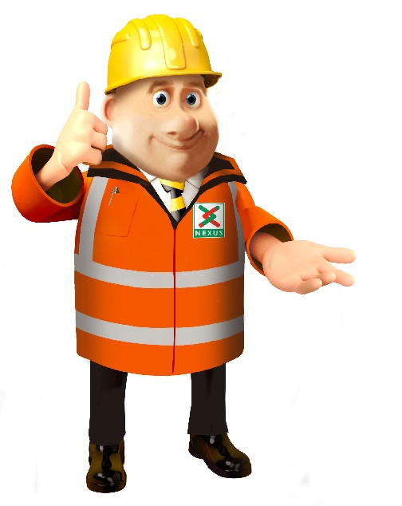

Keep yourself SAFE!

Slide 14

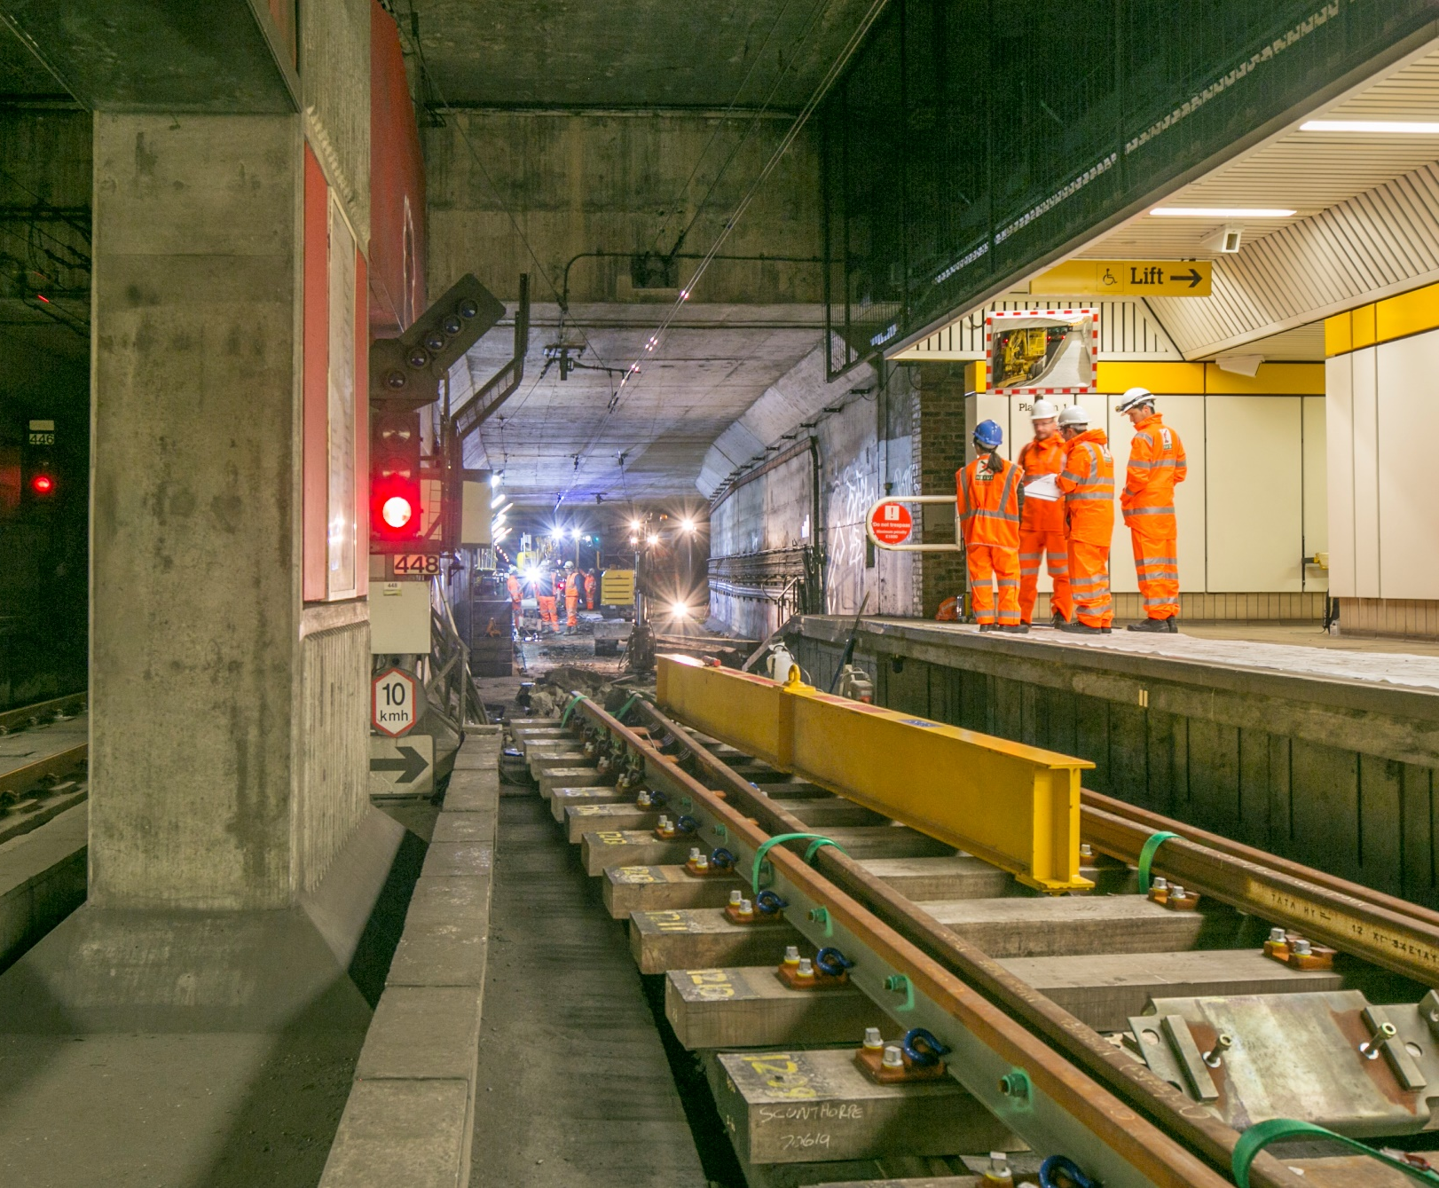

Engineers working in the underground stations
Notes:
Engineers working in the underground stations

Slide 15

What dangers are there around a working compound?
Notes:
In our compounds there will be many hidden dangers and heavy machinery. Can you think of any dangers?

Slide 16

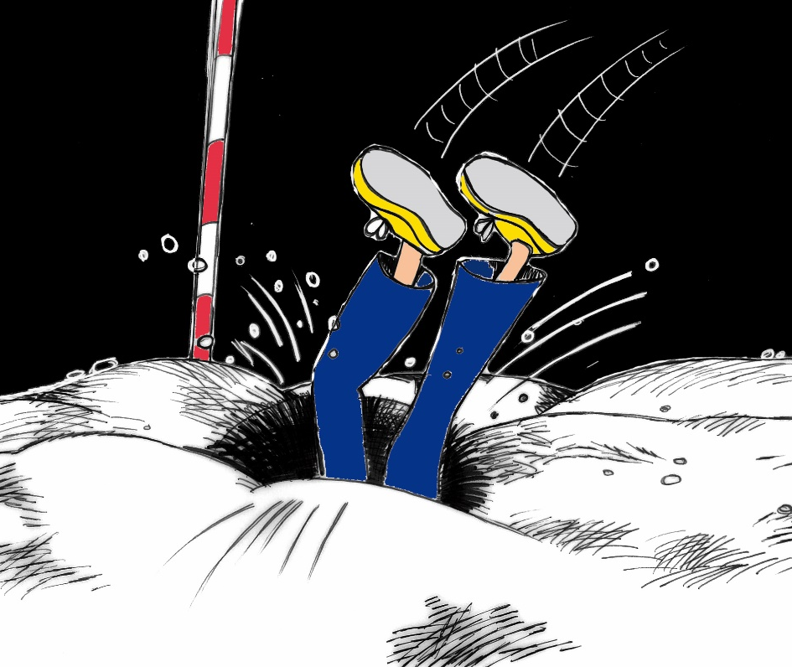
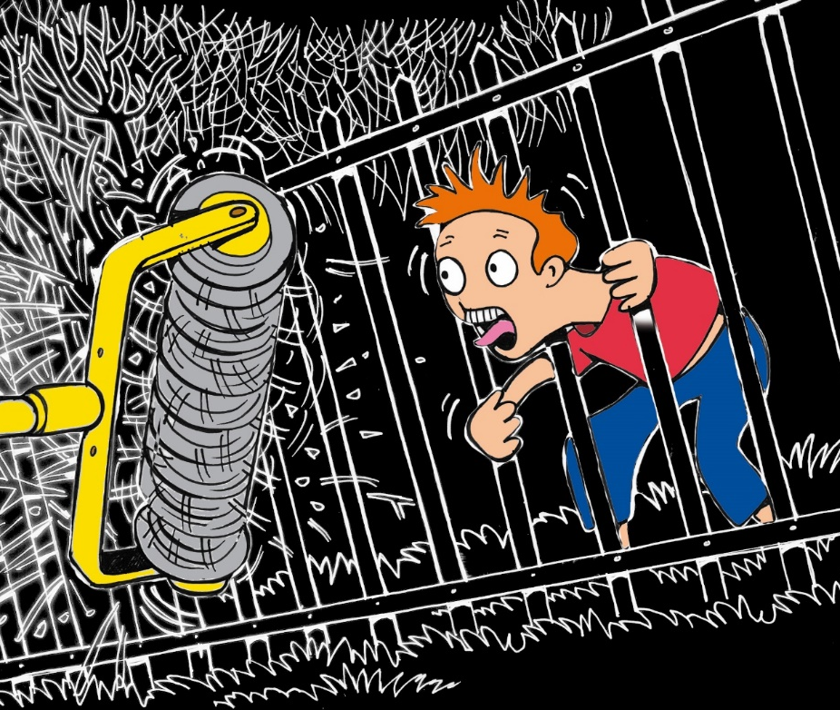
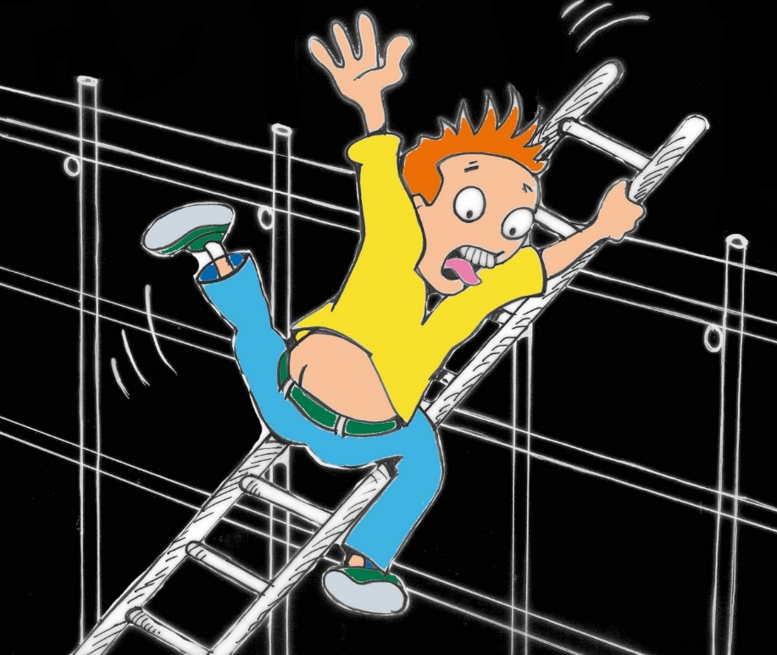
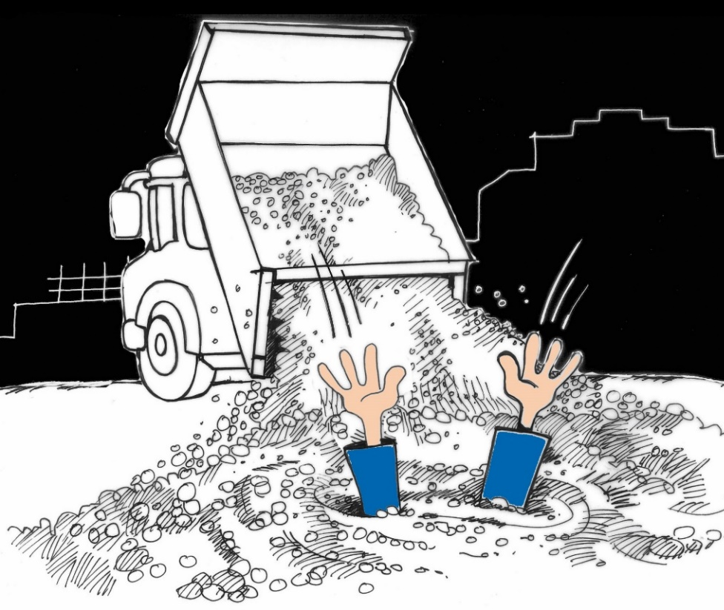
Remember our engineers where PPE and are fully trained to work in these areas. We are not allowed in this area and we would be trespassing and could get in trouble with the police ,be hurt or we could be killed.
Notes:
Remember our engineers where PPE and are fully trained to work in these areas. We are not allowed in this area and we would be trespassing and could get in trouble with the police ,be hurt or we could be killed.

Slide 17

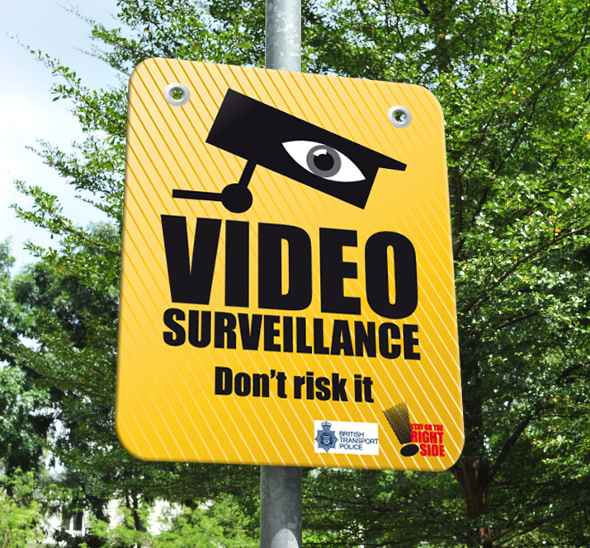
We have loads of CCTV Cameras
Notes:
We have loads of CCTV Cameras

Slide 18
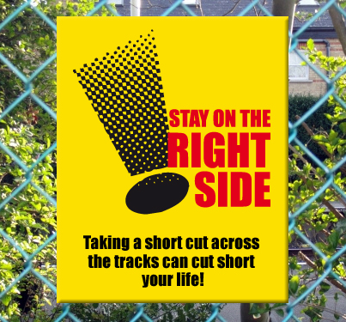
Stay on the right side of the fence as short cuts could cost you your life.
Notes:
Stay on the right side of the fence as short cuts could cost you your life

Slide 19
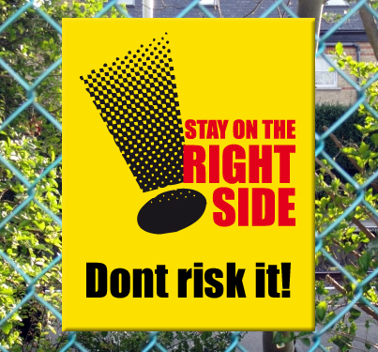
Notes:
Don’t risk it

Slide 20
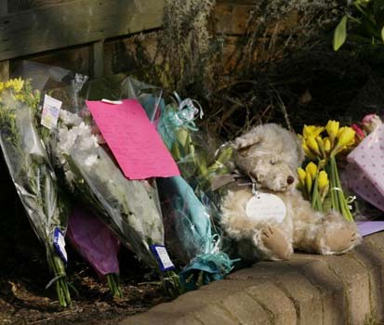
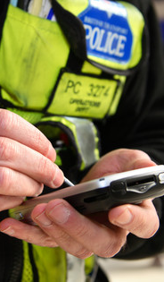
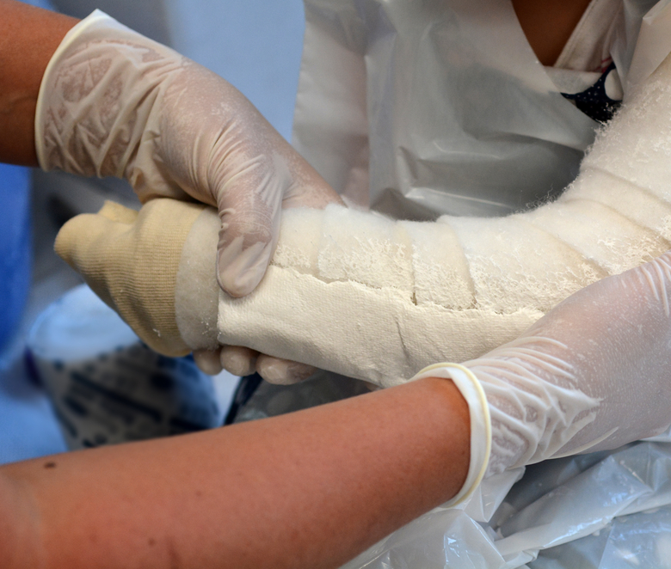
Remember the consequences could effect your family and friends, teachers and the emergency services.
Notes:
Remember the consequences could effect your family and friends, teachers and the emergency services.

Slide 21

Play Safe Stay Safe

