Slide 1
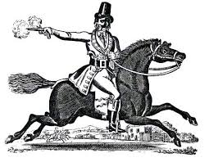
Learning Intention – To explore grammatical terminology Relative Clauses Narrative Poetry- The Highwayman
The highwayman, who was scared of the dark, rode through the wood.

Slide 2
Relative Clauses
Relative clauses can give more information about a noun or pronoun.
Bess looked out of the window.
Tell me more about Bess.
Bess, who was the landlord’s daughter, looked out of the window.
Bess, who was feeling bored, looked out of the window.
Bess, who was a little crazy, looked out of the window.

Slide 3
Relative Clauses
Relative clauses can give more information about a noun or pronoun.
They usually begin with a relative pronoun/adverb.
Bess looked out of the window.
Tell me more about Bess.
Bess, who was the landlord’s daughter, looked out of the window.
Bess, who was feeling bored, looked out of the window.
Bess, who was a little crazy, looked out of the window.
Relative Pronouns/Adverbs
who, which, where, when, whose, that

Slide 4
Relative Pronouns/Adverbs
These relate the clause to the noun or pronoun.
The soldiers, who were wearing red uniforms, marched to the inn.
He wore a velvet coat which was stolen from a duke.
They looked at the sky where stars twinkled like diamonds.
Relative Pronouns/Adverbs
who, which, where, when, whose, that

Slide 5
Punctuating Relative Clauses
When the relative clause comes after the main clause,
we do not usually separate the clauses with a comma.
main clause
relative clause
Tim listened in the yard which was full of barrels and boxes.
A comma would create an unnecessary break in the sentence.

Slide 6
Punctuating Embedded Relative Clauses
Sometimes the relative clause is embedded in the main clause.
The landlord slept upstairs.
main clause
main clause
The landlord, who got up early each day, slept upstairs.
The embedded clause is separated by two commas.

