Slide 1
ch
Today’s sound is...

Slide 3
My turn, your turn...
ch

Slide 4
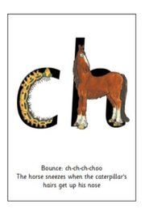
My turn, your turn...

Slide 5
My turn, your turn...
ch

Slide 6
Speedy sounds...
m

Slide 7
Speedy sounds...
e

Slide 8
Speedy sounds...
sh

Slide 9
Speedy sounds...
k

Slide 10
Speedy sounds...
j

Slide 11
Speedy sounds...
f

Slide 12
Speedy sounds...
i

Slide 13
Speedy sounds...
u

Slide 14
Speedy sounds...
v

Slide 15
Speedy sounds...
w

Slide 16
Speedy sounds...
ch

Slide 17
ch

Slide 18
Special friends, fred talk, word
chop

Slide 19
Special friends, fred talk, word
chin

Slide 20
Special friends, fred talk, word
chat

Slide 21
chop
chin
chat

