Slide 1
20.1.21. To stay safe online.

Slide 2
How do you go on the internet?

Slide 3
Strangers.

Slide 4
When you are playing games or using the internet, a stranger might try and talk to you.
A stranger online might not look scary.
They might be nice to you.
They might want to be your friend.

Slide 5
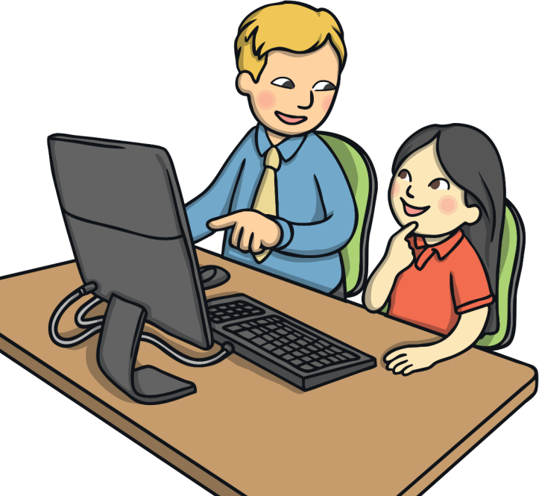
Keeping safe online.
Do not talk to strangers on the internet.
Do not tell them anything about you, like your name, date of birth or address.
If someone does try and talk to you, always ask your grown up for help.
If you are unsure, always go on the internet with a grown up in the room.

Slide 6
Can you write or draw a poster to remind you how to stay safe online?

