Slide 1
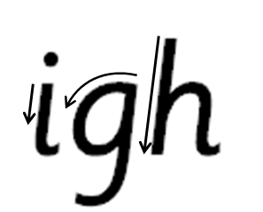
Focus: igh
i – start at the top, come all the way down, flick and dot
g – make a curve, go up to the top, come all the way down and curve to the left
h – start at the top, come all the way down, bounce half way back up, go over, down and flick

Slide 2
Your turn! Write igh in your book using the lines.
Then try:
high
might
flight

