Slide 1
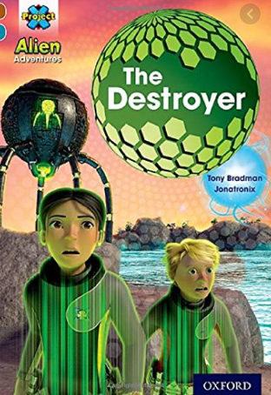
The Destroyer (gold)

Slide 2
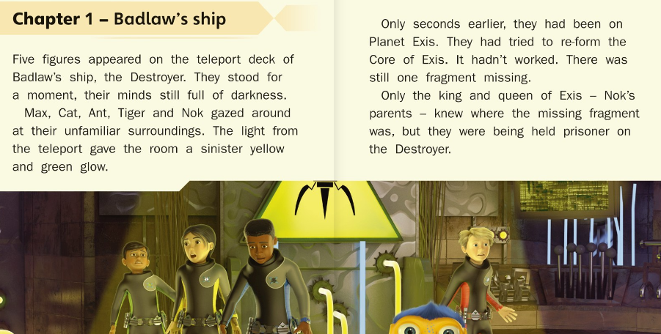
Read each section of the text I have given you then on the next page answer the questions

Slide 3
Answer these questions
Its says “their minds full of darkness.” What do you think this means?
2) Which of these is another word for ‘sinister’?
Evil Beautiful Quiet Loud
3) Where were the characters before they arrived on the ship?
4) How do you think the characters are feeling? Why do you think this?

Slide 4
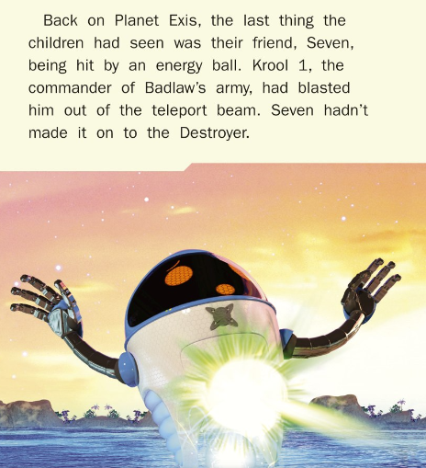
5) Why did Seven not make it onto the ship with the others?
6) Why do you think the author gave the bad character the name ‘Kroll 1’?
7) Which description best describes how the characters feel about Seven’s attack?
He’s only a robot so their not interested
They are very upset about it because he was their friend
They were happy because he was finally gone

Slide 5
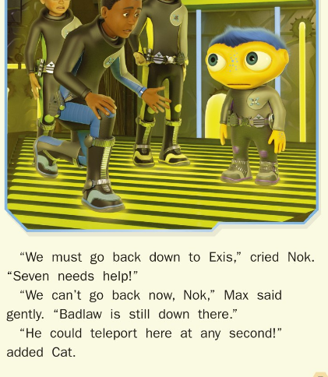
8) Read about what the characters are discussing.
If you were with the group what would you do? Why?

