Slide 1
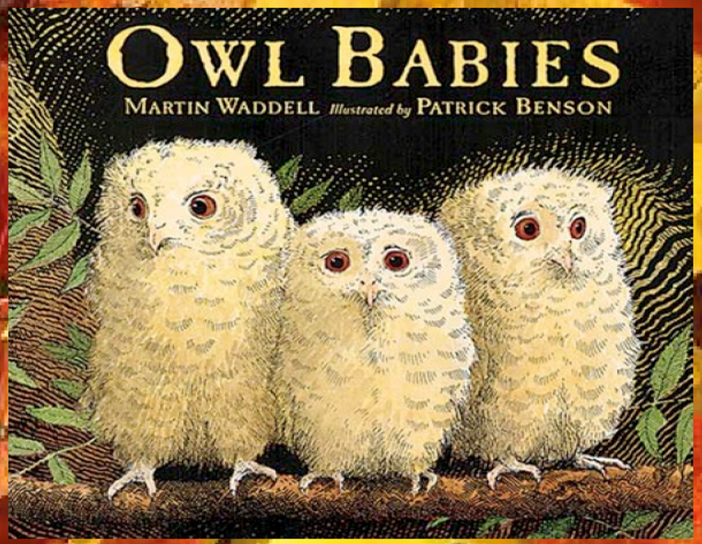
Today we will share the beginning of the story.

Slide 2
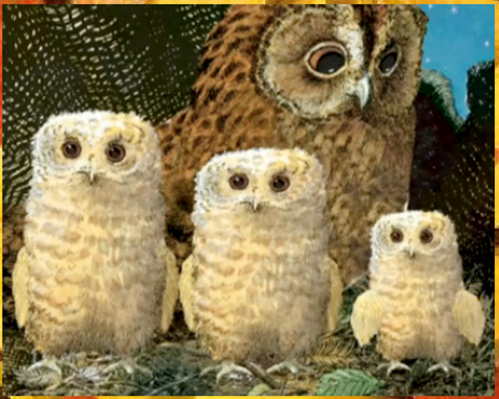
Once there were three owls, Sarah, Percy and
Bill.
They lived in a whole in the trunk of a tree with their Owl Mother.

Slide 3
Look at the different sizes of the owl babies.
Who do you think is the smallest?

Slide 4
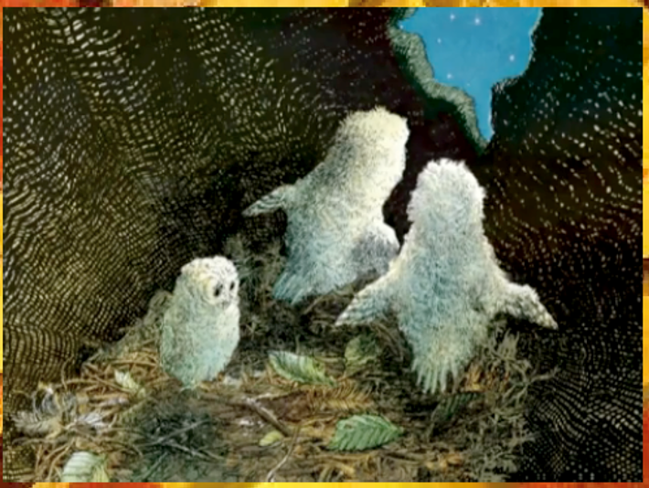
One night they woke up and their Owl Mother was gone!

Slide 5
How do you think they are feeling?
The smallest owl looks sad.

Slide 6
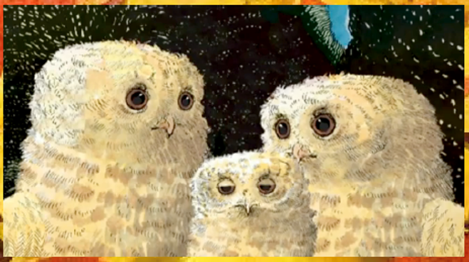
“Where’s Mummy?” asked Sarah.
“Oh my goodness!” said Percy.
“I want my Mummy!” said Bill.
But their Owl Mummy didn’t come . . .

Slide 7
Where could Owl
Mother have gone?
Do you think she will come back?

Slide 8
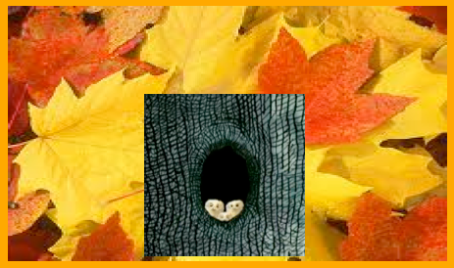
“I think she’s gone hunting,” said Sarah.
“To get us some food,” said Percy.
“I want my mummy,” said Bill.
But their owl mummy did not come…
Can you remember where the owls live?

Slide 9
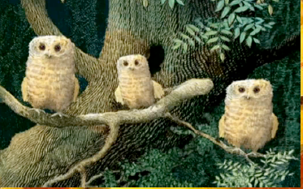
The owl babies came out of their house and waited…
“She’ll be back,” said Sarah.
“She’ll be back soon,” said Percy.
“I want my mummy!” Said Bill.
Why do you think Bill keeps saying that he ‘wants his mummy?’

Slide 10
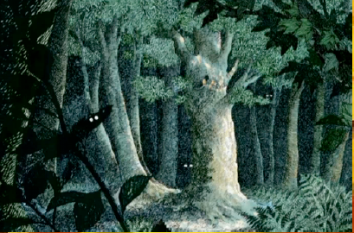
It was dark in the wood.
They had to be brave.
Things moved all around them.
What things do you think moved around the owls?
Are you frightened of the dark?

Slide 11
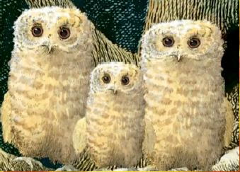
“She’ll bring mice and things that are nice!” Said Sarah.
“I suppose so!” Said Percy.
“I want my mummy!” Said Bill.
“I think we should sit on my branch,” said Sarah.
And they did all three of them.
What do you think the owls are feeling?

Slide 12
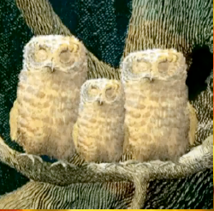
“Suppose she got lost or a fox got to her!”
“I want my mummy!”
The three babies closed their owl eyes and wished for their owl mummy to come
home.
Which owl babies are speaking?
Which one of the babies is saying “I want my mummy?”

Slide 13
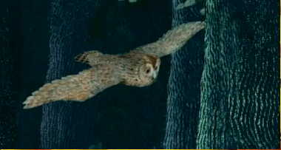
Twit Twoo!
And she came!
Soft and silent she swooped trough the trees to Sarah, Percy and Bill.
What do you think the word swooped means?
Does Owl Mother have anything with her for the baby owls?

Slide 14
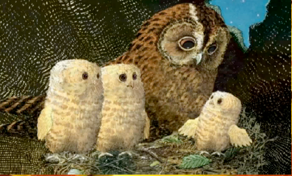
“What’s all the fuss. You knew I’d come back!”
“I knew it!” Said Sarah.
“I knew it!” Said Percy.
“I love my Mummy!” Said Bill.
What do you think the owl babies are saying to their mummy?
Has Bill said anything different?

