Slide 1
Science
Air Resistance

Slide 2
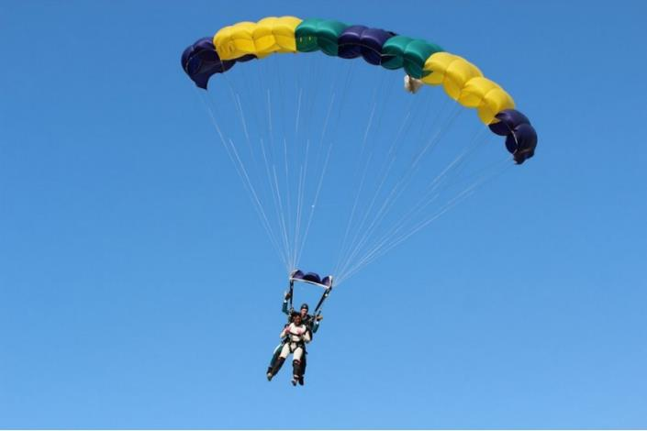
Science: Air Resistance

Slide 3
Air resistance
Air resistance
gravity
gravity
Science: Air Resistance

