Slide 1
To be able to recognise and add UK coins

Slide 2
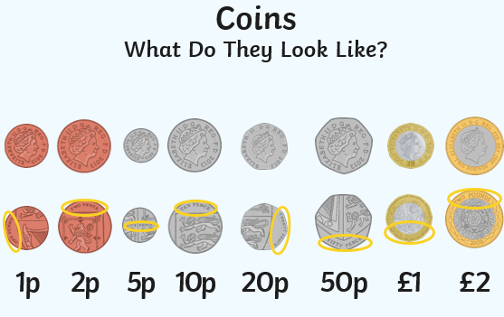
In the UK we have many different coins
In the UK we have many different coins.
The main way we identify the UK coins is by looking at the colour and the shapes of the coins.

Slide 3
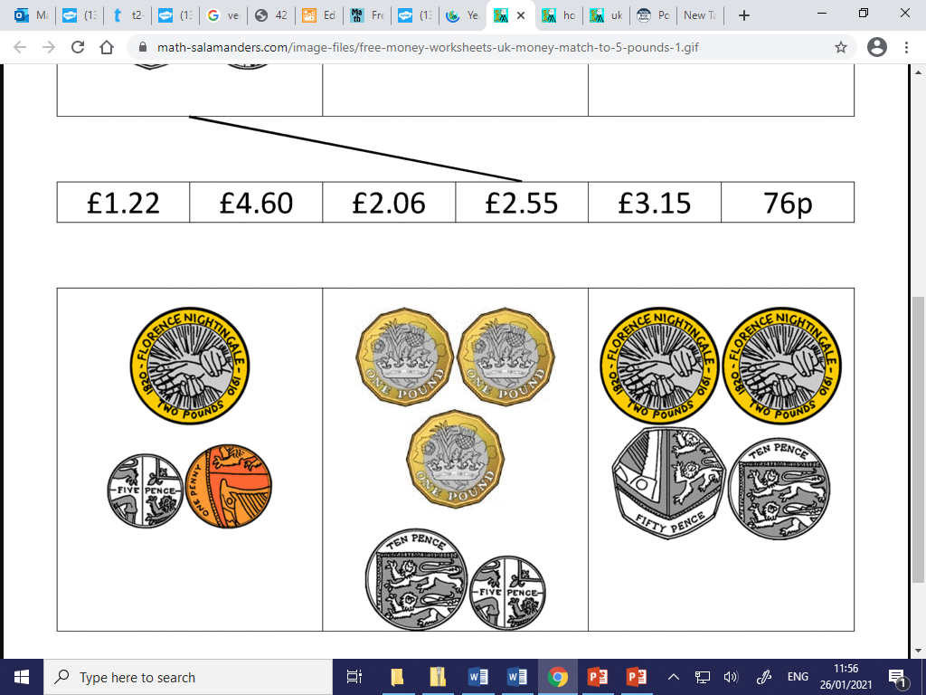
Finding the total
When finding the total of money its best to look at it in two parts.
First find the total of the pounds, then the total of the pence, then add it together.
£1 + £1 + £1 = £3 10p+5p = 15p Total £3 + 15p = £3.15

