Slide 1
Set 1 Sounds z

Slide 2
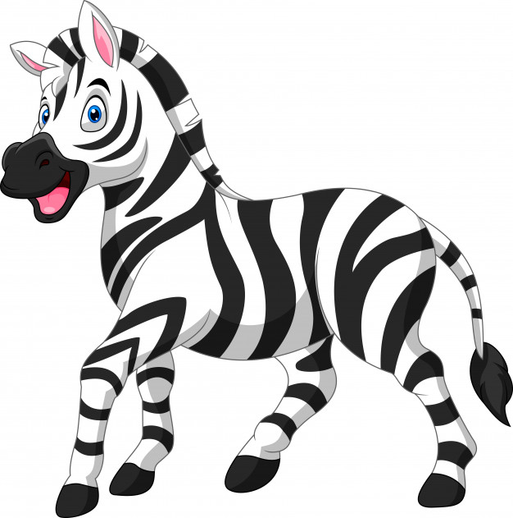

Slide 3
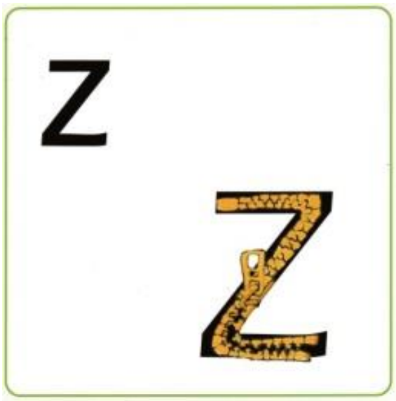

Slide 6
