Slide 1
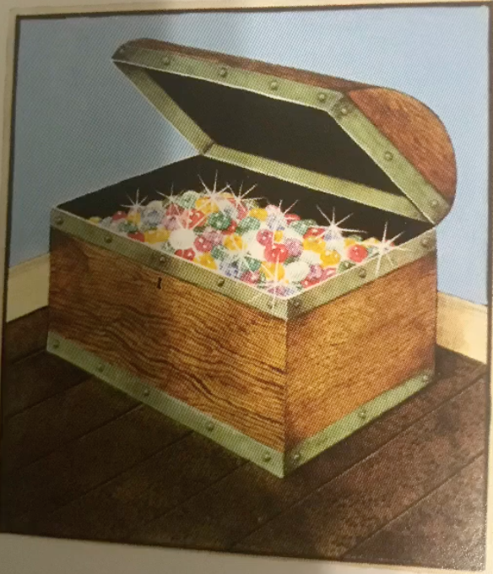
Learning Intention: To write a story
Today we are writing the ending of the story.
You could make your story more exciting by changing the ending. What interesting ending can you think of for Hansel and Gretel’s story? Add it to your story map.
Look at the next slide to see how I edited my story map to help me to write the end of the story.

Slide 2
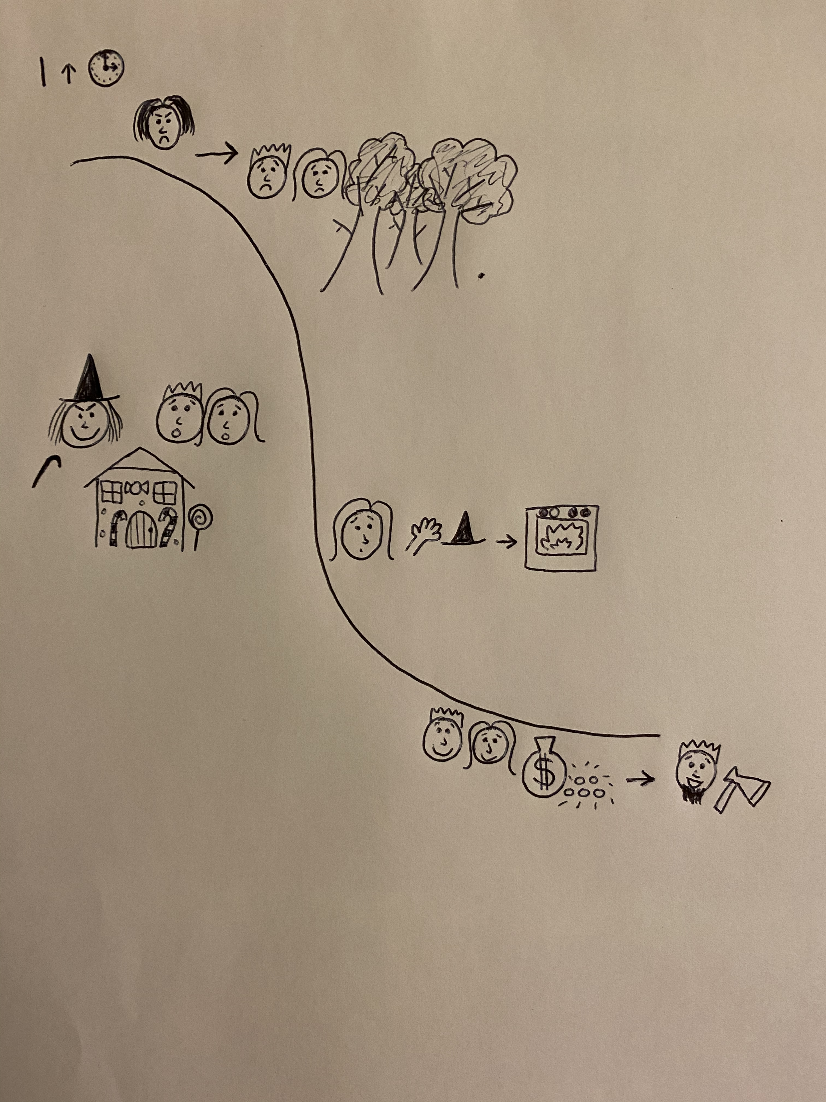
peaceful
freezing
suspicious
towering mountains
My story ending

Slide 3
Hansel was free at last. The witch’s house suddenly felt warm and there was even a room filled with gold! The children decided to stay because the gingerbread house on the mountain seemed like a nicer place to live than their old, broken house. Their father came to live with them and they were never hungry again. They all lived happily ever after.
Write your own story ending in your own words. What happens to Hansel and Gretel?

Slide 4
Can you write the end of your story using your edited story map?
Remember:
Capital letters
Full stops
Conjunctions to extend your sentences (and, or, but, because, when, if, that)

