Slide 1
Measures
Key words:
Length, capacity, mass, metric

Slide 2
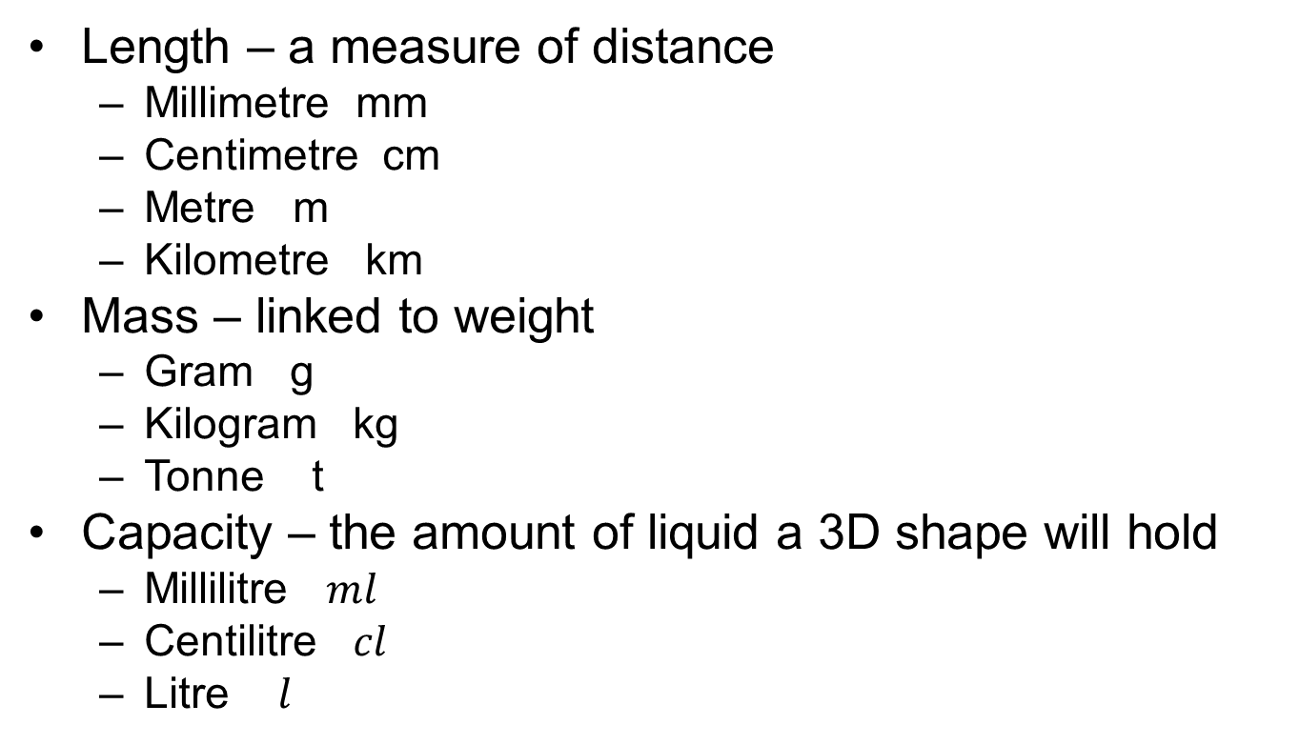
Metric units of measurement
Length – a measure of distance
  Millimetre mm
  Centimetre cm
  Metre m
  Kilometre km
Mass – linked to weight
  Gram g
  Kilogram kg
  Tonne t
Capacity – the amount of liquid a 3D shape will hold
  Millilitre $ml$
  Centilitre $cl$
  Litre $l$

Slide 3
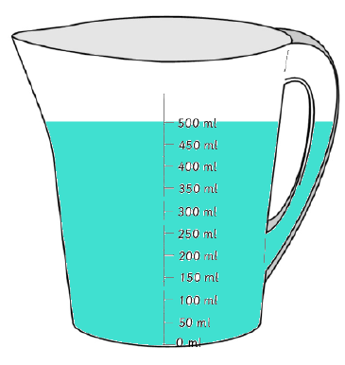
Capacity is measured in litres and millilitres
This jug shows 500 millilitres.

Slide 4
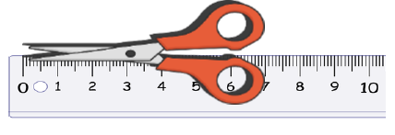
Length is measured in centimetres and metres.
The scissors are 7 centimetres long.

Slide 5
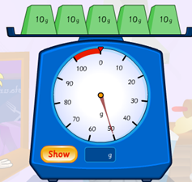
Mass is measured in grams and kilograms.
These scales show 50 grams.

Slide 6
Tell someone which metric unit you would use to measure these items? Would you use centimetres, metres, grams, kilograms, millilitres or litres.
a) Length of a bedroom
d) Length of a pen
b) Weight of a man
e) Weight of a tin
c) Capacity of a bottle of pop.
f) Capacity of a carton of cream.
Complete the worksheet on metric measurements.

