Slide 1
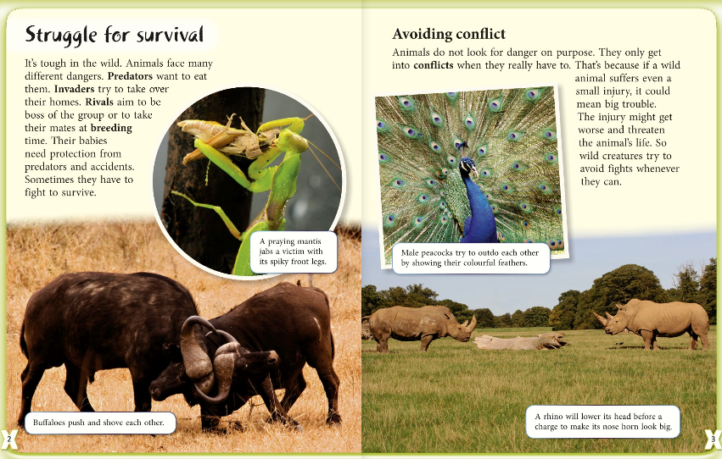
Read this first chapter carefully.
Next think about the meaning of each of the words.
Remember to read around the words because they give you clues their meaning.
survival
predator
invader
rivals
breeding

Slide 2
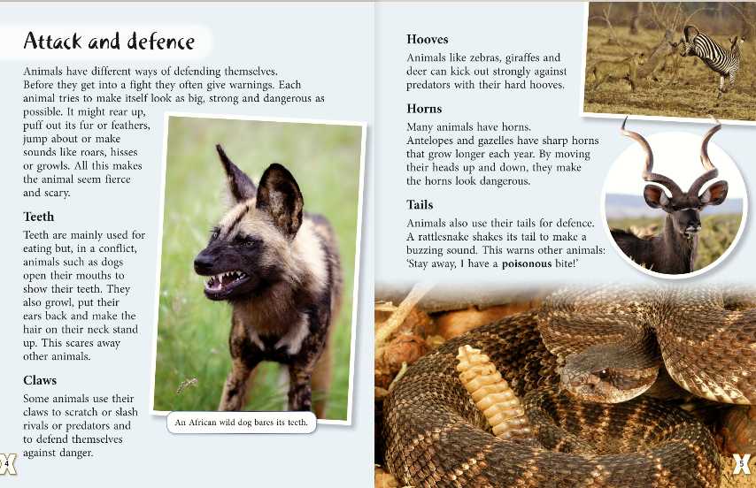
Read this first chapter carefully.
Next think about the meaning of each of the words.
Remember to read around the words because they give you clues their meaning.
fierce
defence
slash

