Slide 1
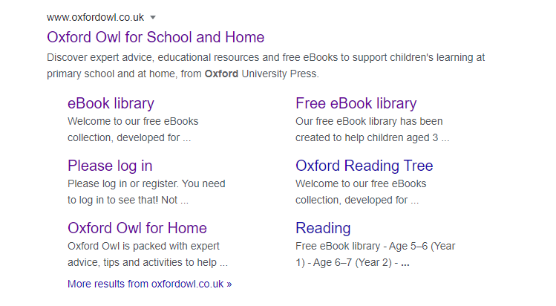
To access Orange level book (Jam Tarts) follow the instructions below. In your internet browser type Oxford Owl Click on log in and put in your username and password, these need to be exactly as they are written on your sheet. You will find this in you home learning pack.

Slide 2
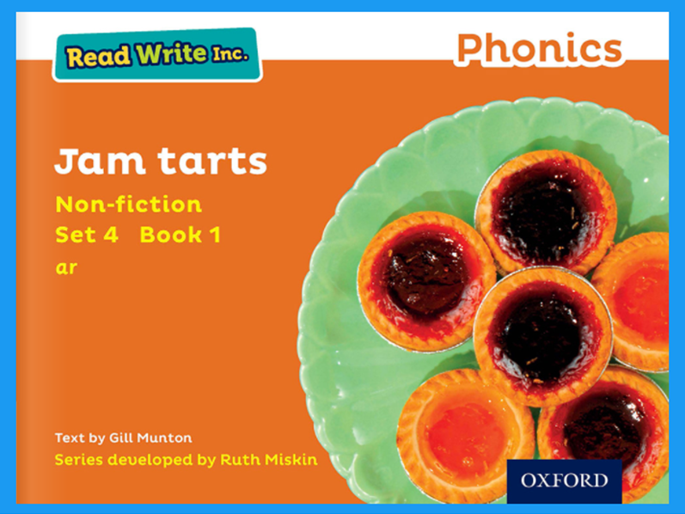
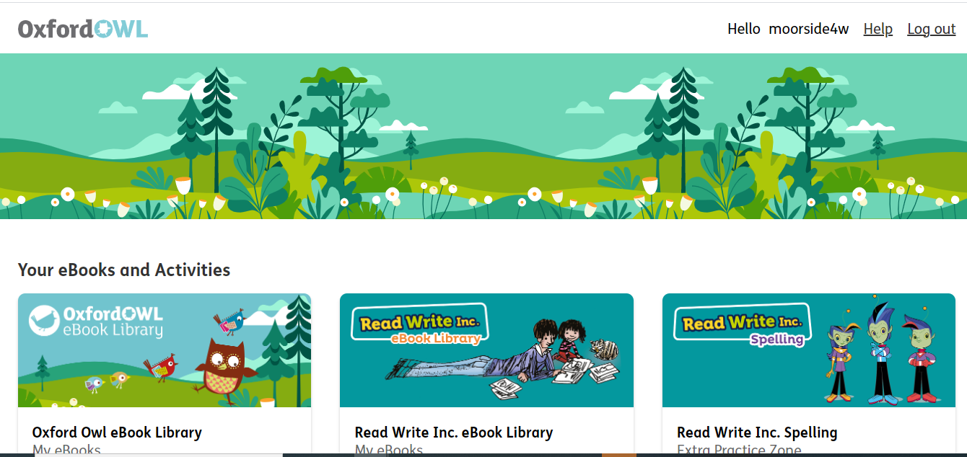
Click on the Read Write Inc eBook Library. Scroll down until you see Jam Tarts book click on the book to open.

Slide 3
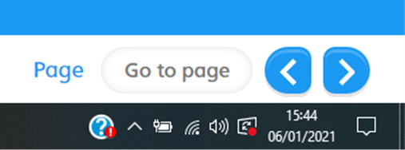
Use the buttons in the bottom right hand corner to navigate and turn pages in the book.

Slide 4
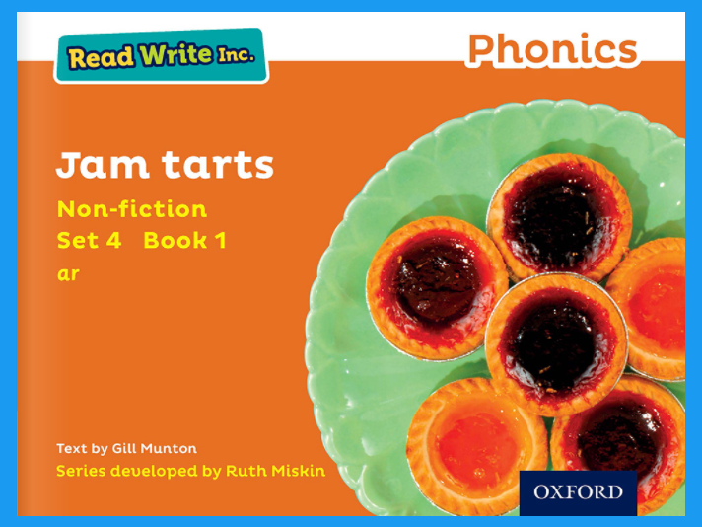

Hello Year 4,today we are reading Jam Tarts let’s begin

Slide 5
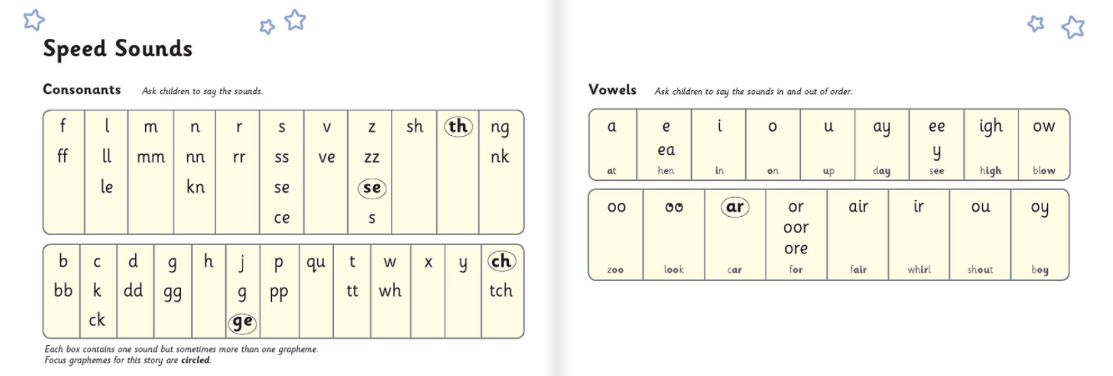
Please turn to pages 4 and 5 Read the speed sounds to your grown up.

Slide 6

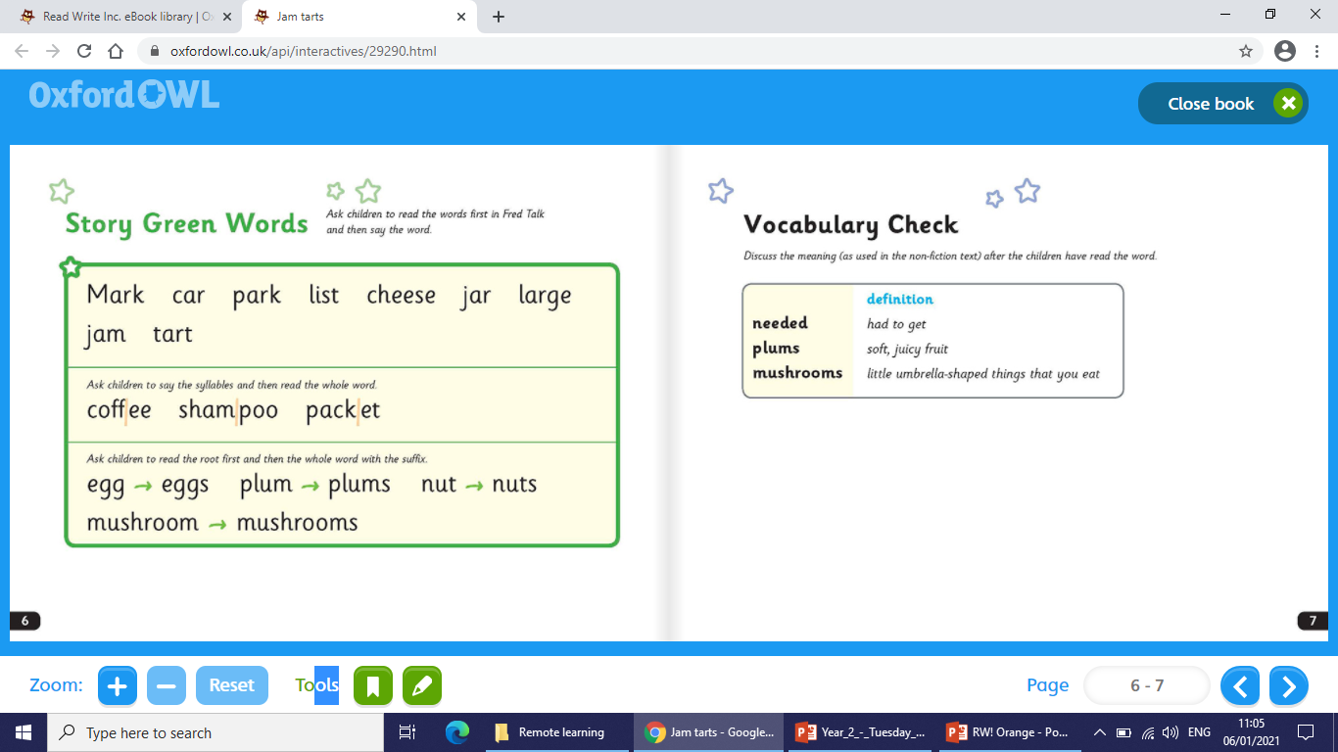
Well done, now turn to pages 6 and 7 in your book. Carefully read your story green words, remember to use Fred talk then say the words. I will read the first row to help, click on the at the bottom of this page to hear me.

Slide 7
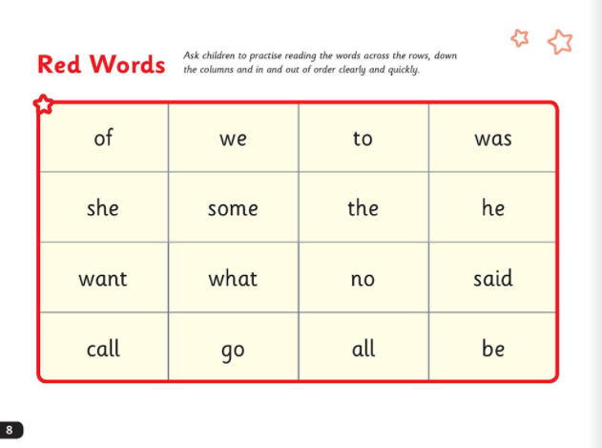
Great, now turn to page 8 in your book. Remember we read these words without blending, practice with your grown up.

Slide 8
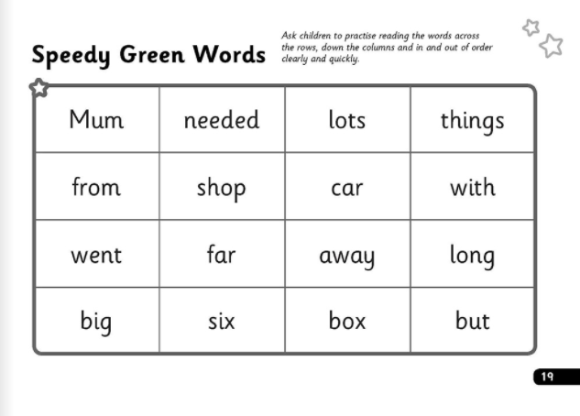
Turn to page 19, at the back of the book, have a go at reading these speedy green words.

Slide 9
Click on this sound button children

Slide 10
Click on the sound button to hear what you have to do next. Page 9 Where are they going? Page 10 Where did mum park? Page 11 What is at the top of Mum’s shopping list? Page 12 What was the coffee in? Page 13 How big were the eggs? Page 16 Do you think Mum was cross with Mark? Why or why not?

Slide 11

Nearly done, ask your grown up to read the questions on page 18. See if you can answer the questions without help. Well done, I hope you have enjoyed this session. See you next time. Stay safe, I look forward to seeing you soon. Bye.

