Slide 1
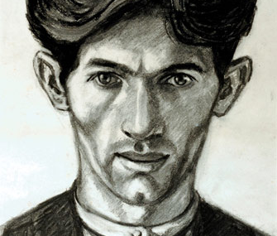

Norman Cornish
Durham Artist
Self-portrait

Slide 2
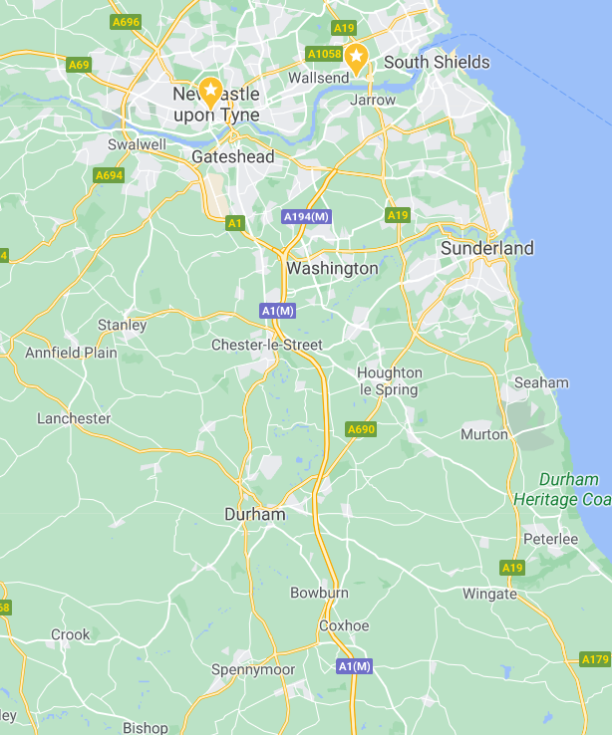
Early Life
Norman Cornish was born on 18th November 1919 in Spennymoor in Durham, only a short distance from Newcastle.
He was interested in drawing from an early age and even won a prize for his drawing of a leather boot, when he was just 4 years old!

Slide 3
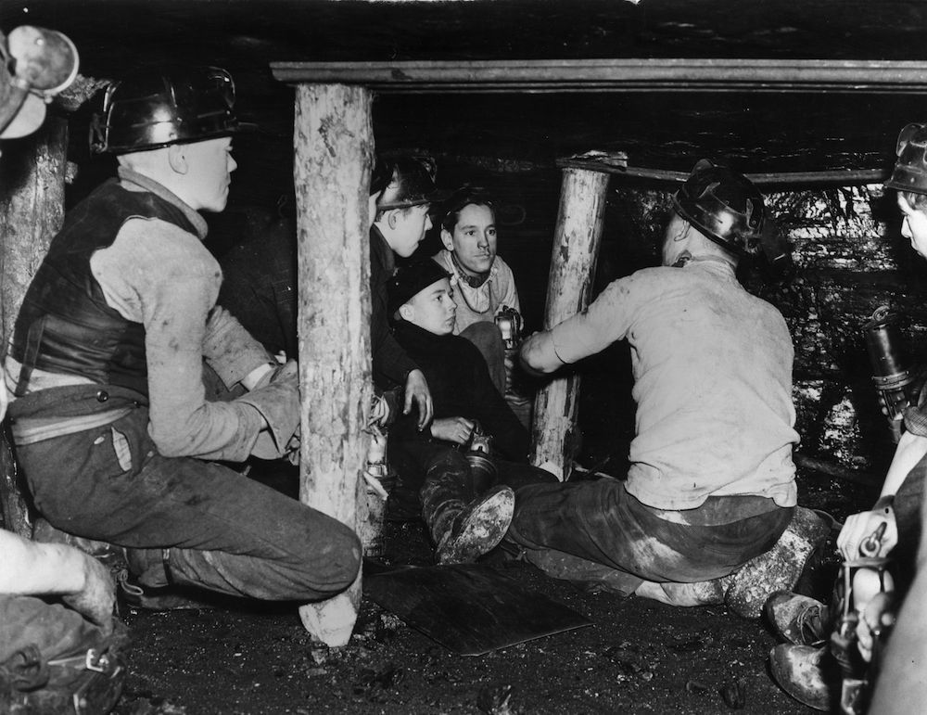
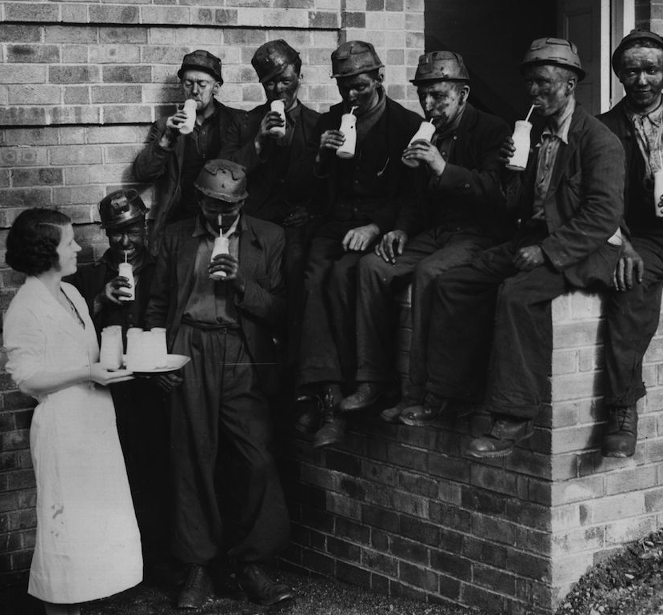
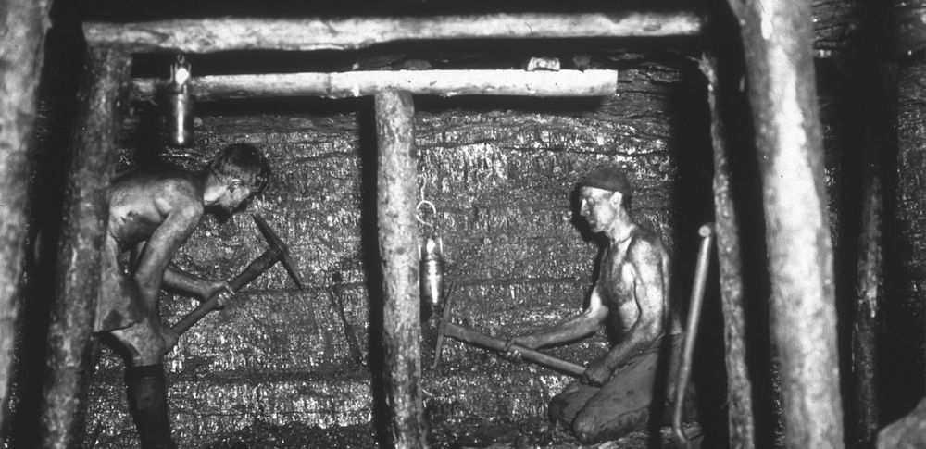
He left school when he was 14 and went to work in the coal mines.
What do you think it was like working in the mines in the 1930’s?
This video shows you what it was like.
https://www.britishpathe.com/video/coal-mining-1920s-1930s/query/++1930
He joined a local art group when he was 16.
Sometimes he didn’t know what to paint or draw. He was told to
“paint what you know”
So he did!
What do you think he painted?

Slide 4
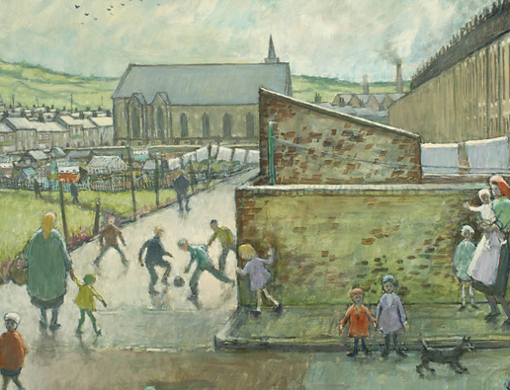
What did he paint?
In Spennymoor there were lots of coal mines
He saw lots of men walking to the pits and the pit buildings and machinery
Children were often playing in the streets
After work, the men would go to the pubs with their friends and play dominoes
This was what he “knew” so this was what he painted
Can you see the mining buildings in the background?

Slide 5
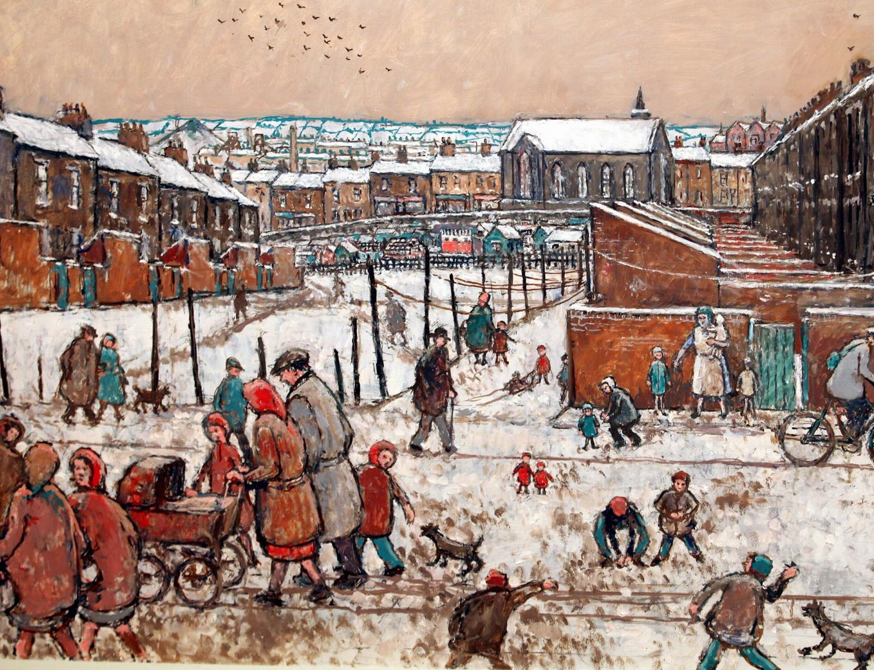
He worked as a miner for more than 30 years
He continued to paint and draw throughout this time
In the 1960s, he left the mine and became a full-time professional artist
He died in 2014, at the age of 94

Slide 6
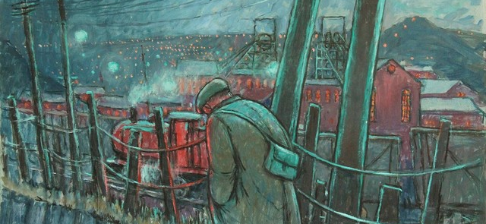
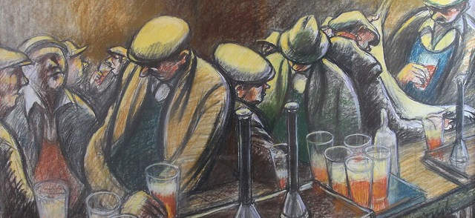
Importance
Cornish’s paintings have shown us what life was like in these poorer villages in the North East of England.
Lots of other miners took up painting as a hobby and an escape from the hard, dirty, dangerous work of coal mining.
They have become an important source of information on life for people in pit villages then.

Slide 7
Activity
Study Norman Cornish Characters
Find the sheet Norman Cornish Characters.
Discuss the people in the pictures with an adult.
Use the questions to help you.
Draw your favourite character and explain why you like them.

