Slide 1
Year 1 Maths Learning intention: To count forwards and backwards.

Slide 2
We are going to be learning about counting forwards and backwards to 100.
1
10
100

Slide 3
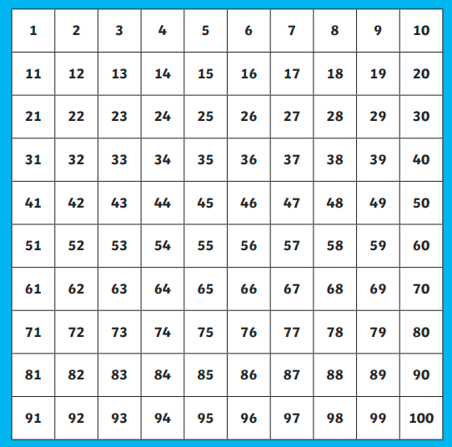
Now lets have a look at a 100 square and see if we can use it to count forwards from 1 to 100.

Slide 4
Now lets try and count backwards from 100 to 1.

Slide 5
Now have a go at finding these numbers on the 100 square.
24
62
76
37
55
16
41
83
99
20

