Slide 1
Chinese New Year
Chinese New Year begins on 12th February In 2021 .
Kung Hei Fat Choy!
(That is how you say “Happy New Year!” in Chinese)

Slide 2
Chinese New Year is also known as the Spring Festival. It is the biggest and most important festival in China and it is celebrated in Chinese communities all over the world.
It is celebrated with gifts, fireworks and dragon and lion dances. The celebration ends on the 15th day with a lantern festival.
The 15-day festival begins with spring cleaning: everyone joins in with cleaning the home ready for the New Year.

Slide 3
There are many legends about how the Chinese New Year came about and why each year is linked to a different animal.
One legend describes a swimming race between twelve different types of animal. The animals argued about who should be first in the cycle of years. The gods decided that there should be a swimming race and the animal that won would be the first animal in the cycle. The rest of the animals would be in the order that they finished. The order that they finished the race was rat, ox, tiger, rabbit, dragon, snake, horse, goat, monkey, rooster, dog then pig.

Slide 4
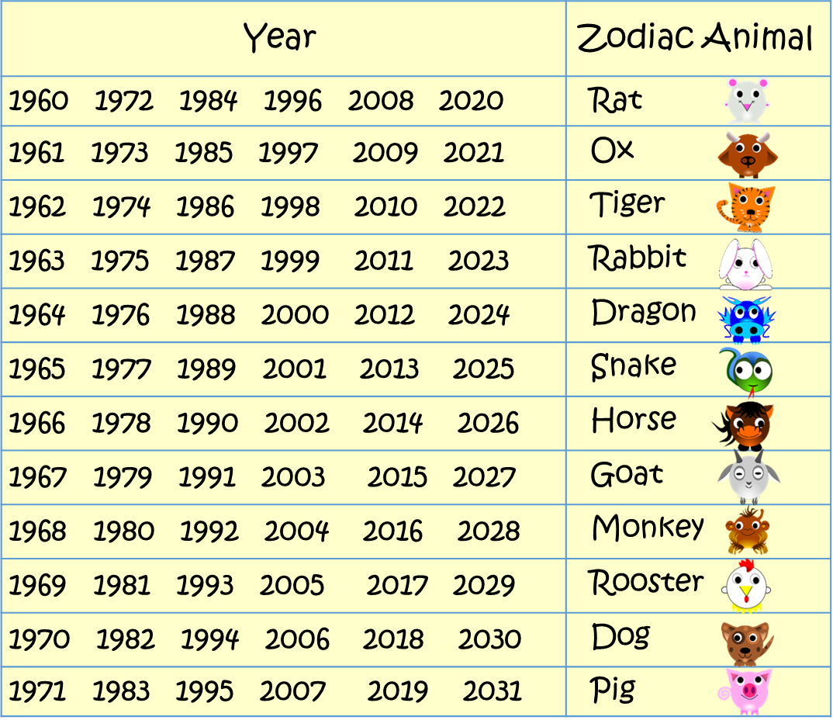
What is your zodiac animal? Find the year you were born in the chart.
What year will 2021 be?

Slide 5
How is Chinese New Year celebrated?
The first day of the New Year is "the welcoming of the gods."
On day two, the Chinese pray to their ancestors as well as to all the gods.
The third and fourth days are for the sons-in-laws to pay respect to their parents-in-law.
The fifth day is called Po Woo. On that day people stay home to welcome the God of Wealth.
On the 6th to the 10th day, the Chinese visit their relatives and friends.
The seventh day of the New Year is the day for farmers to display their crops.
On the eighth day people have another family dinner, and at midnight they pray to Tian Gong, the God of Heaven.
The ninth day is to make offerings to the Jade Emperor.
Days ten, eleven and twelve are the days on which friends and relatives are invited for dinner.
After so much rich food, on the 13th day people eat simple rice and vegetable meals.
The 14th day is for preparations to celebrate the Lantern Festival which is to be held on the 15th night.
In this video, a young member of the Chinese community in the UK tells us about the festival of Chinese New Year and why she enjoys it so much...

Slide 6
Chinese New Year quiz:
What is another name for Chinese New Year?
When do the Chinese New Year celebrations begin in 2021?
How long do the celebrations last?
4) In the legend of the swimming race, which animal came first? Which animal came last?
5) What is your zodiac animal?
6) On which day are the offerings to the Jade emperor made?
7) What happens on the 15th night?

