Slide 1
RWI Red: Pin it Onup

Slide 2
f | l | m | n | r | s ss | v | z | sh | th | ng nk
b | c k ck | d | g | h | j | p | qu | t | w | x | y | ch
a | e | i | o | u
Speed Sounds
Speed Sounds

Slide 3
pin | on | not | leg
chin | tum | yes
Story Green Words

Slide 4
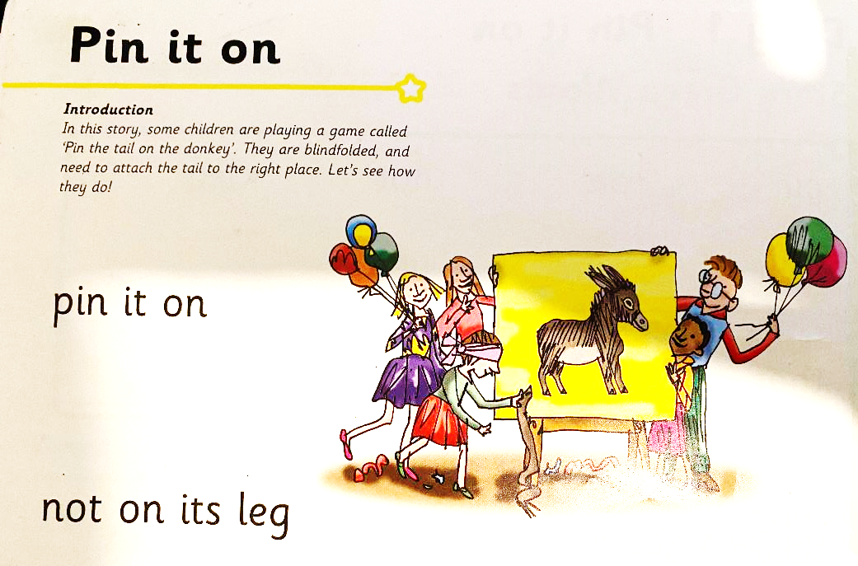
Ditty 1:Pick it up

Slide 5
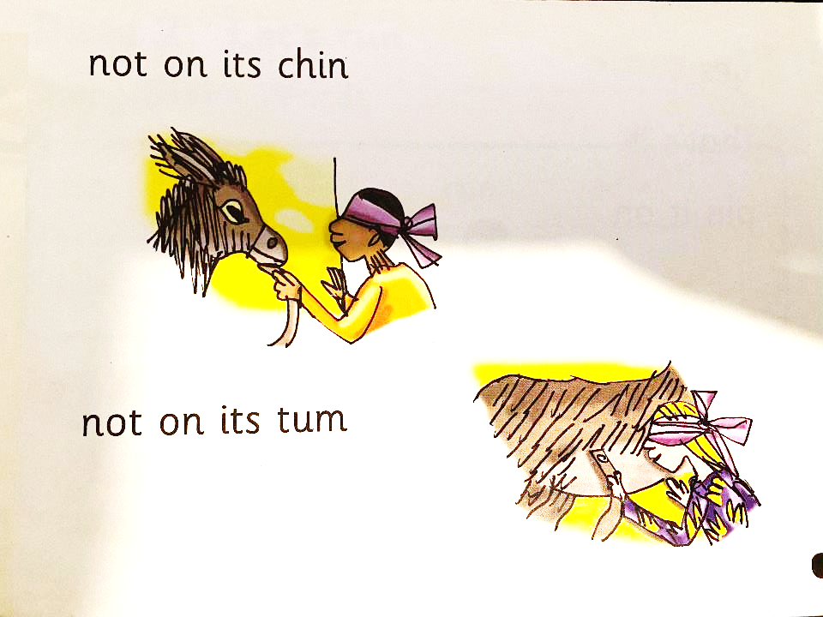

Slide 6
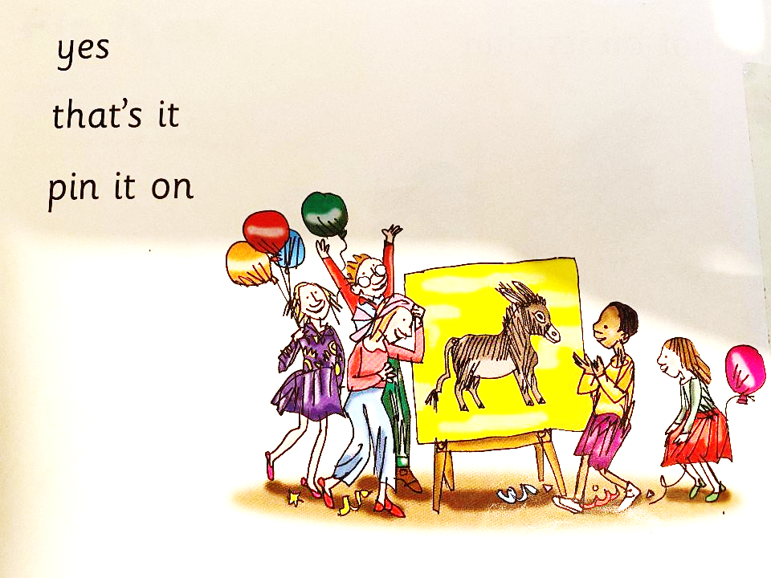

Slide 7
zip | up | run
let-> let’s | put
Story Green Words

Slide 8
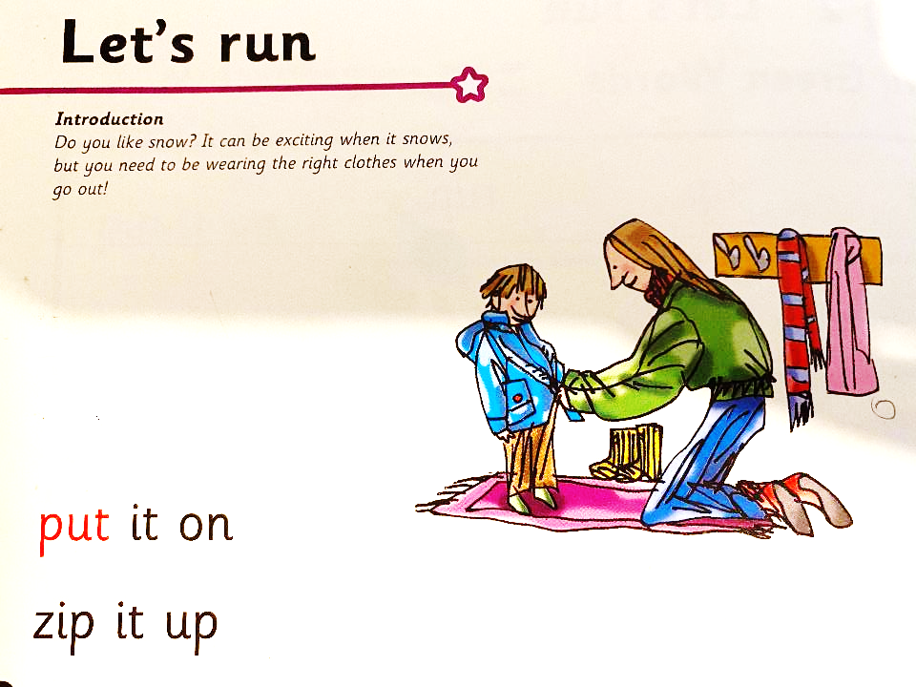

Slide 9
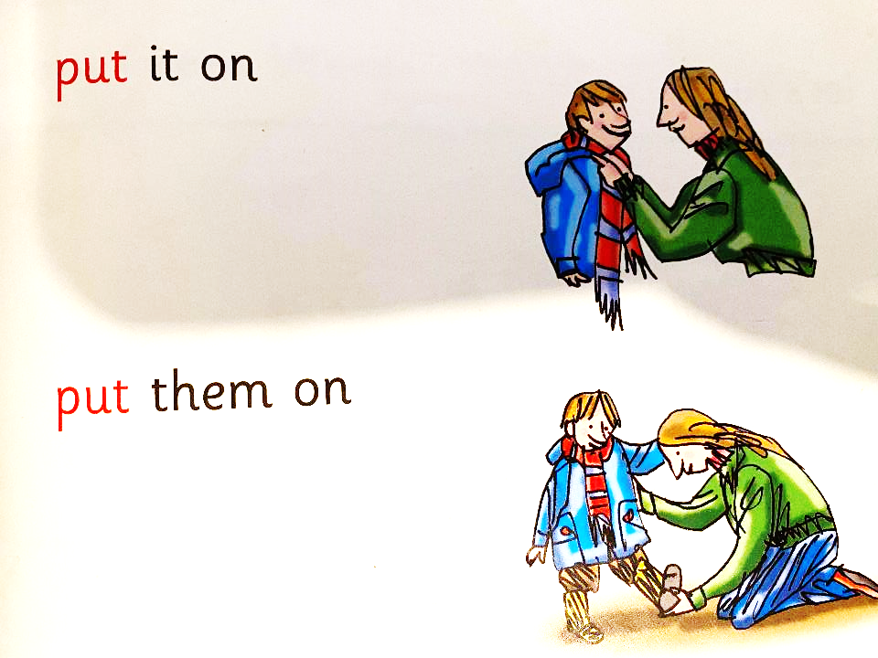

Slide 10
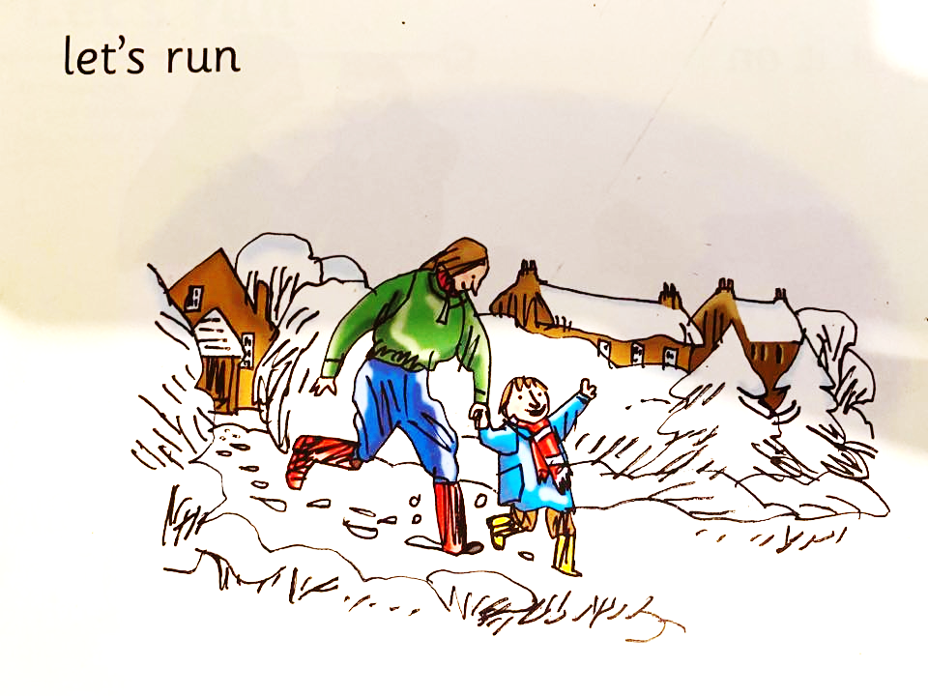

Slide 11
hen | in | red | hat
fox | sun | man | top
Ditty 3:Story Green Words
Story Green Words

Slide 12
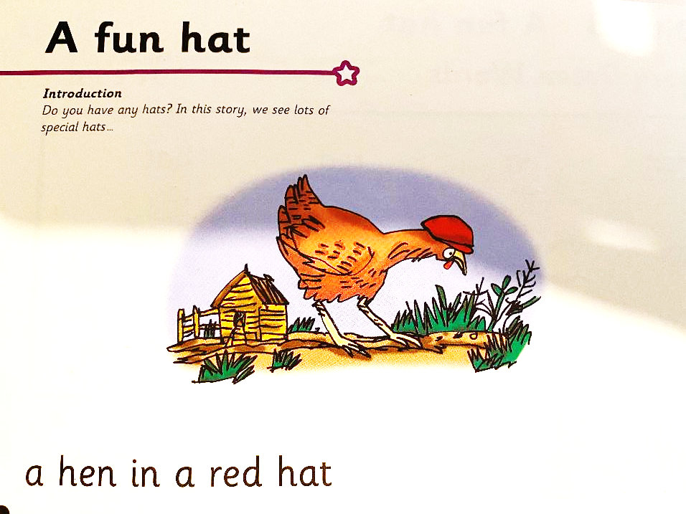

Slide 13
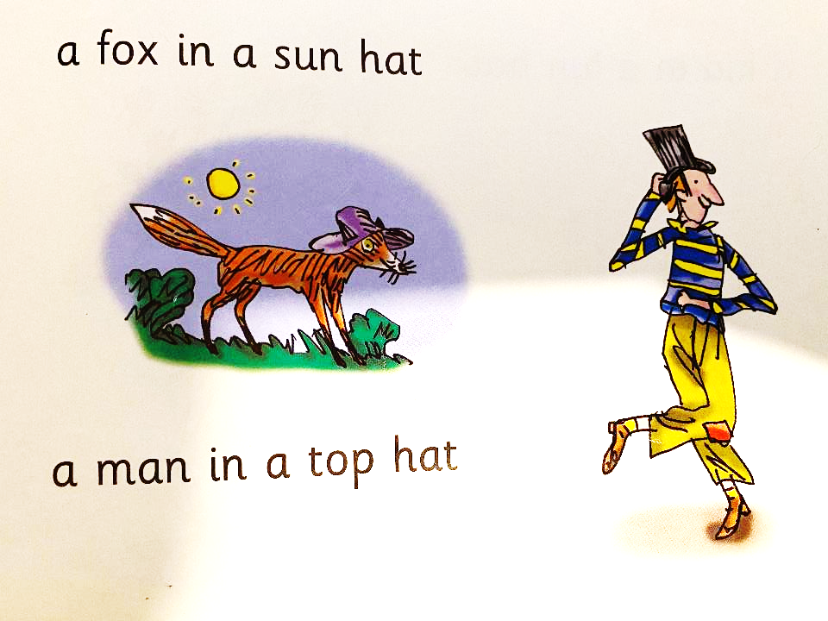

Slide 14
