Slide 1
English
adjectives

Slide 2
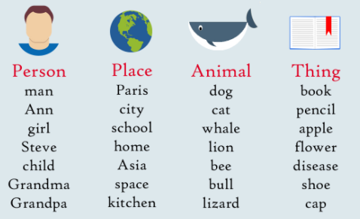
What is a noun?

Slide 3
What is an adjective?
mean
red
green
thin
big
sad

Slide 4
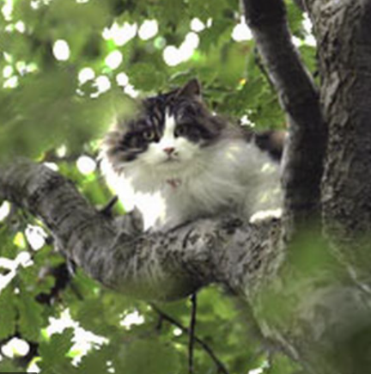
What is an adjective?
The big cat got stuck in the tree.

Slide 5
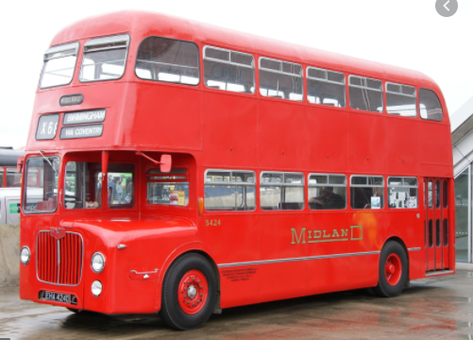
What is an adjective?
I went on the red bus.

Slide 6
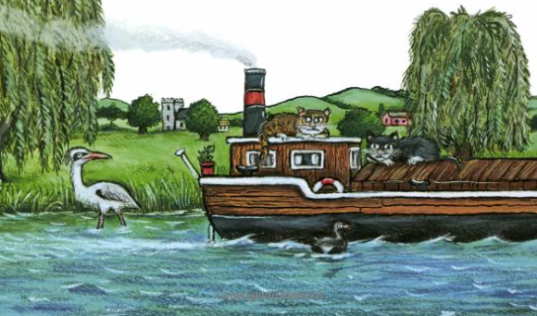
What is an adjective?
Growltiger lived on a ______ boat. .

Slide 7
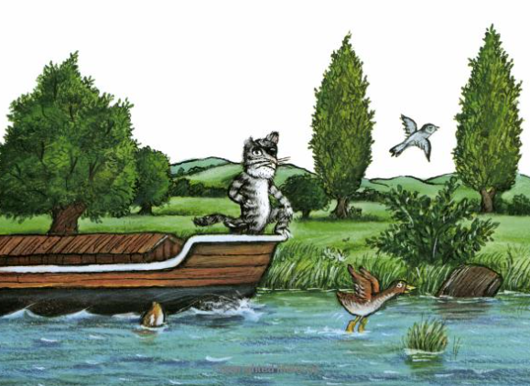
What is an adjective?
Growltiger was a _______ cat.

Slide 8
What is an adjective?
Growltiger fell into the ________ water.

