Slide 1
PSHE: Discuss topical events

Slide 2
Step 1: Schools opening- 8th March
On the 8th March 2021, schools will open again to all children.
Why do you think this is?
It is important for schools to open again for many reasons.
Can you think of some of those reasons?

Slide 3
Step 1: Schools opening- 8th March
It is important for schools to open again for many reasons.
Can you think of some of those reasons?
Important for children to get a good education in school.
Easier for parents to then return to work if needed.
Seeing friends again and being able to be socialise.
Returning to a more ‘normal’ way of life.

Slide 4
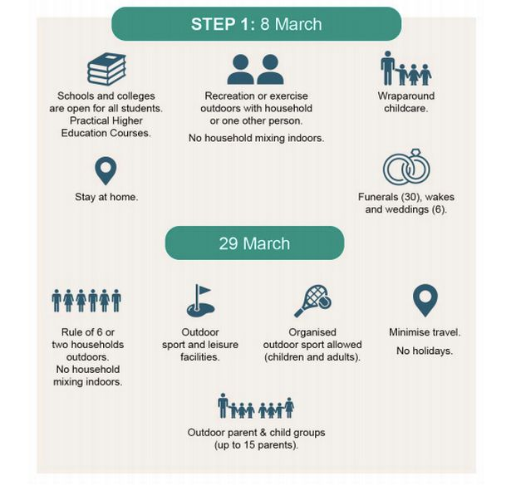
Step 1

Slide 5
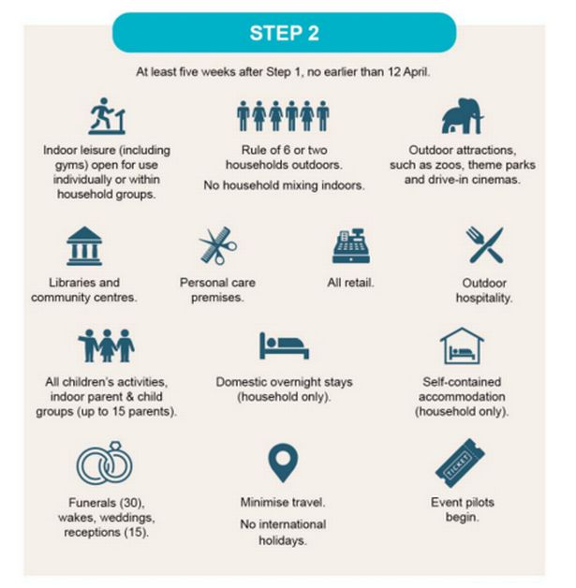
Step 2

Slide 6
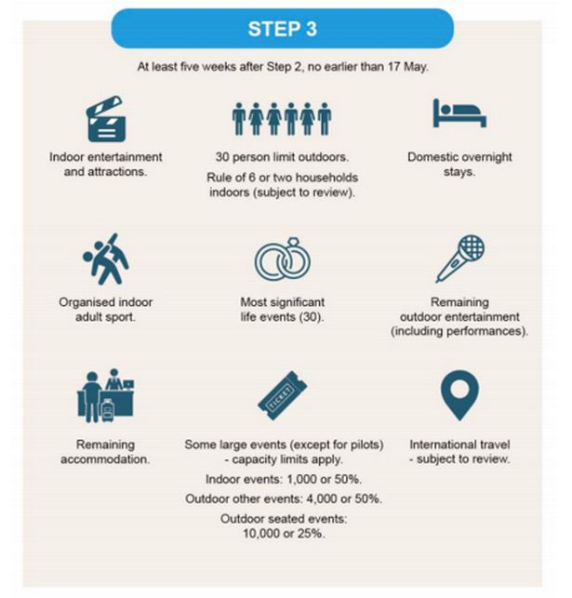
Step 3

Slide 7
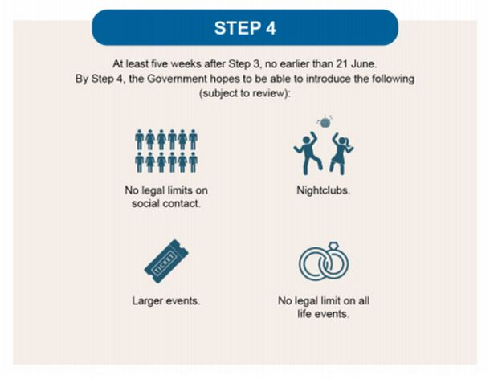
Step 4

Slide 8
Your thoughts: Returning to school
Discuss these questions with somebody at home.
How do you feel about returning to school? Why do you feel that way?
Is there anything that you are nervous about?
What are you looking forward to when returning to school?
Why do you feel it is important to return to school?
Do you think anything will be different when you return to school?
What have you learnt whilst learning from home?

Slide 9
Your thoughts
Now discuss these questions:
What are you most looking forward to when life begins to return to ‘normal’?
What have you learnt during the past year of COVID-19?
What is your favourite memory from the past year?
What have you enjoyed whilst being at home?
Is there anything that you have learnt since lockdown began?

