Slide 1
Maths
Calculating the area of a rectangle

Slide 2
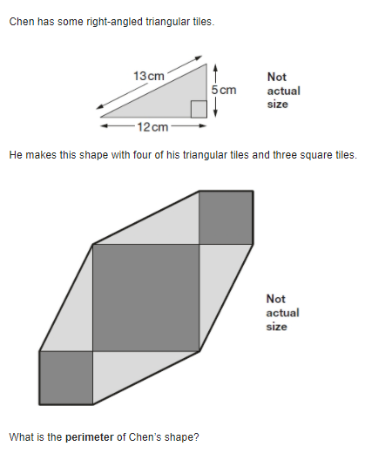
13 + 13 + 5 + 5 + 13 + 13 + 5 + 5
13 x 4 = 52
5 x 4 = 20
5cm
13cm
5cm
Perimeter = 72cm
13cm
13cm
5cm
13cm
5cm

Slide 3
The area of a shape is the amount of space inside a 2D shape.

Slide 4
Area = 10cm²

Slide 5
Area = 4cm²

Slide 6
5cm
5 x 2 = 10
2cm
Area = 10cm²

Slide 7
2cm
2 x 2 = 4
2cm
Area = 4cm²

Slide 8
length
width
Area = length x width

Slide 9
3cm
3 x 4 = 12
4cm
Area = 12cm²

Slide 10
27cm
27 x 3 = 81
3cm
Area = 81cm²

