Slide 1
Learning Intention – To explore our new poem

Slide 2

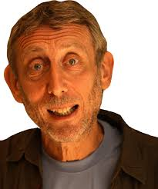
Who Started It?
Our new poem is called “Who Started It?” by Michael Rosen.
Michael Rosen is a very famous poet, who has written many poems, mainly for children.
What do you think this narrative poem could be about?

Slide 3
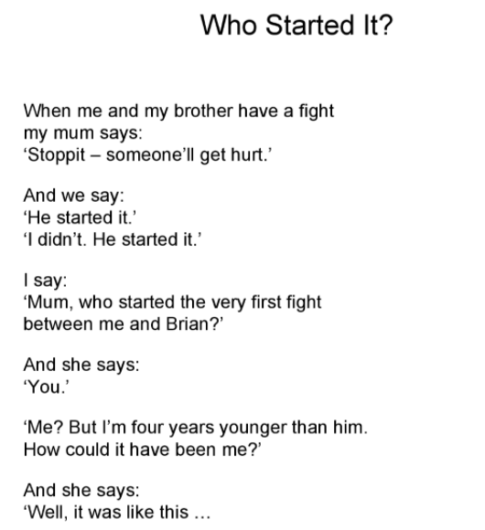
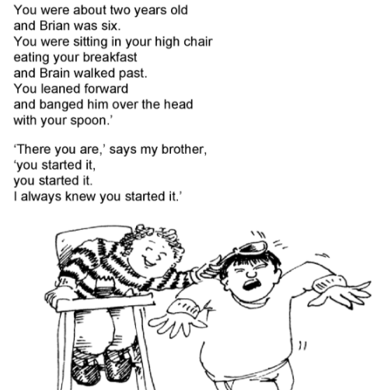
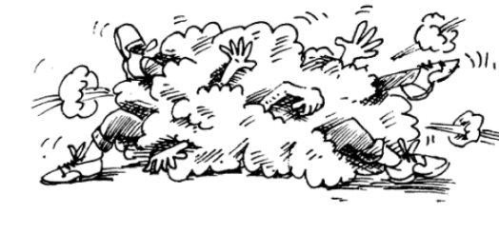

Slide 4
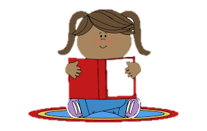
Today’s task
Read this poem again with someone in your house, what do you like and dislike about the poem? Why?
Read the poem again but this time, make it more of a performance. Think about how you use your voice:
- pace (the speed of your reading)
- tone (the sound of your voice)
- enthusiasm (the excitement or emotion of your voice)
Can you here how this is very different to reading a normal story?

