Slide 1
To tell the time to the nearest minute

Slide 6
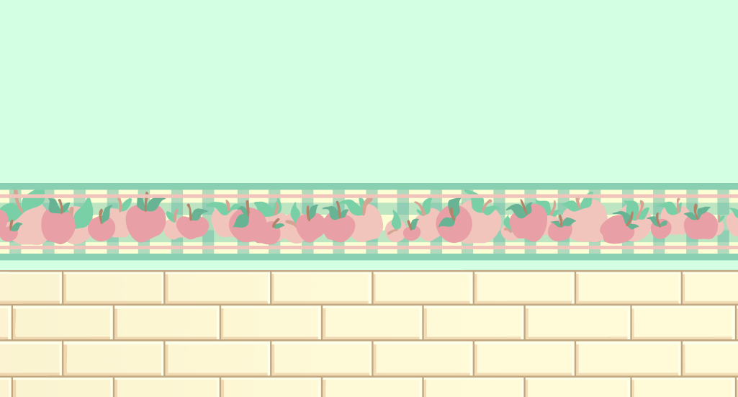
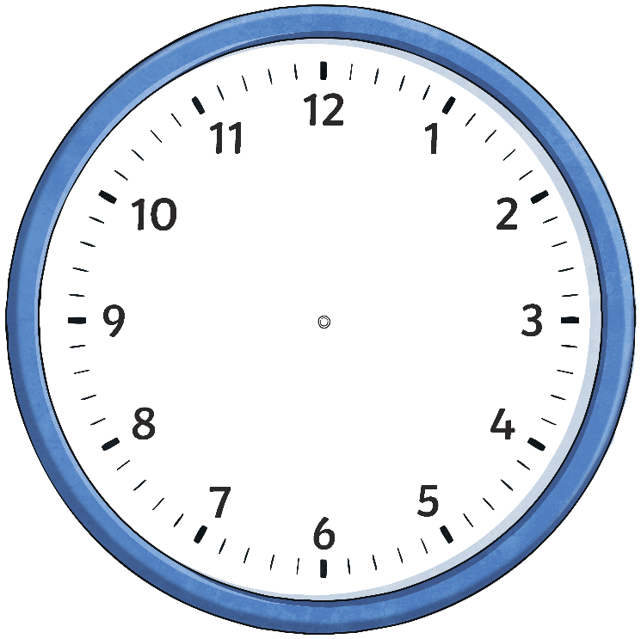
Clock Hands
a) 16 minutes past 3
The big hand points 1 minute after the 3. The small hand points just after the 3.

Slide 7
Clock Hands
b) 22 minutes past 11
The big hand points 2 minutes after the 4.
The small hand points between
the 11 and 12.

Slide 8
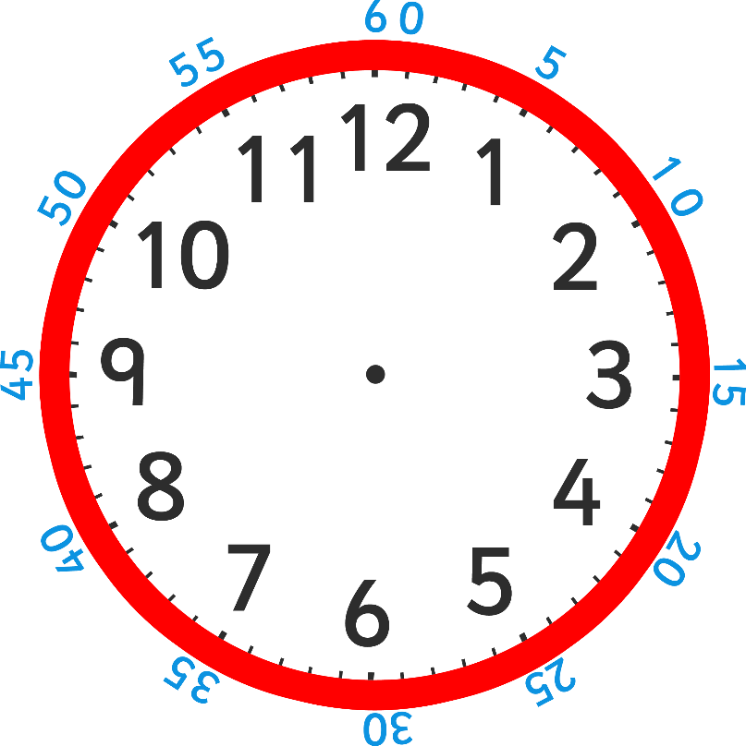
What is the exact time?

Slide 9
After half past the hour we read the time as ‘minutes to’. This is because it sounds better to say ‘13 minutes to 11’, rather than 47 minutes past 10’.

Slide 10
Reading the time to the hour needs a little more concentration than with minutes past the hour. A simple method is to count the blocks of 5 minutes to the hour from ‘0’ at the top, then any more minutes there may be. This show 5 lots of 5 minutes and 1 more minute. What is the exact time?

Slide 11
The exact time is 26 minutes to 10.

Slide 12
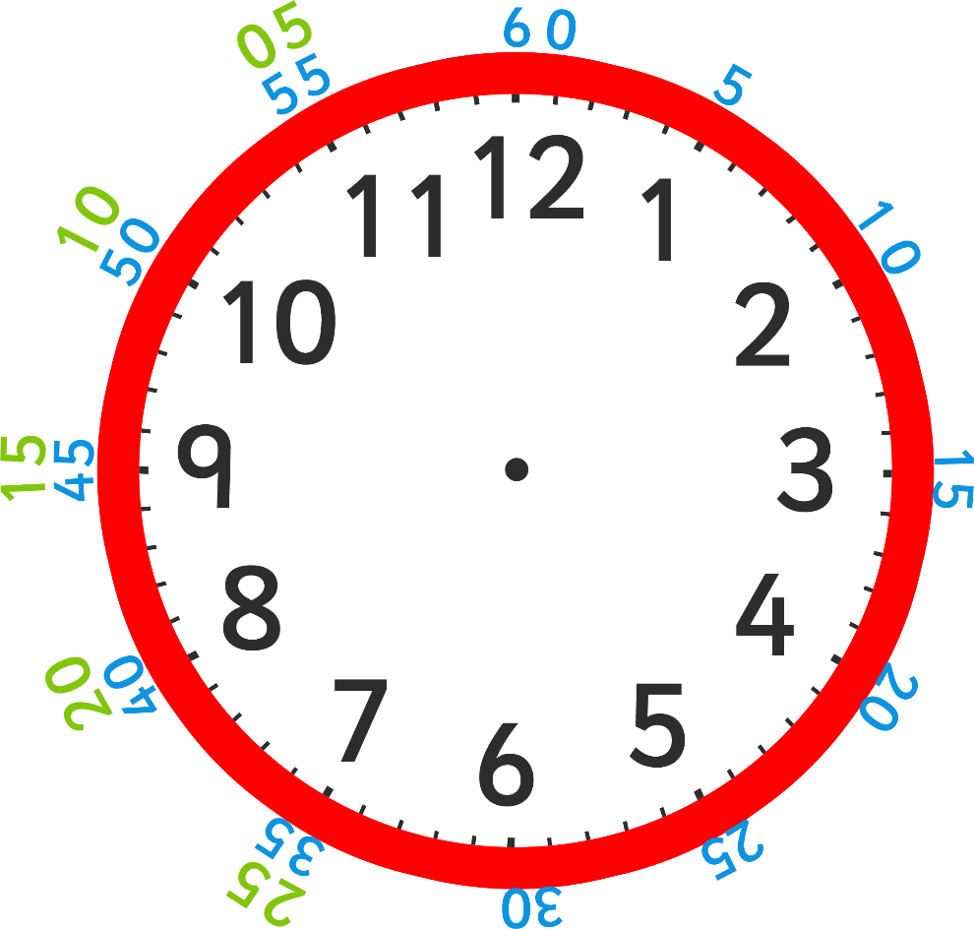
The numbers in green on this clock show the minutes to the hour. These green numbers just make it easier to read the minutes to the hour (normal clocks don’t look like this)

Slide 13
What is the exact time here? (Hint – it is the green number to the black number.)

Slide 14
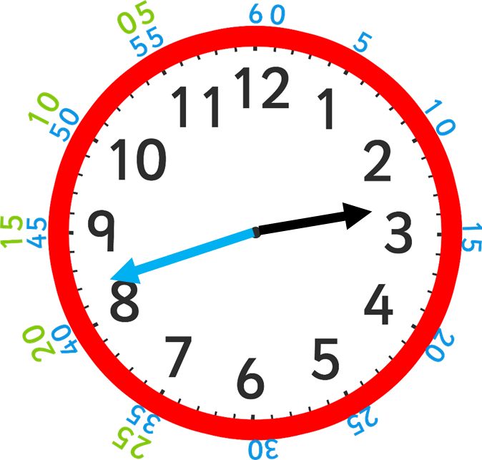
The exact time is 18 minutes to 3.

