Slide 1
Set 2 Sounds
‘ow’

Slide 2
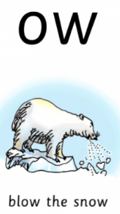
Notes:
Fly high

Slide 3
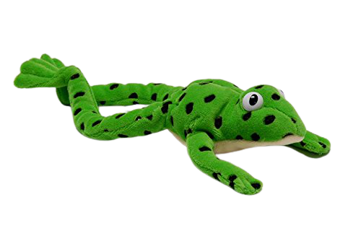
Notes:
Lets fred talk using todays sound. Are you ready? B l ow blow, s n ow, snow, th r ow, throw, b ow, bow sh ow, show. gl ow, glow

Slide 4
Notes:
Igh, three letters, one sound, special friends, igh

Slide 5
Notes:
My turn – igh. Your turn. My turn – Fly high. Your turn.

Slide 6
Notes:
Now let’s play our game – can you remember? When it wiggles tell me if it’s igh, or fly high. If you don’t have the wiggle don’t worry, ask someone to point and if you don’t have someone there, that’s ok too, have a practice at being super speedy and point when you say it. Igh or fly high.

Slide 7
snow
blow
glow
Notes:
It’s time for some green words – let’s use Fred talk to help us sound them out: h-igh, n-igh-t, b-r-igh-t

Slide 8
Notes:
Let’s practice writing our sound - igh

Slide 9
Notes:
Can you write some words with today’s sound? Blow, snow, throw. Tick and fix on the next slide

Slide 10
Notes:
Let’s use our Fred fingers, n-igh-t 3 sounds, h-igh 2 sounds, f-r-igh-t 4 sounds.

Slide 11
2: Blow the snow
3: Fred talk time!
4: ow, two letters, one sound, special friends, ow
5: My turn – ow. Your turn. My turn – Blow the snow. Your turn.
6: Take turns at pointing to the sound and the picture and say what they are.
7: It’s time for some green words – let’s use Fred talk to help us sound them out.
8: Let’s practice writing our sound - ow
9: Can you write some words with today’s sound? Blow, snow, throw. Tick and fix on the next slide

