Slide 1
Learning Intention: To study the architecture of Newcastle

Slide 2
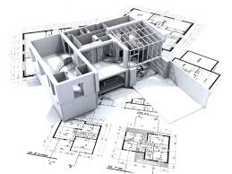
What is architecture?
Architecture is the planning, designing and building of a structure.
It involves thinking about what a building will look like, the materials it will be used and how it will look.
An architect is the person responsible for
this work.

Slide 3
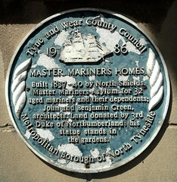
John and Ben Green
John and Ben Green were father and son and worked together as architects in Newcastle in the 19th Century.
They worked an a variety of different structures in Newcastle including:
Theatre Royal
Grey’s monument
Penshaw Monument
And many others.

Slide 4
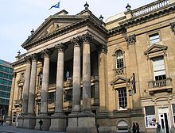
This half term
This half term we will be looking at the different structures that the pair designed and think all about the reasons behind their designs and why they made their choices.

Slide 5
Today’s task
Today I would like you to look at six of the Green’s most famous designs and look at the similarities and differences between them, you could talk to someone at home about this, there is a word bank to help you.
Similarities | Differences

Slide 6
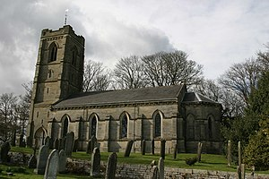
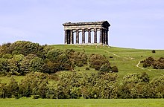
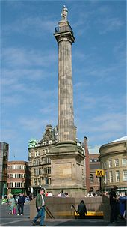
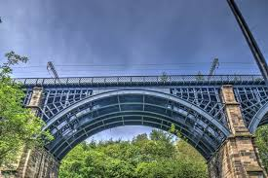
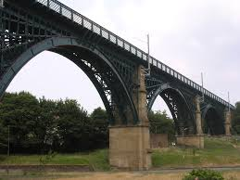
Holy Trinity Church Theatre Royal Penshaw Monument
Grey’s Monument Ouseburn Viaduct Willington Viaduct

Slide 7
Word Bank
You could use these words to help you write your similarities and differences.
Brick curve tall metal column roof grey blue iron old

