Slide 1
Learning Intention To write my own narrative poem

Slide 2
Comic book style
To write out poems, we are going to make a comic strip to show what each character is going to say.
This will be a bit like your plan but it will include what all three characters will say.
Have a look at my example on the next slide.

Slide 3
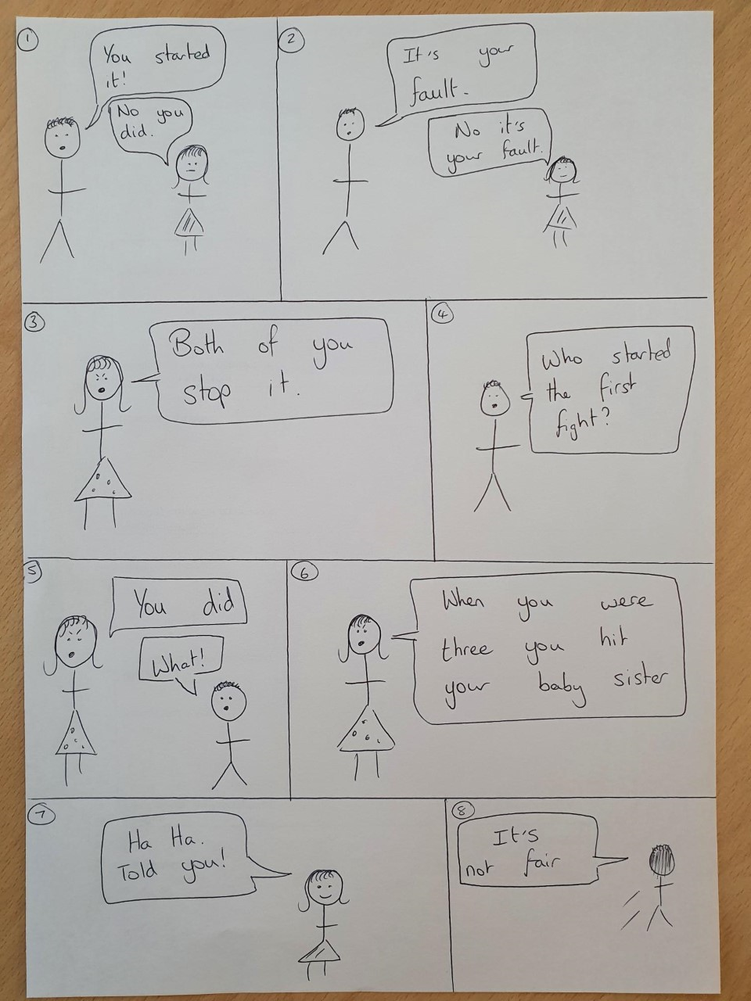
Can you see how I have included what each of the character’s say?
It tells the story of what will happen in the poem.

Slide 4
Your turn
I would like you to create your own comic book design to help tell your narrative poem.
Use my comic to help you but remember to use your own ideas and characters.

