Slide 1
Today we are reading… Light and Shadow

Slide 2
How to get to the book:
1. Log in to Oxford Owl
2. Click on Read Write Inc eBook library
3. Click on Light and Shadow (pink)

Slide 5
Page 9
Question: What happens if light rays get blocked?

Slide 6
Page 10
Question: What happens to the shadow at 8 o’clock?

Slide 7
Page 11
Question: What happens to the shadow at midday?

Slide 8
Page 12
Question: What happens if the sun is low?

Slide 9
Page 13
Question: What happens if the sun is high?

Slide 10
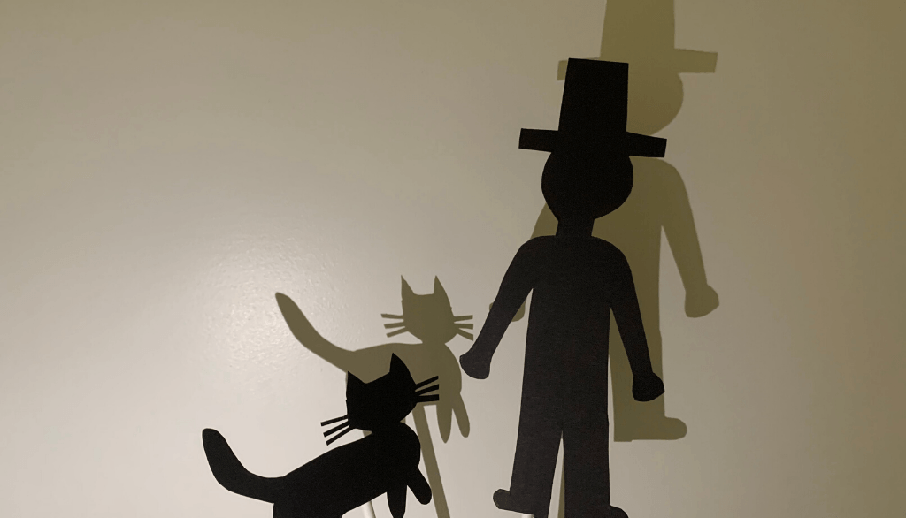
Page 14-15
Question: How do shadow puppets work?

Slide 11
Page 16
Question: What could you use to make a shadow puppet?

