Slide 1
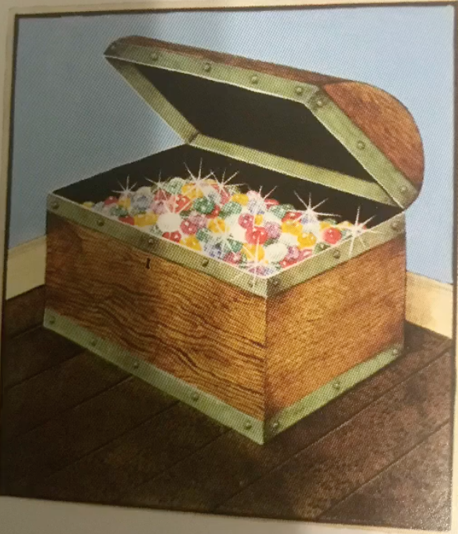
Alternative English 1 Learning intention: To write a story
Today we are writing the ending of the story.
Remember to use your setting description and story map from last week to help you to write your story.
Look at the next slide to see how I used my story map to help me to write the ending of the story.

Slide 2
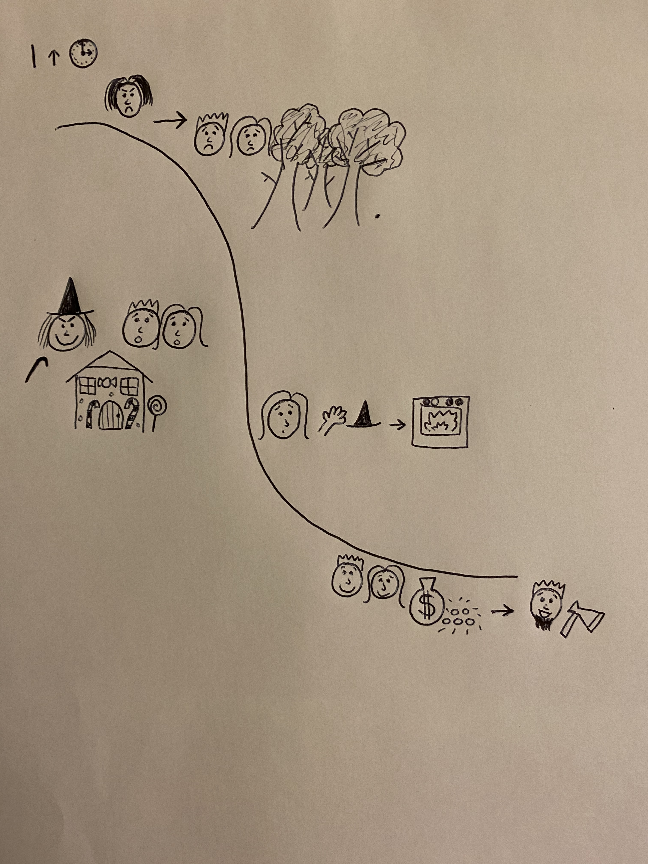
peaceful
freezing
suspicious
towering mountains
My story ending

Slide 3
Hansel was free at last. The children found the witch’s gold and took it home with them. They left the creepy, lonely mountain behind. Their father was so happy to see them and the stepmother had died. Hansel, Gretel and the woodcutter lived happily ever after.
Write your own story ending in your own words. What happens to Hansel and Gretel?

Slide 4
Can you write the end of the story using your story map?
Remember:
Capital letters
Full stops
Conjunctions to extend your sentences (and, or, but)

