Slide 1
Hello boys and girls Hope you are all well today.

Slide 2
Today we are going to learn some new words and actions from the story of Rosie's Walk.

Slide 3
The words that we are going to look at today are.
on
over
under
in

Slide 4
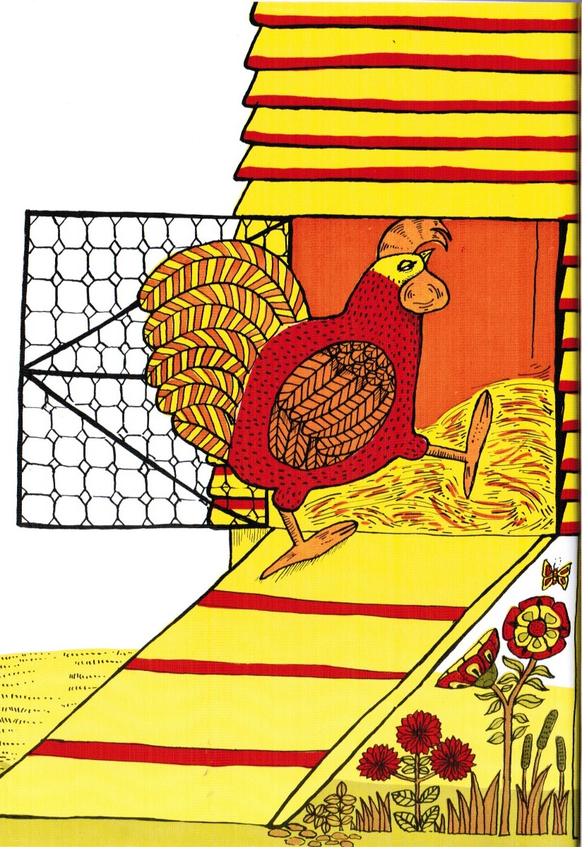
Can you tell an adult where Rosie is going ?

Slide 5
Well done! That’s right.
She has gone in the hen house.

Slide 6
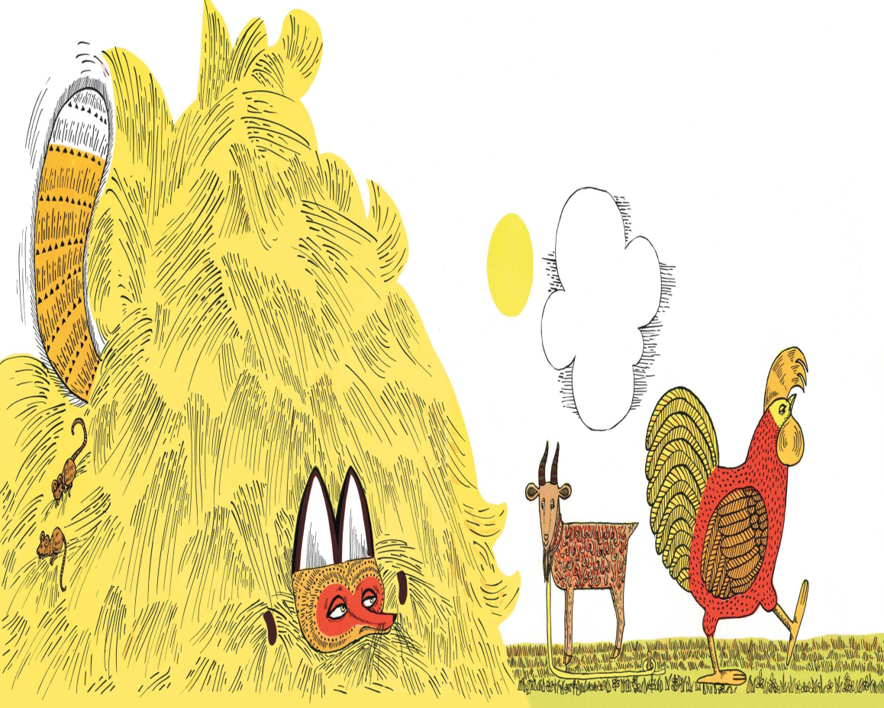
Can you tell an adult in your house where the fox is?

Slide 7
The fox is in the haystack.
That’s right you are working really well today.

Slide 8
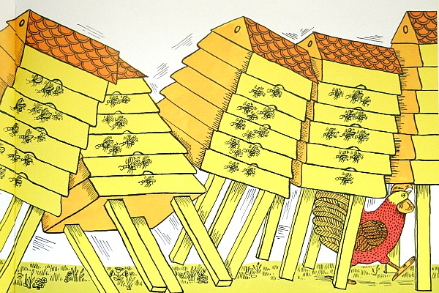
Now can you tell an adult where Rosie is?

Slide 9
Yes! Rosie has gone under the beehive.

Slide 10
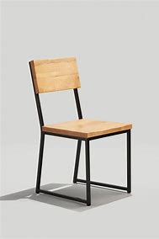
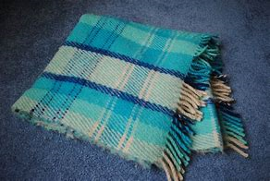
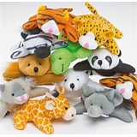
Can you get an adult to help you get these objects before we continue.
Cushion
Blanket
Chair
Toys

Slide 11
Can you get an adult to help you place the objects on the floor.

Slide 12
Can you put the toy on the chair?

Slide 13
Yes that's right!
Have a go at the next one.

Slide 14
Now can you step over the cushion?

Slide 15
Yes that's right! ​
Have another go at the next one. ​

Slide 16
Can you see if you can put the toy under the blanket?

Slide 17
Yes that's right ​​Well done! You all have worked really hard today. ​​

Slide 18
Can you sit on the chair with your toy?

Slide 19
That's right! ​​​
Well done boys and girls. ​​​

Slide 20
Thank you for working and listening today everyone and keep safe.

