Slide 1
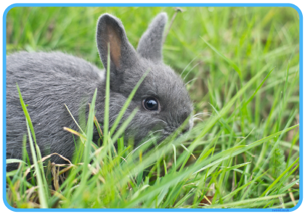
All about rabbits
They have soft fur to keep them warm.

Slide 2
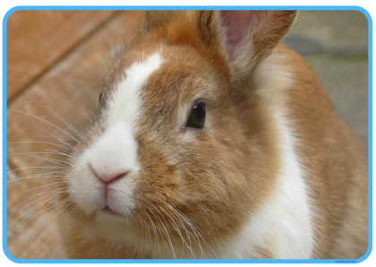
All about rabbits
They can be many different colours.

Slide 3
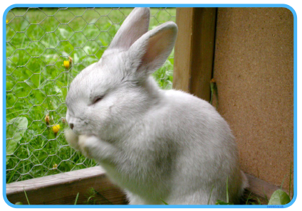
All about rabbits
They can be kept as a pet or live in the wild like a park.

Slide 4
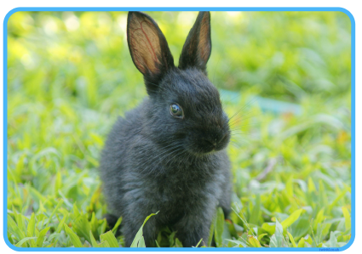
All about rabbits
They are small animals with long ears and large feet.

Slide 5
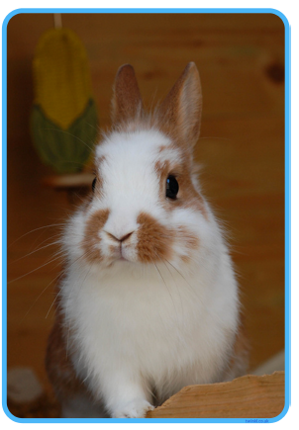
All about rabbits
They have sharp nails to help them dig.

Slide 6
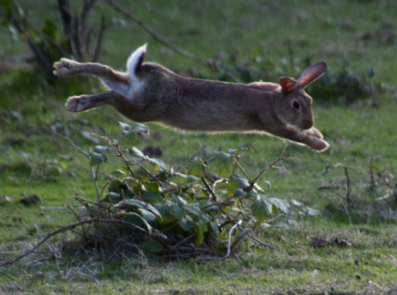
All about rabbits
They have very strong legs and can jump up high.

