Slide 1
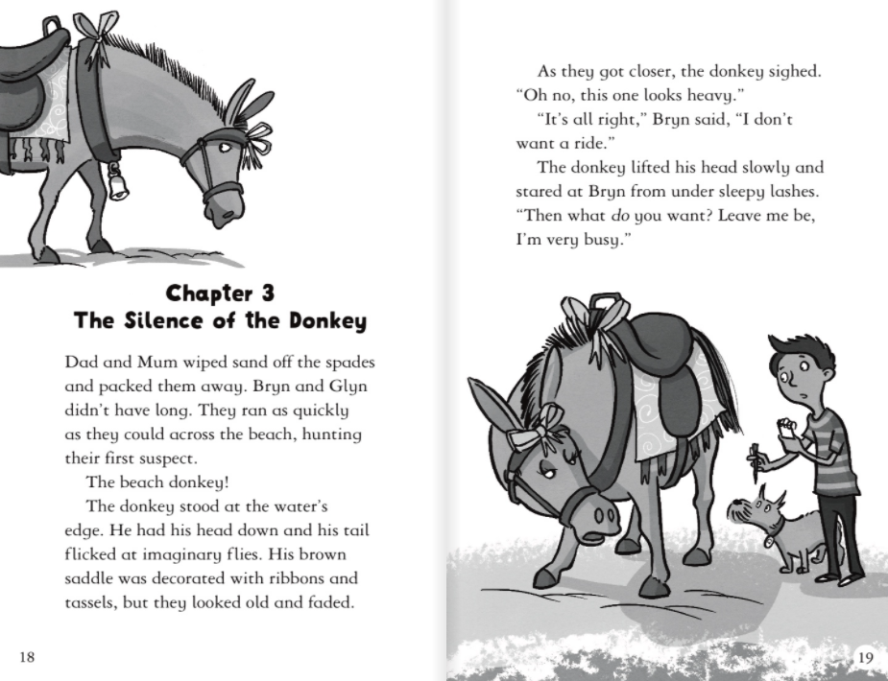
1.Why do Bryn and Glyn not have long to investigate?
2. What was the donkey’s saddle decorated with?

Slide 2
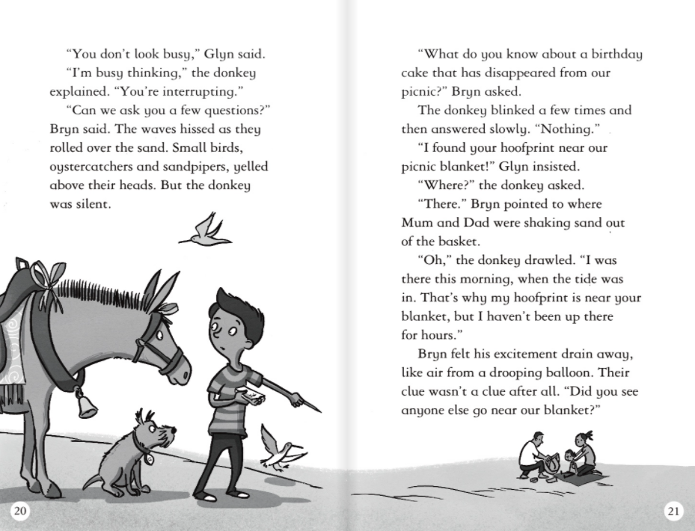
3. When did the donkey say he was near the blanket?

Slide 3
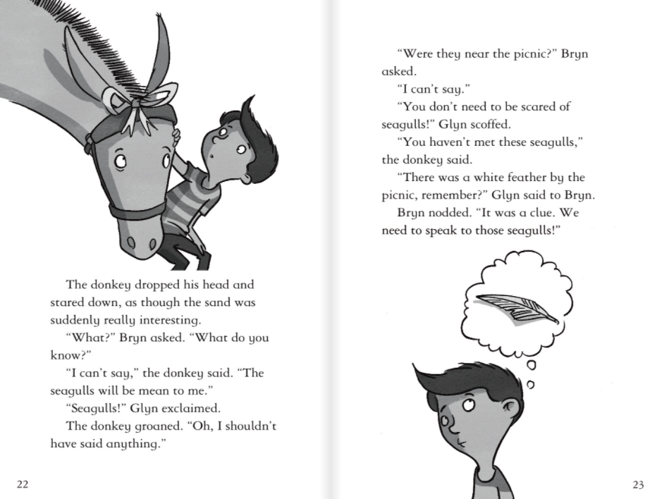
4.What clue did the seagulls leave behind?

