Slide 1
Set 1 Sounds u

Slide 2
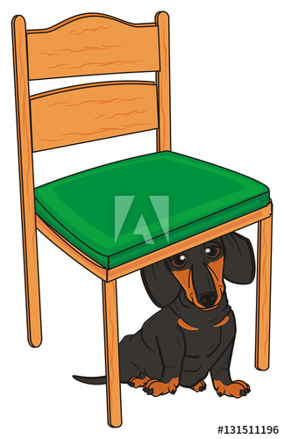

Slide 6
