Slide 1
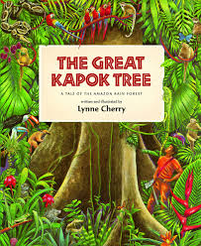
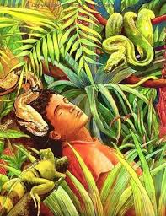
To write my version of The Great Kapok Tree

Slide 2
Let’s recap what we have looked at yesteday
Expanded noun phrases
This is where we have two adjectives, separated by a comma, before a noun to help give more information about the noun.
The slow, stealthy snake slithered down toward the sleeping man.
Adverbs and adverbial phrases
These give more information about a verb, it tells us how things happen.
The slow, stealthy snake slithered silently towards the sleeping man.
Fronted adverbials
This is where the adverb or adverbial phrase comes before the noun, followed by a comma.
Silently, the slow, stealthy snake slithered towards the sleeping man.

Slide 3
Your story
You are going to use these features you have practiced last week and the plan you made to create your own story, in the style of ‘The Great Kapok Tree’.
Yesterday you wrote the beginning paragraph and the next paragraph where we met the new animal.
Today we are going to continue our story have give you an example set of paragraph to support you.

Slide 4
The next paragraph (Remember to leave a space before writing this.)
Curiously, a timid, brown anteater crept along the forest floor. Quietly, the creature approached her and lay next to her. Whispering gently into her ear, “Senhora, we have seen the damage that cutting down trees does to our great, precious forest. There will be no trees or food left for our families. Where will we live? What will we eat?”
I have introduced my next animal then described it using a fronted adverbial and an expanded noun phrase.
I have explained how the animal spoke using the word whispered then I have written down what the animal said in speech marks.
If your main character is a woman you would say senhora, if it’s a man you would say senhor.

Slide 5
The next paragraph (Remember to leave a space before writing this.)
In the blink of an eye, a rustling sound echoed from the top of the canopy. Clambering down from the rough, brown branches came a screeching, orange orangutan.“Senhora, listen to my words. Please don’t cut down our tree. How can we survive with our home,” shrieked the creature into the woman’s ear.
fronted adverbial and an expanded noun phrase.
I have explained how the animal spoke using the word whispered then I have written down what the animal said in speech marks.
If your main character is a woman you would say senhora, if it’s a man you would say senhor.

Slide 6
Use this to support you create you next paragraphs.
Use our examples to help you but it’s not there for you to just copy. Magpie our ideas and make them your own.
Complete you final paragraph also to create your ending.
Will your character chop down the tree?
Will your character leave the rainforest without chopping it down?

