Slide 1
Learning Intention
How to stay safe.

Slide 2

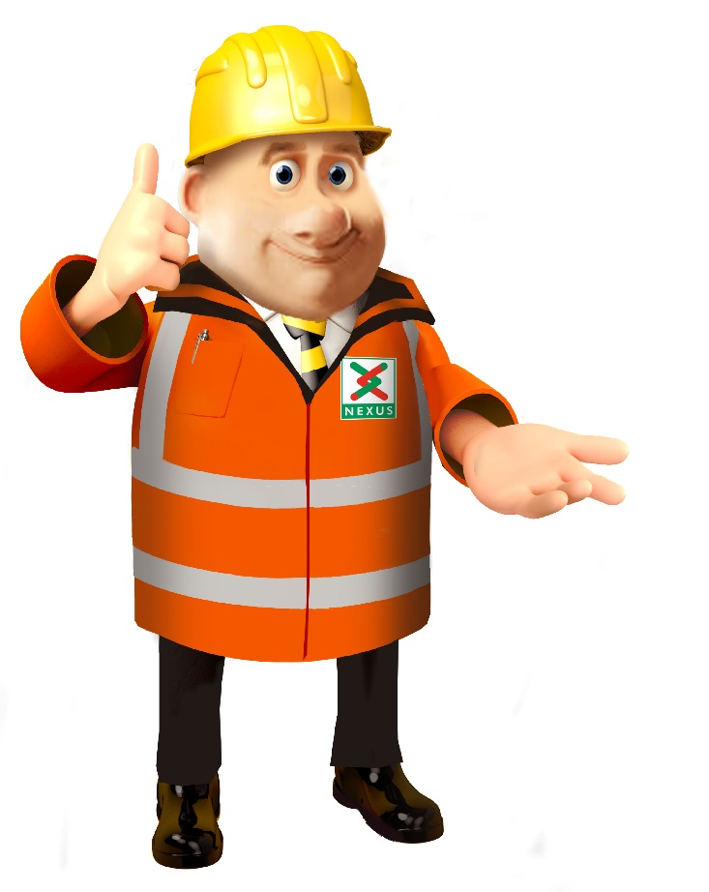

Do you recognise this symbol?

Slide 3
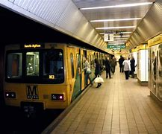
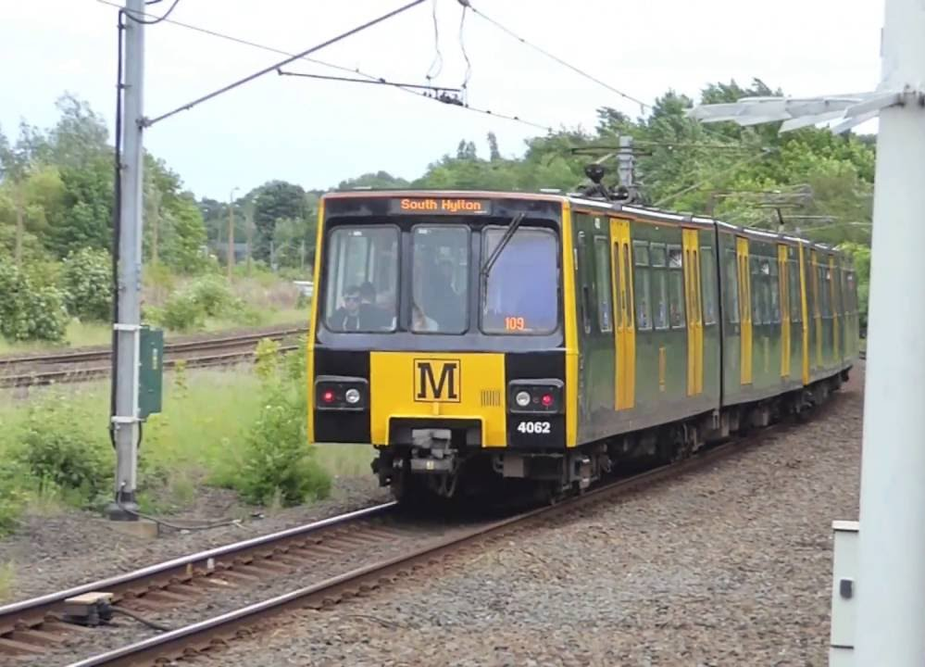


Nexus is the company that looks after the Tyne and Wear metro service

Slide 4
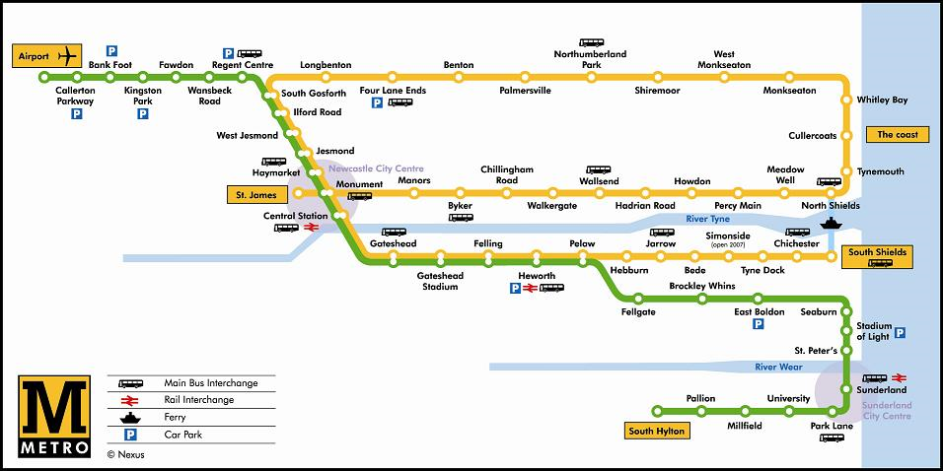
Here is a map of the Metro.
How many lines are there?
How many stations can you spot?

Slide 5
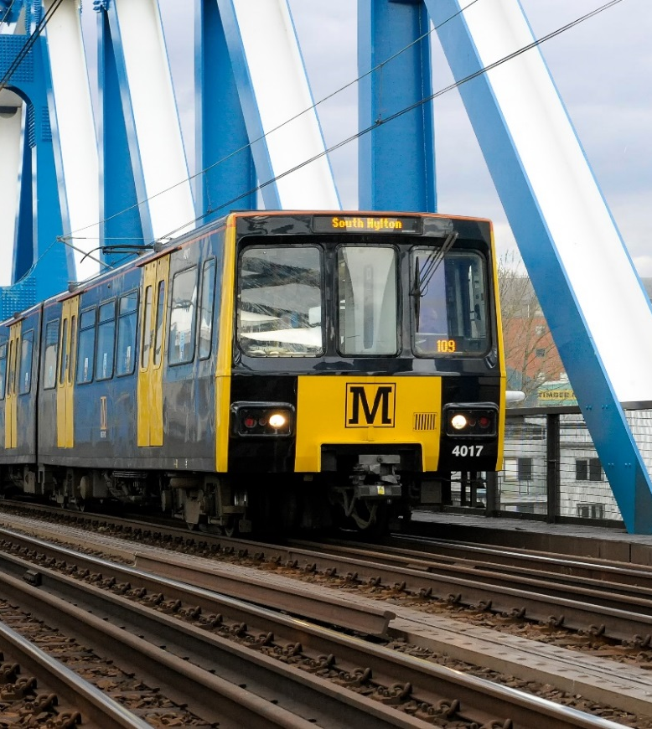
Let’s look at this key information about the Metro service
90 trains
40 tonnes each
50 mph
150 metres to stop in an emergency
That is as long as 1 ½ football pitches!
1500 volts of electricity

Slide 6




28 Feb
15 Feb
Between 15th and 28th February the Metro will be closed between two weeks.
It will be closed between Longbenton and Felling.
Notes:
Between the 15th February

Slide 7
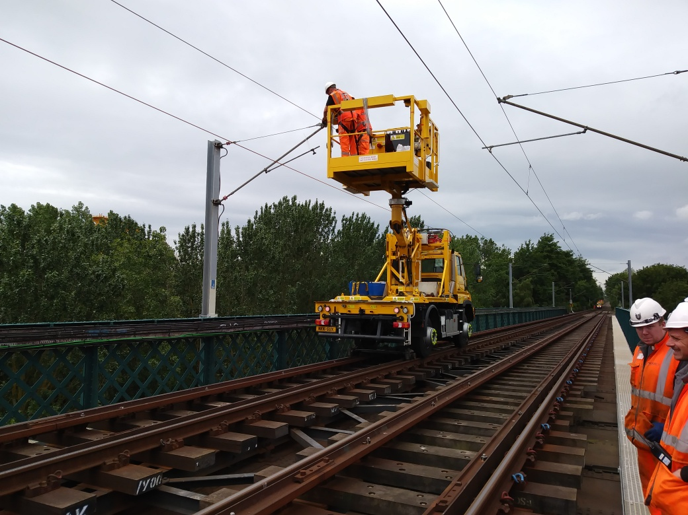
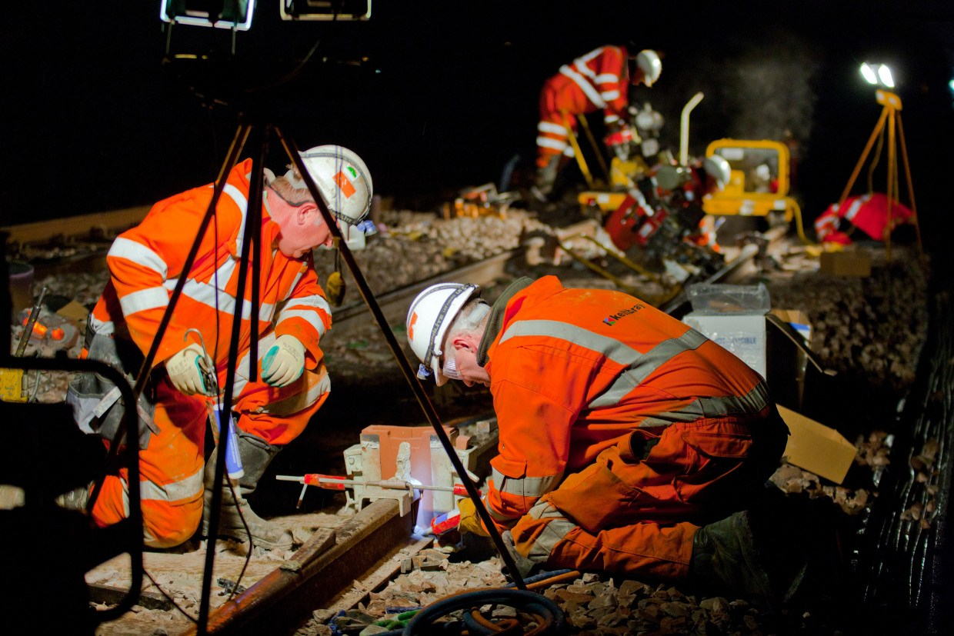
Day
Night
During the day and night engineers will be working to replace the overhead lines.

Slide 8
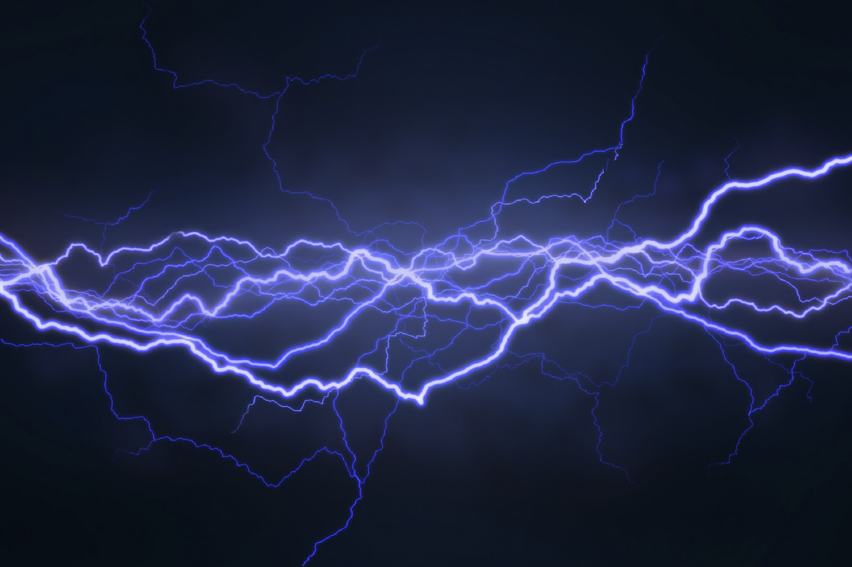

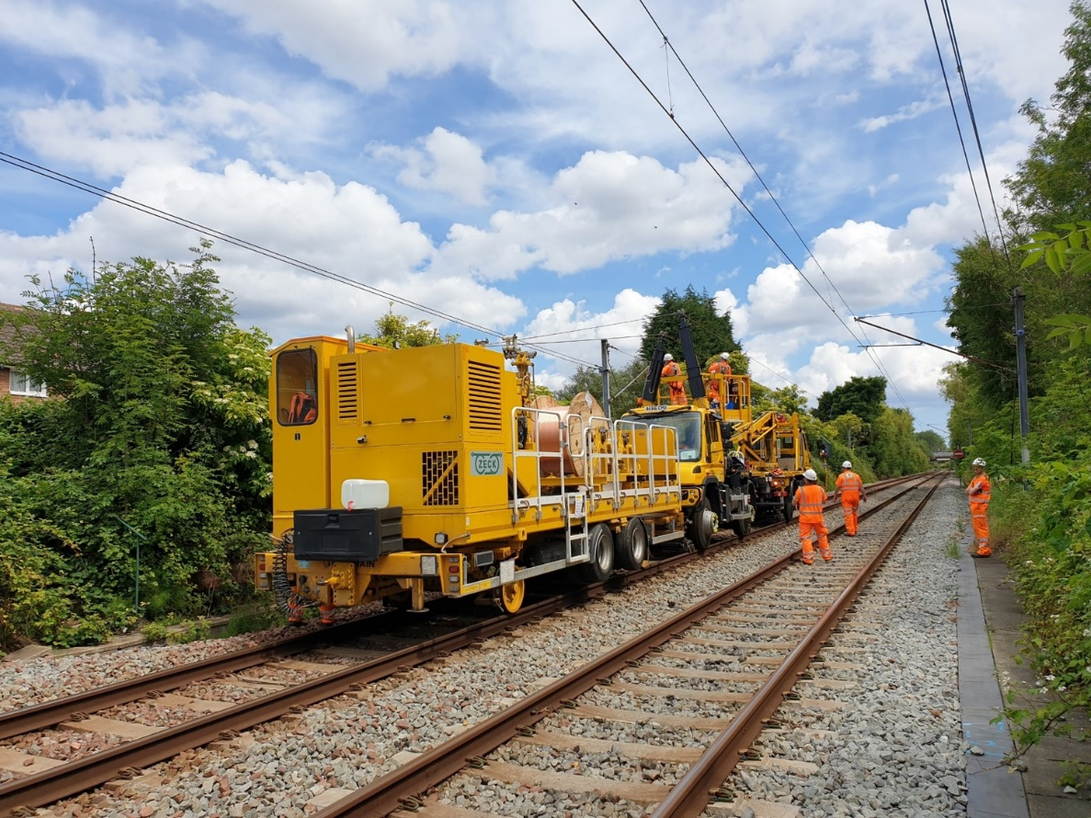
Overhead lines will be replaced by the engineers.
What makes the train travel so fast?
The electricity that flows through the overhead lines.

Slide 9

Do you think that you should be going near the tracks?
If not why not?
What might it be dangerous?

Slide 10
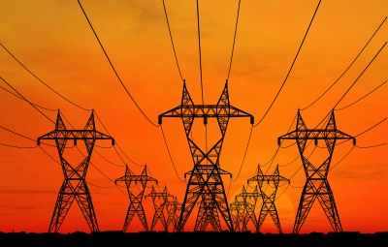
How powerful are electric overhead lines?
7 times
A
100 times greater voltage than the power supply in the average home
7 times greater voltage than the power supply in the average home
C
The same as the power supply in the average home

Slide 11
What happens when you get electrocuted?
A. A tingling or painful sensation.
B. A painful shock, muscles contract and grip the electrical source so you’re unable to let go.
C. The heart ‘flutters’ (ventricular fibrillation). Burns at entry and exit points and internal damage.
or D. Prolonged exposure or strong muscular contractions stop the heart. Internal organs, tissue and skin burn.
The effects vary depending on the electric current and frequency, but they affect the whole of the body…

Slide 12
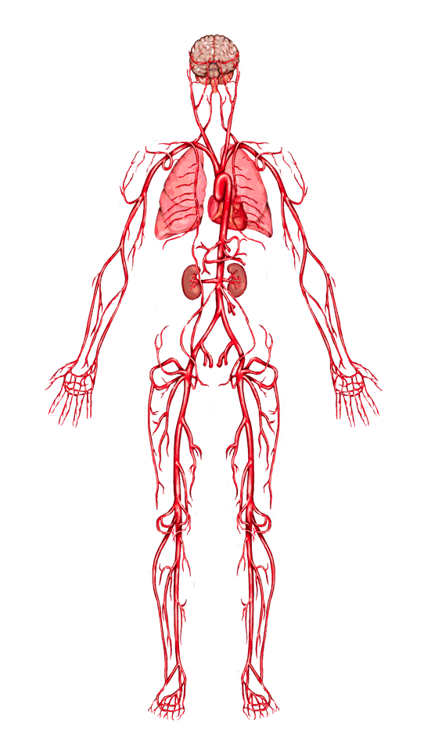
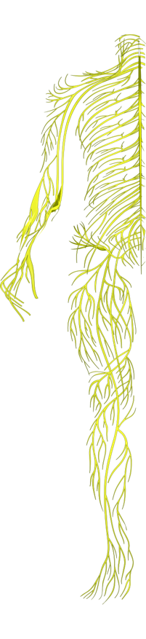
When you get electrocuted all of the things on the last slide can happen.
Lungs: breathing can stop.
Hands, heels, head: points of contact with the electrical source and the ground can be burned.
Heart: ‘flutters’ and fails to pump blood properly. Goes into cardiac arrest, resulting in death.
Nervous system: disrupts the tiny electrical impulses that enable you to sense, move, think, respond and remember.

Slide 13
When you get electrocuted…
Spine/Bones: being thrown by force of the electricity can lead to broken bones or an injured spine.
Muscles: sometimes you grip the electrical source so you can’t let go!
Skin and tissue: electricity burns beneath the skin and skin can melt.
FACT: 9 out of 10 people die from the electric shock received
from getting too close to railway electric overhead lines.

Slide 14

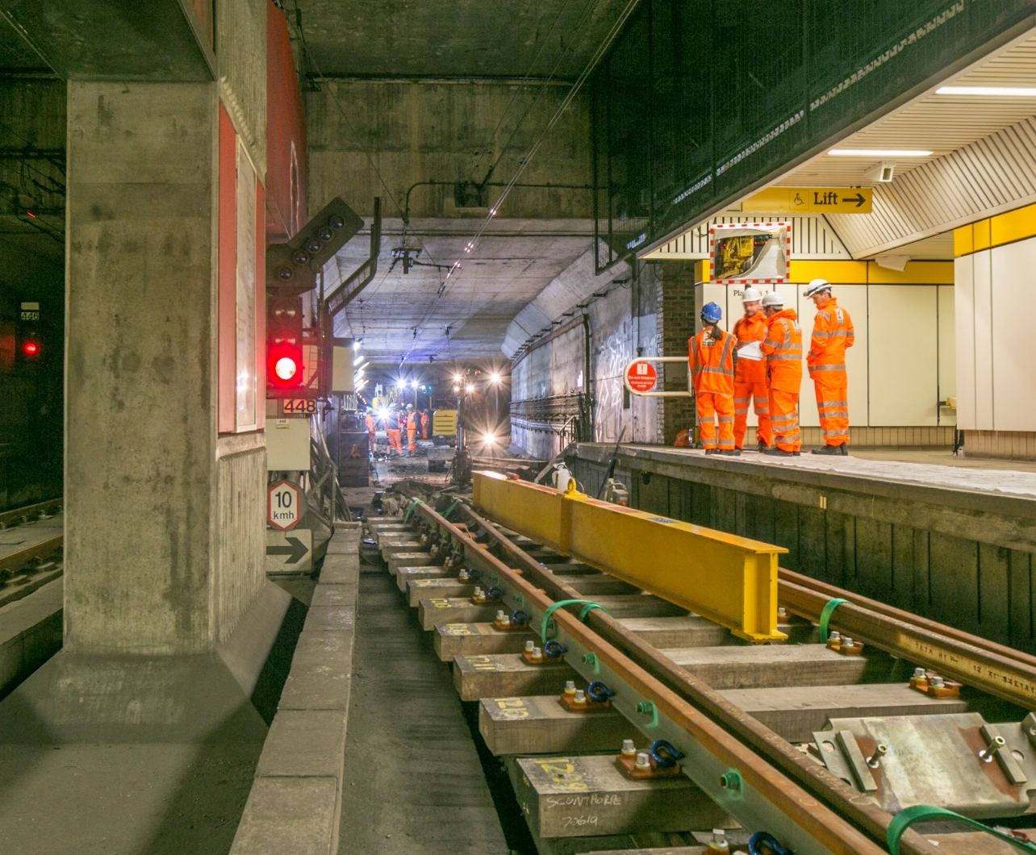

So should we go anywhere those train tracks whilst engineers are working?

Slide 15
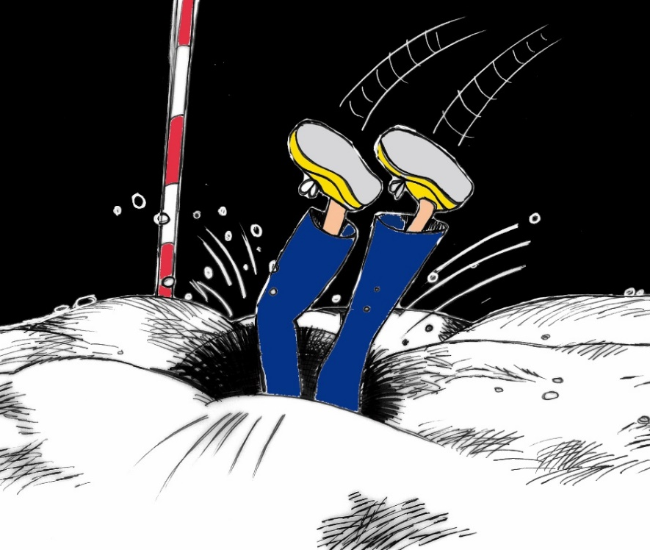
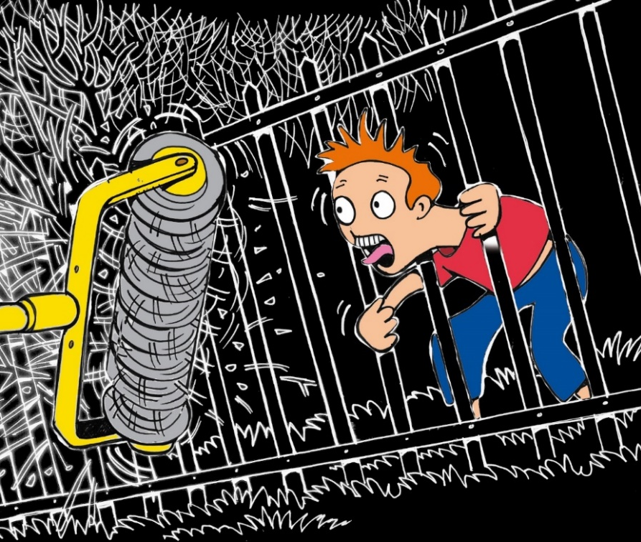
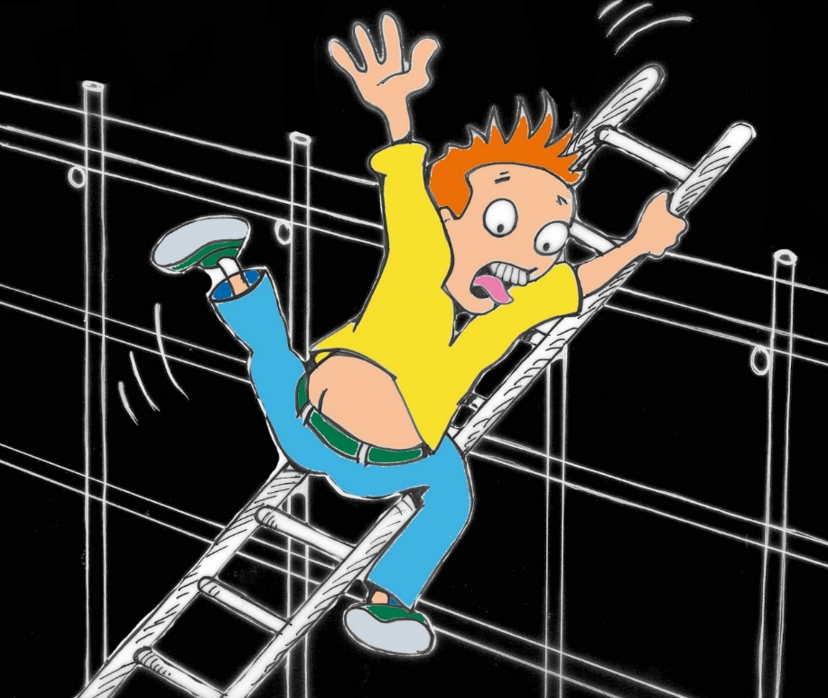
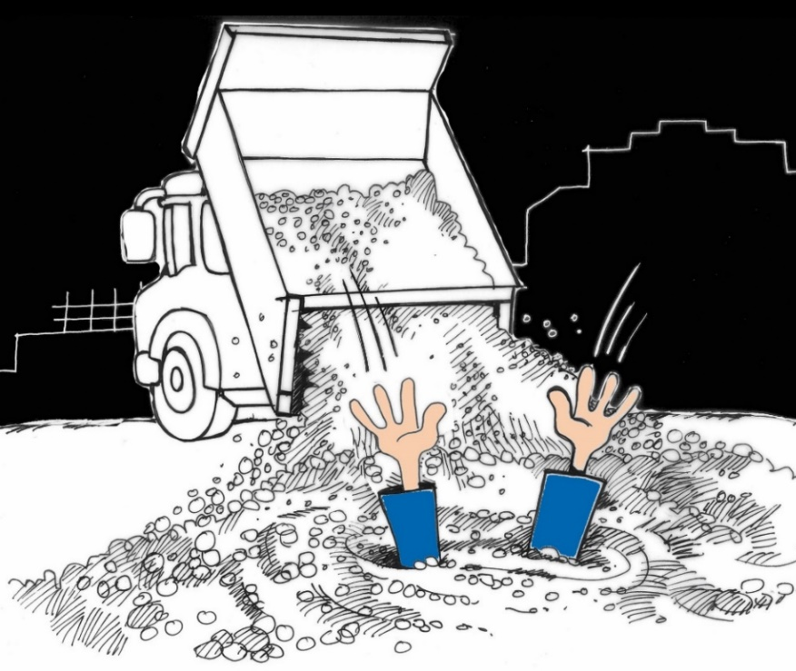
Look carefully at the dangers.
What can you see?
Why are they dangerous?

Slide 16
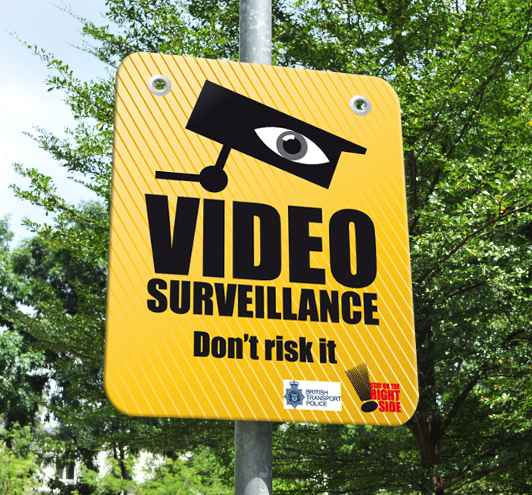
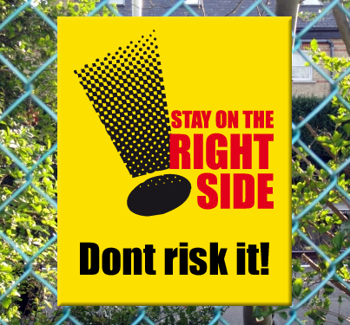
Look carefully at these signs. They are warning you that it is very dangerous to play or go near the lines. You must stay on the right side of the fence as short cuts could cost your life. There is also surveillance cameras keep watch.

Slide 17


Play Safe Stay Safe

