Slide 1

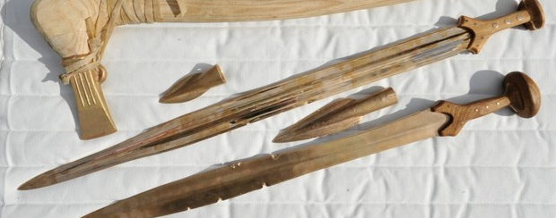

Bronze: how it was made and used in the Bronze Age
History

Slide 2
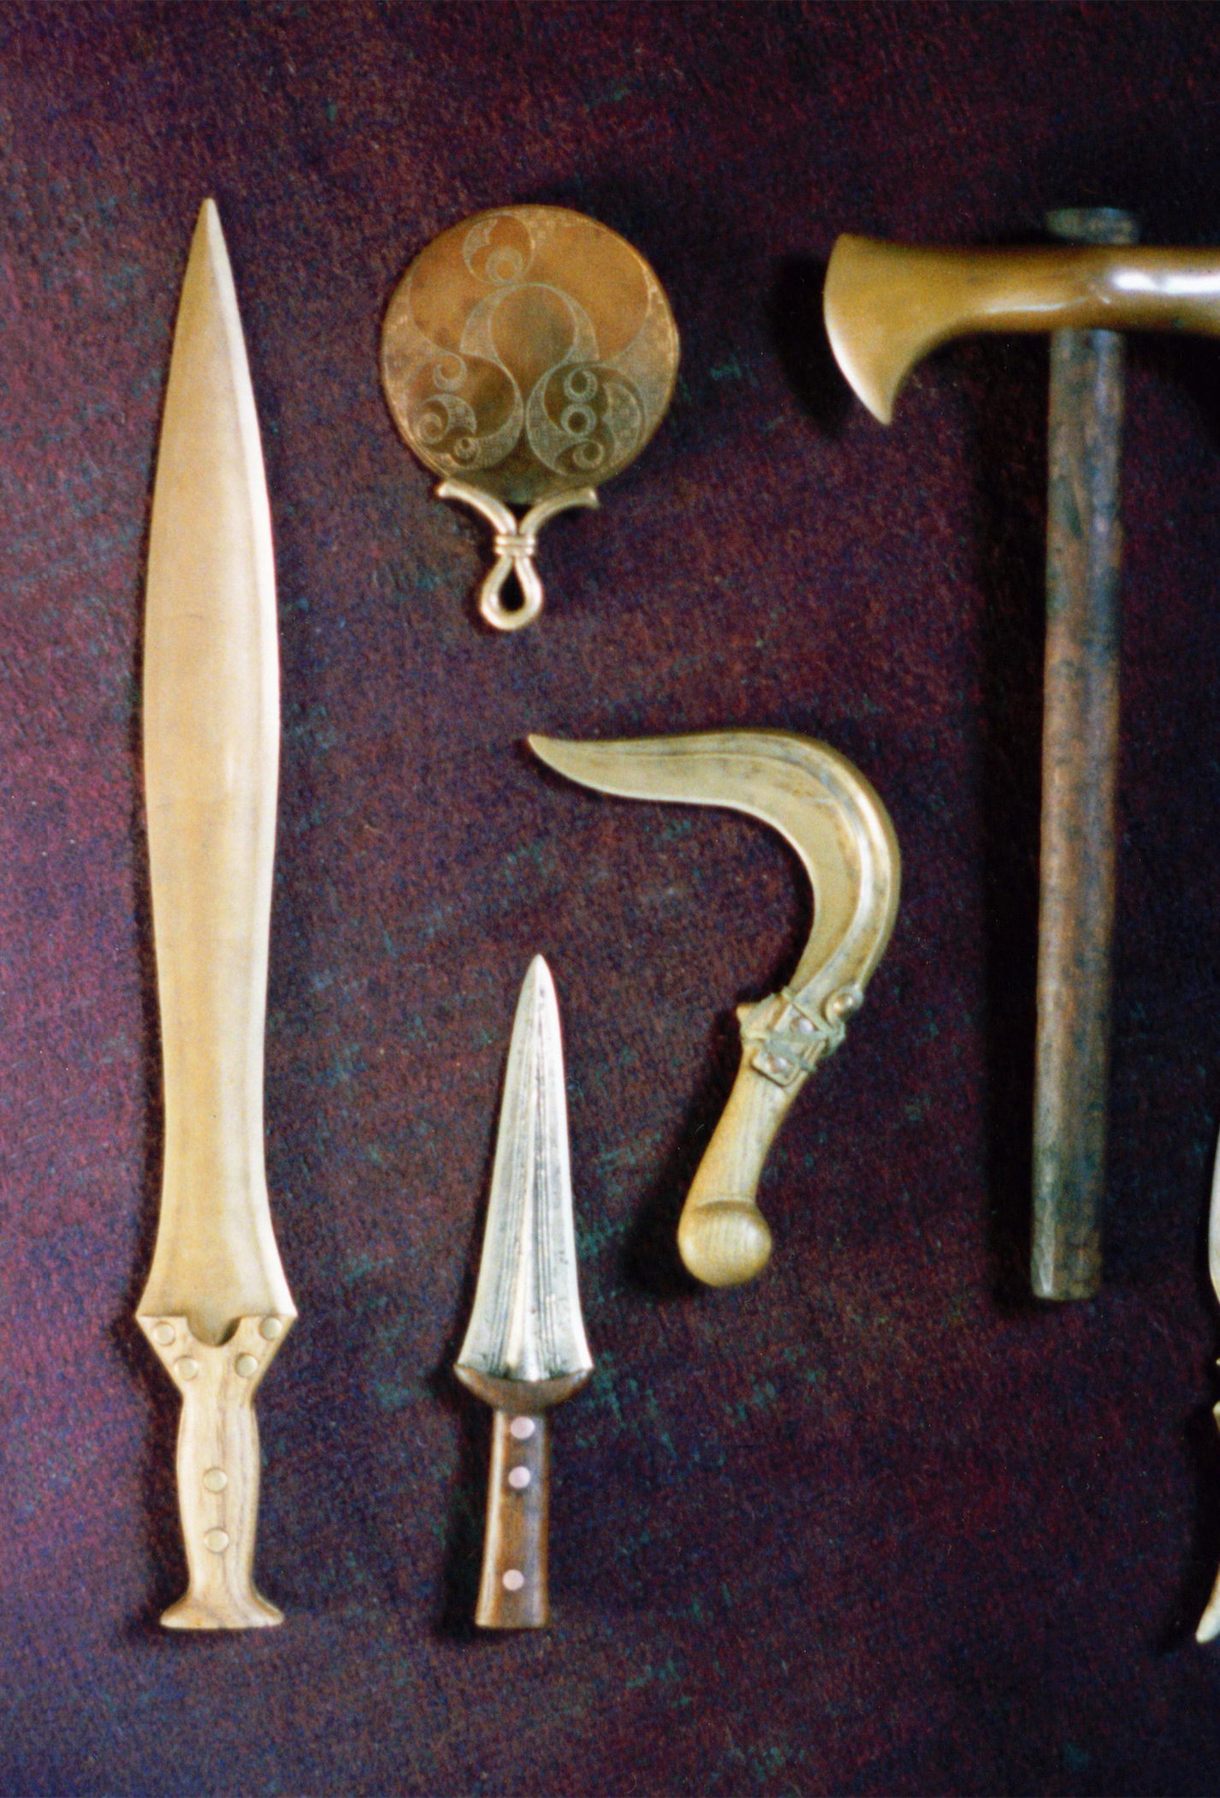
How is bronze made?
The Stone Age, the Bronze age and the Iron age were all named after the materials that were used to make tools throughout prehistory.
In this lesson we will find out how bronze is made and some of the tools that it was used for.

Slide 3
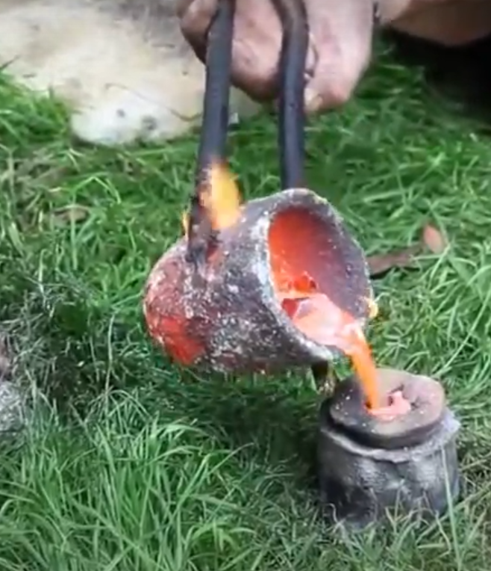
Task 1
Watch this video to see how bronze was made during the bronze age.
Metals like steel are still made in the same way today!
https://www.bbc.co.uk/teach/class-clips-video/history-ks2-discovering-metalwork-in-bronze-age-Britain/zb8b47h

Slide 4
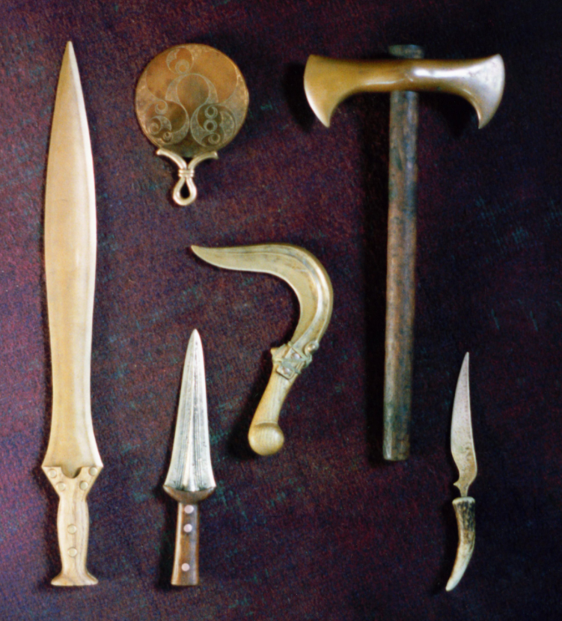
Task 2
Draw these Bronze age tools and label them.
What do you think they are and how were they used?
Imagine you are someone from the bronze age. What tools would you need when working with wood.
How would you hunt and prepare meat or animal skin and cut down the crops you have grown?
Also how would you defend yourself if you needed to?
Which one is which?
mirror scythe (used to cut down crops)
Bone handled knife dagger
axe short sword

Slide 5
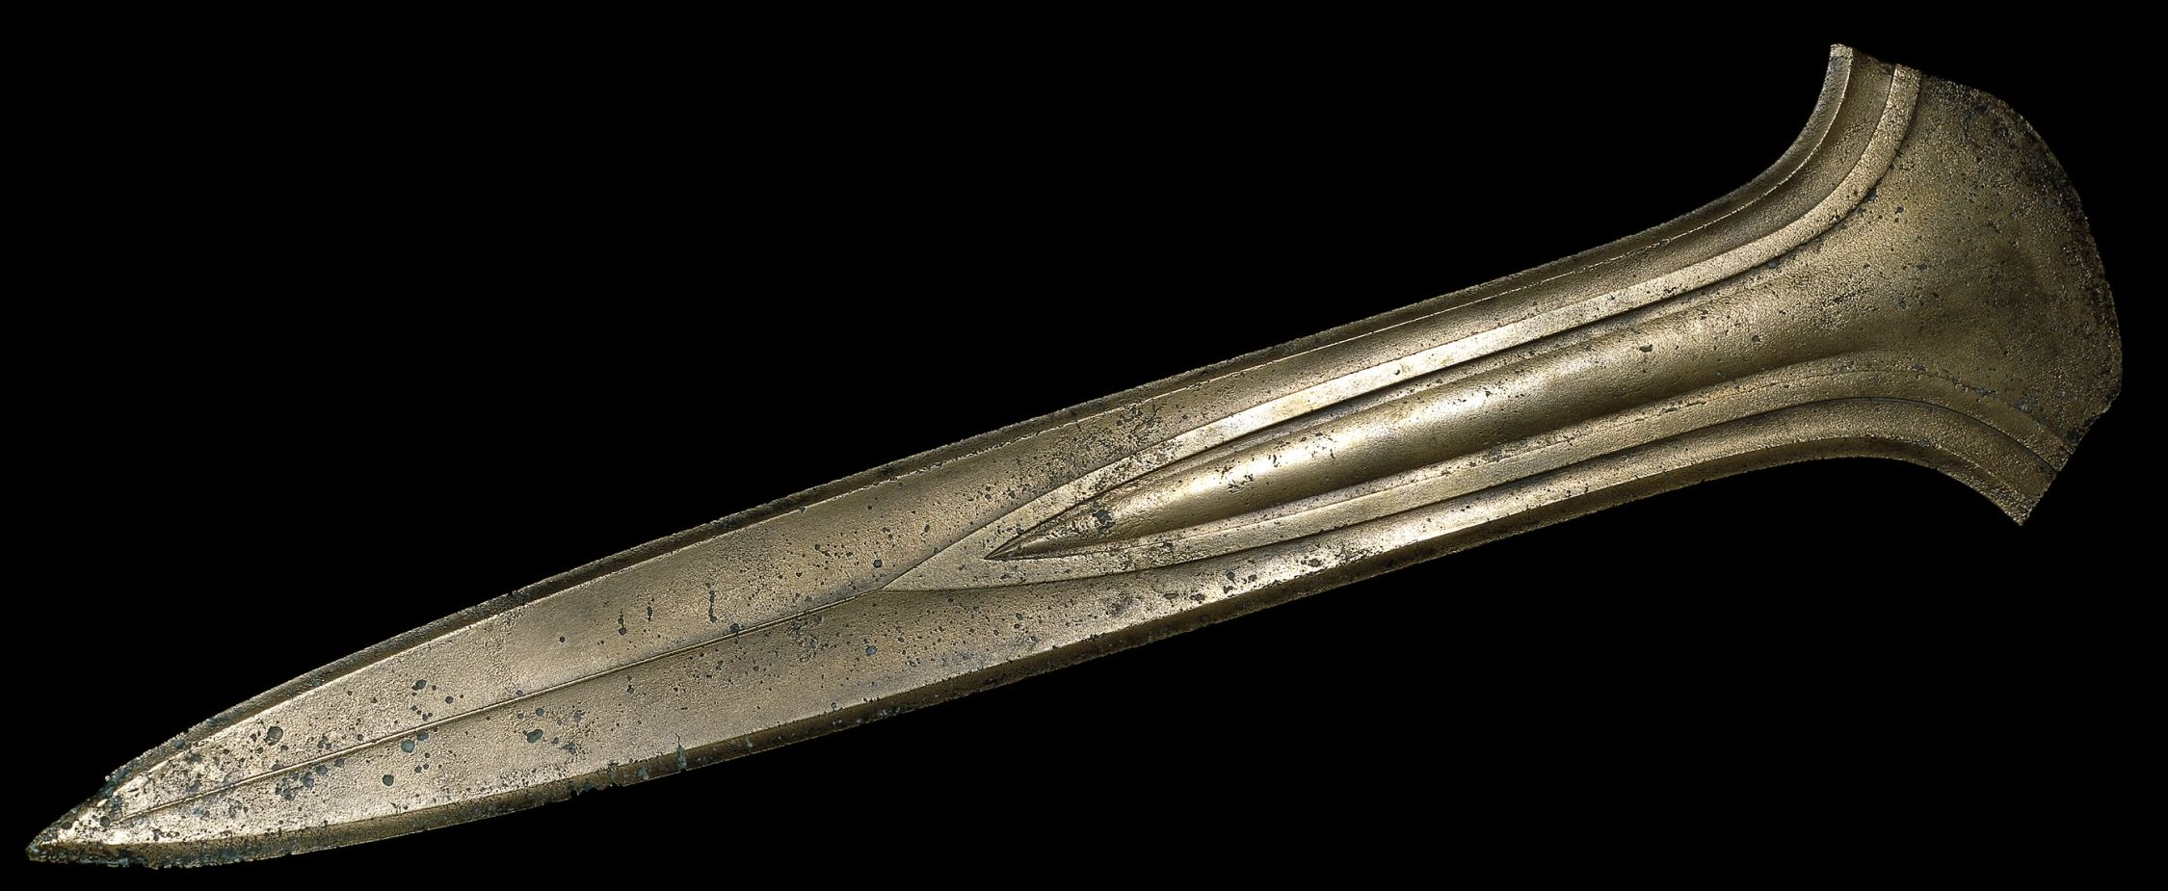
Well done

