Slide 1
Maths
Find the area of compound shapes

Slide 2
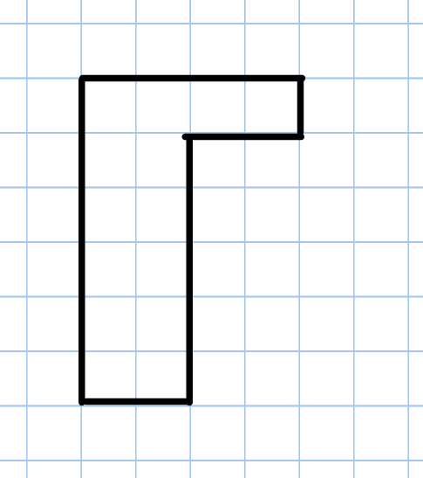
Area = 14cm²

Slide 3
Area = 11cm²

Slide 4
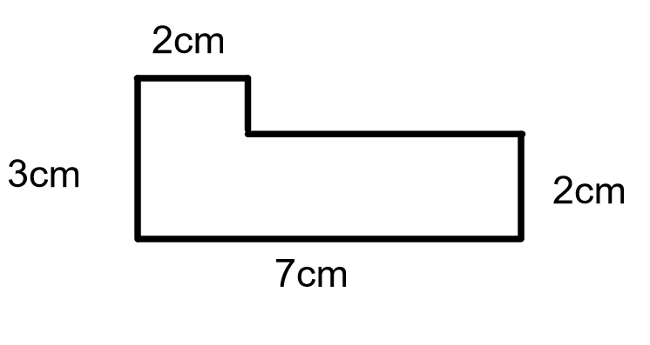
1. 3 x 2 = 6cm²
2. 5 x 2 = 10cm²
Area = 16cm²

Slide 5
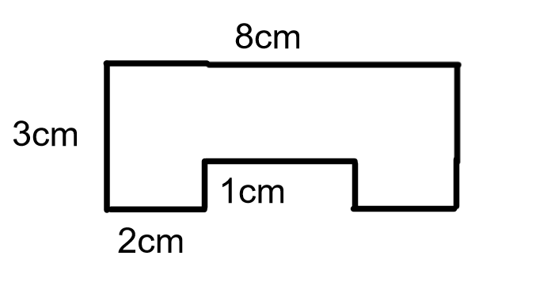
1. 2 x 8 = 16cm²
2. 2 x 1 = 2cm²
3. 2 x 1 = 2cm²
Area = 20cm²

