Slide 1
Reception
Keeping Safe on the Metro
Learning intention: To learn how to keep safe near rail tracks

Slide 2
Notes:
What is this?

Slide 3
Notes:
That’s right, it’s the Nexus Metro Map. This is Ben, he works for Nexus and he has an important announcement to make.

Slide 4
15 Feb
28 Feb
Notes:
Between the 15th February and 28th February, the trains between some platforms have to STOP!

Slide 5
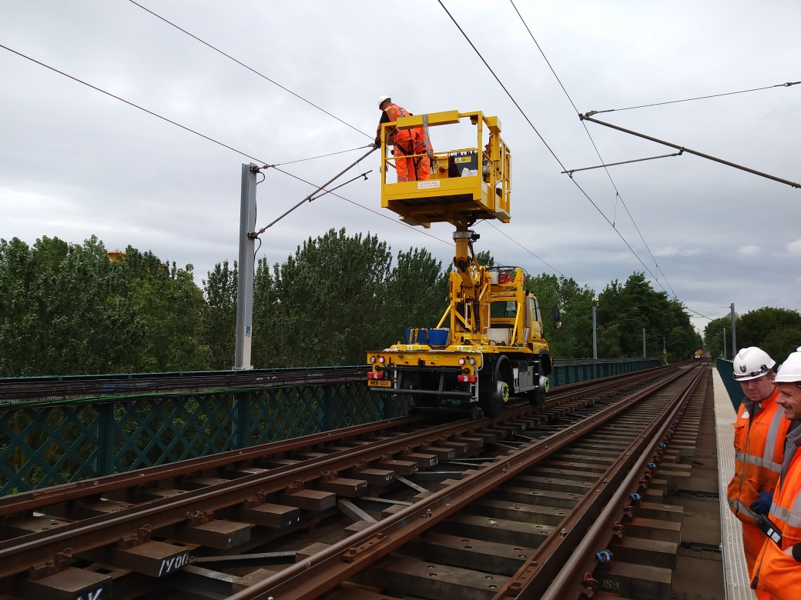
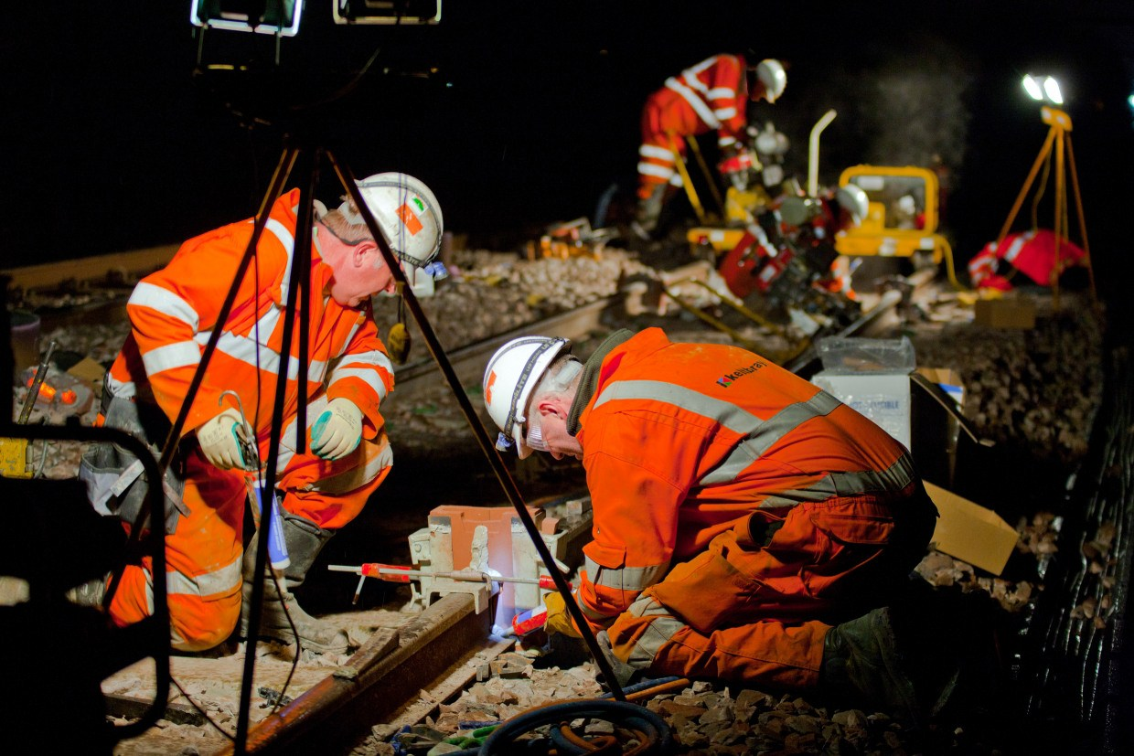
Day
Night
Notes:
This is because the engineers will be working day and night in the busiest area of the Metro, they call it the central corridor.

Slide 6
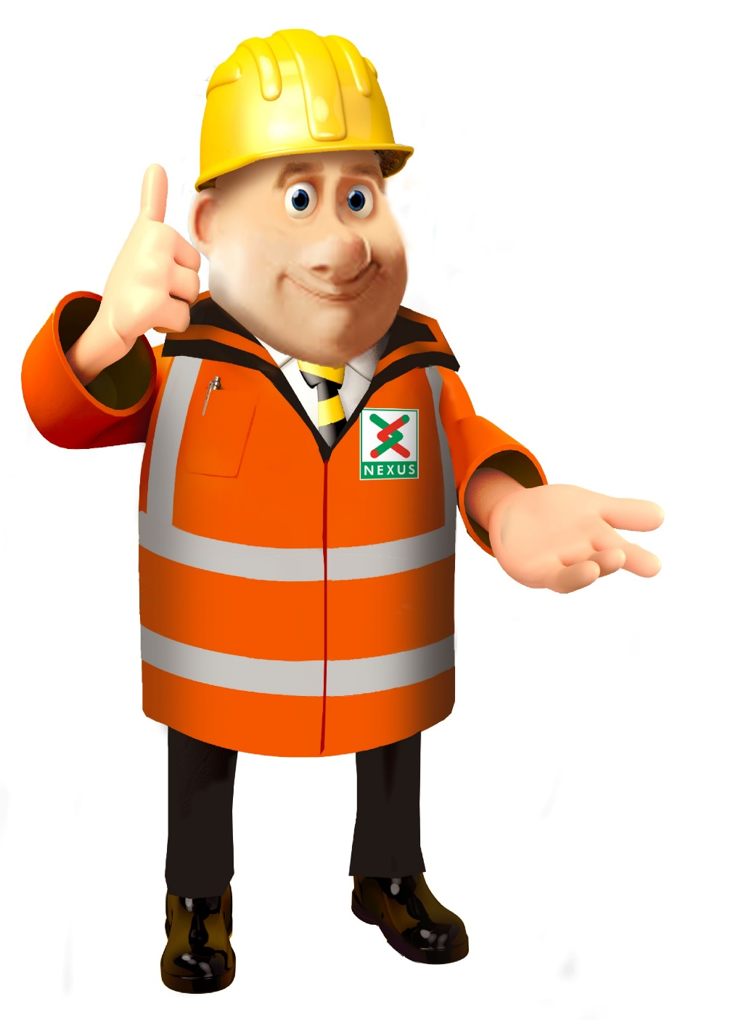
What do you think we are going to be doing?
Notes:
Guess what Ben and the other workers will be doing.

Slide 7
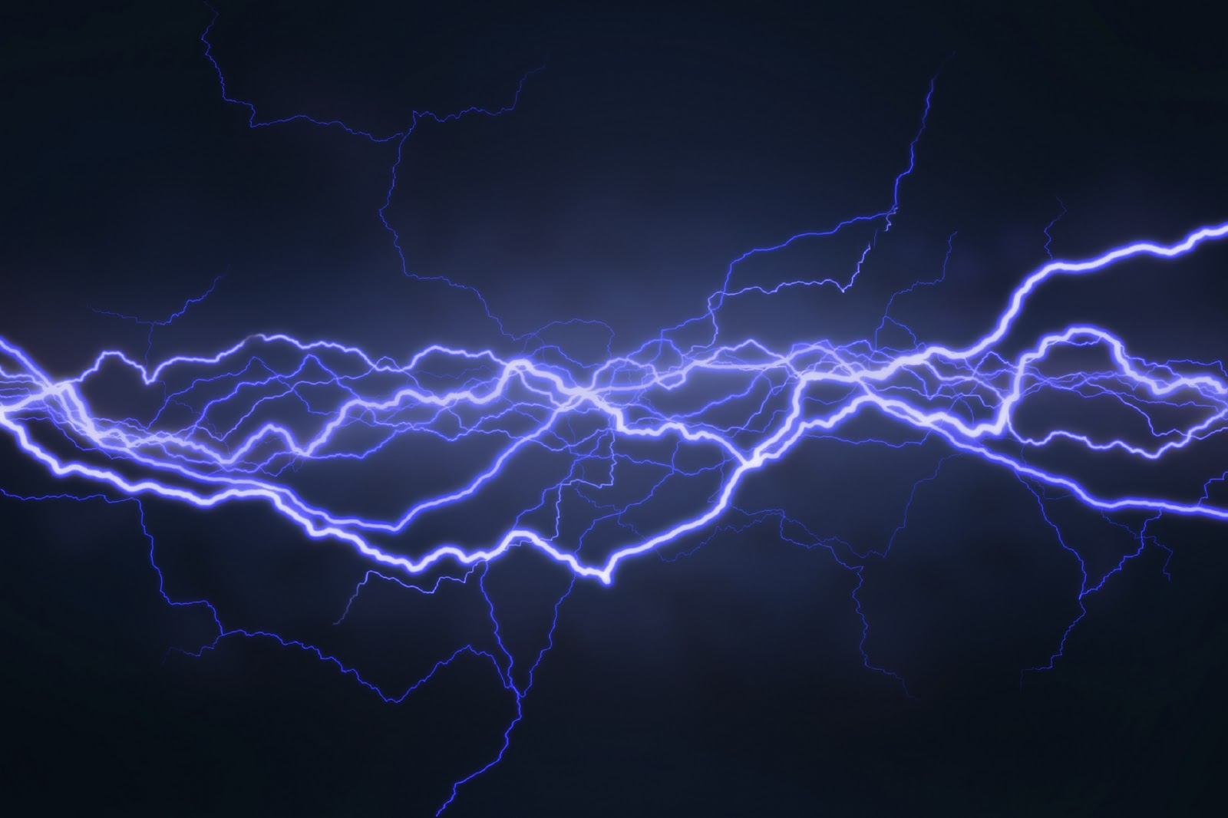
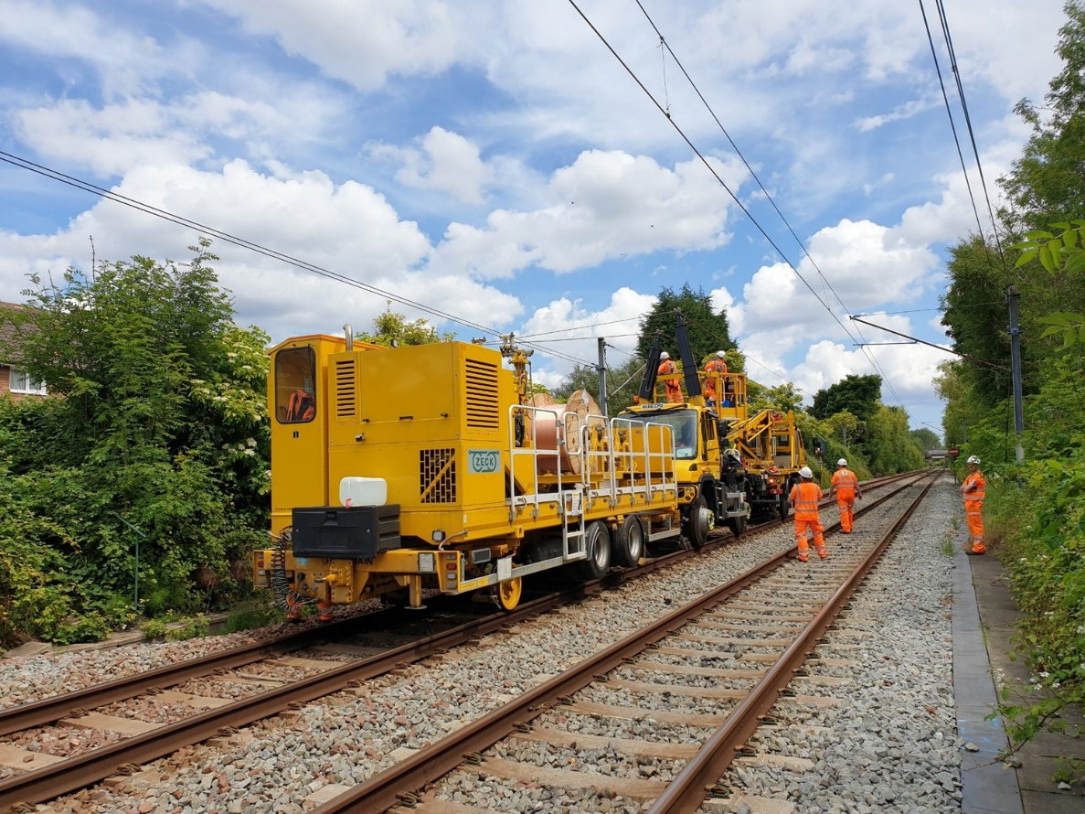
We need to replace the overhead lines.
Electricity →
Overhead Lines
Notes:
There is electricity that is carried in overhead lines. Just like lightening it can jump up to 1 metre. The overhead lines need to be replaced.

Slide 8
Overhead lines carry electricity to help the trains move.
Notes:
Overhead lines carry electricity to help the trains move, but wait a minute…

Slide 9
Electricity is very strong.
What might happen if you touched an overhead line?
Notes:
Electricity is very strong, powerful and dangerous. We cannot touch the overhead lines, this will be very dangerous.

Slide 10
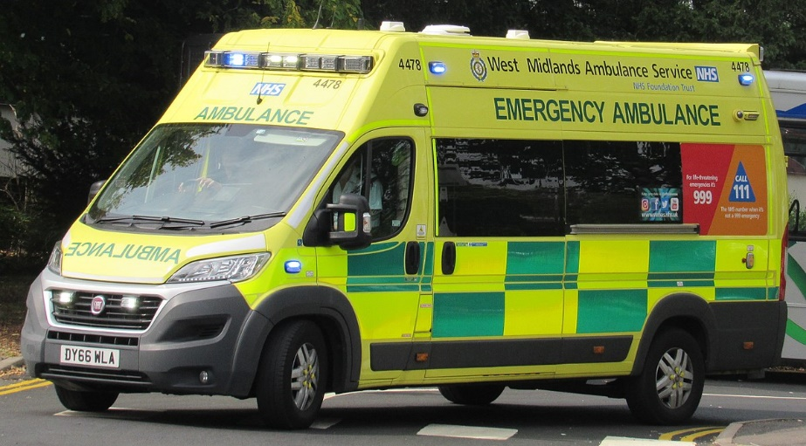
We all need to keep safe!
How can we do it?
Notes:
We all need to keep safe. How can we stay safe?

Slide 11
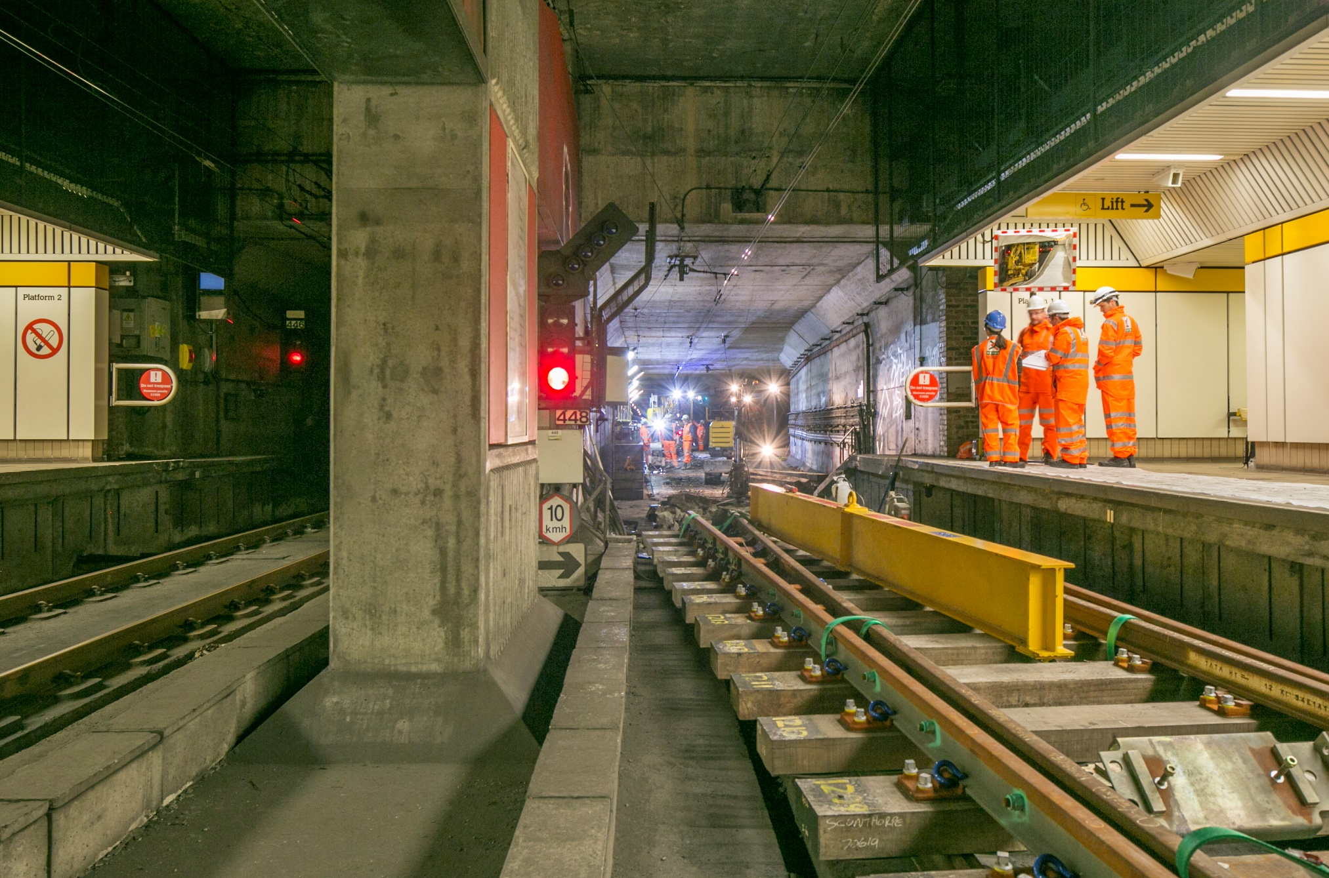
Notes:
The engineers working wear helmets, strong shoes, special gloves and clothes that are bright and safe. They go in and out of the tunnels, so they need to be seen by the driver.

Slide 12
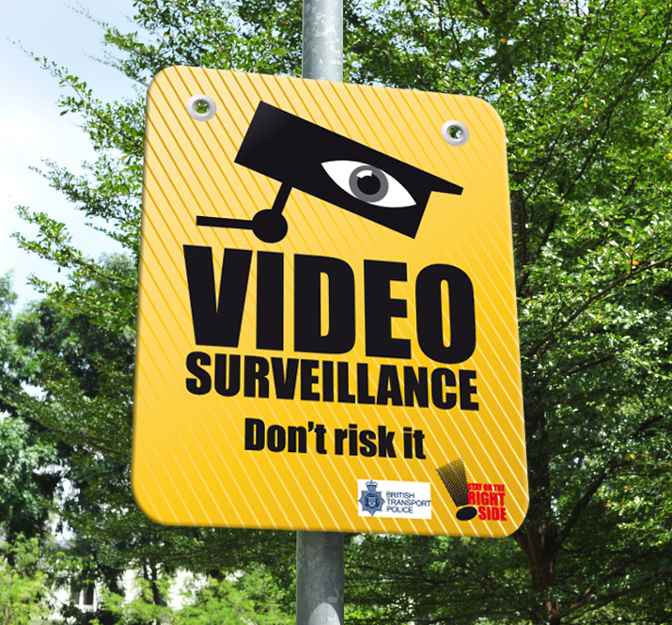
Notes:
Nexus have lots of CCTV Cameras that watch to make sure no-one is doing anything dangerous like touching wires and electrics.

Slide 13
Notes:
Signs are around the Metro to tell people to stay on the right side of the fences and stay away from electricity in the wires.

Slide 14
Remember to stay safe near the metro.
Hold the hand of an adult.
Do not play near the tracks.
Always stand behind the yellow line.
Stay away from the edge of the platform.

