Slide 1
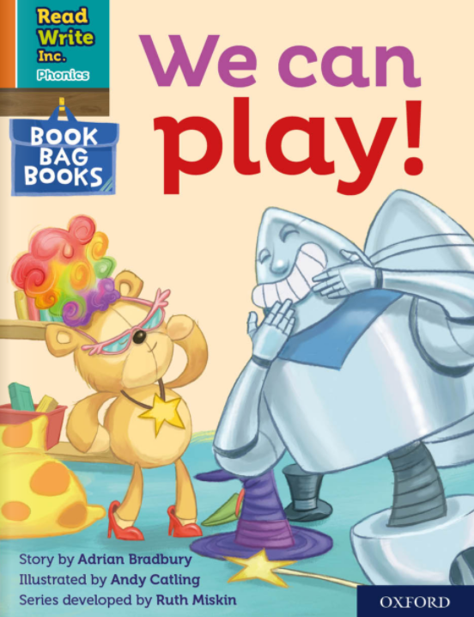

Slide 2
f ff | l ll le | m mm | n nn kn | r rr | s ss se | v ve | z zz s | sh | th | ng nk
b bb | c k ck | d dd | g gg | h | j | p pp | qu | t tt | w wh | x | y | ch tch
Speed Sounds

Slide 3
a at | e hen | i in | o on | u up | ay day | ee y see | igh high | ow blow
oo zoo | oo look | ar car | or for | air fair | ir whirl | ou shout | oy boy
Speed Sounds

Slide 4
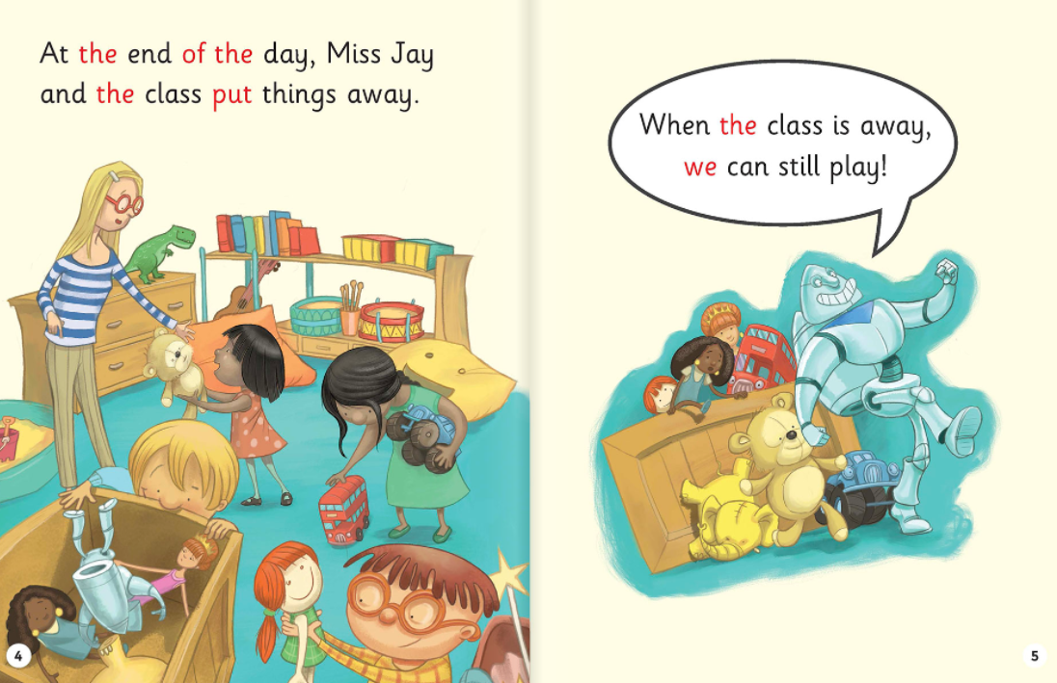

Slide 5
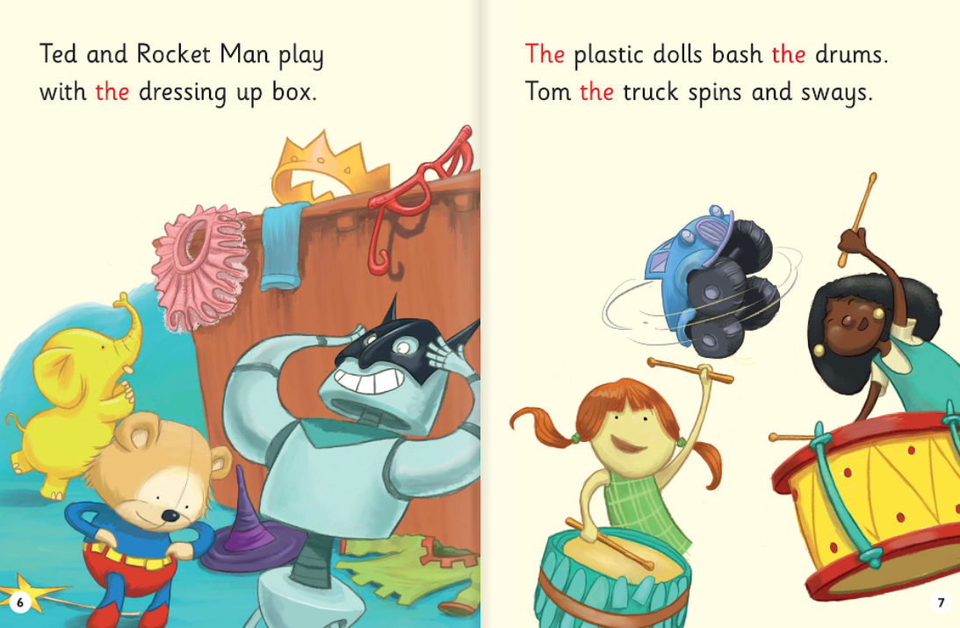

Slide 6
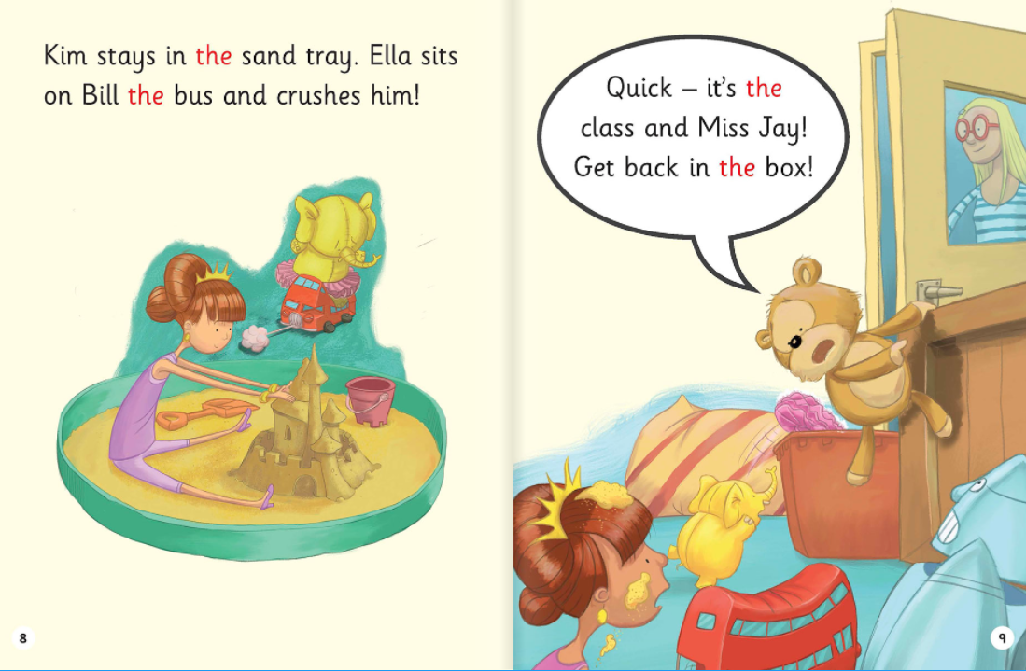

Slide 7
1. What is the teacher’s name?
2. Which toys played in the dressing up box?
3. What did the plastic dolls do?
4. Why did the toys have to get back in the box quickly?

