Slide 1
Art
Learning intention: To learn about a great artist in history – Nicky Phillips

Slide 2
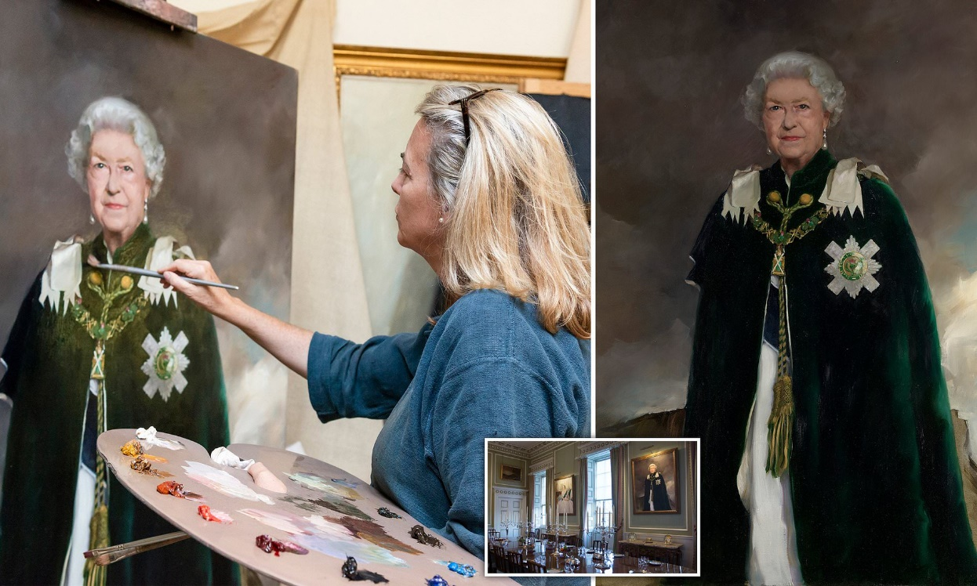
Nicky Phillips
Nicola Jane Phillips (often known as Nicky Phillips) is a British artist whose most famous works are portraits of the royal family using oil paint.

Slide 3
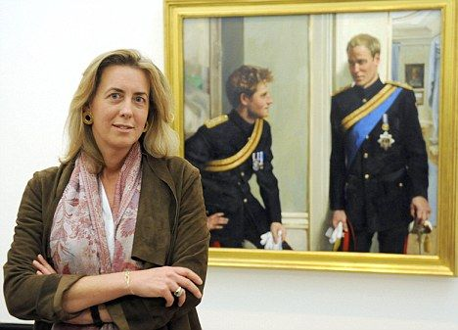
Nicky Phillips
Early life
On 27th August 1964, Nicky Phillips was born in Pembrokeshire, England. Her family are very artistic; Nicky’s mother exhibited her flower paintings in many galleries and her father was a good amateur artist so it is not surprising that Nicky was born with such an incredible artistic talent.

Slide 4
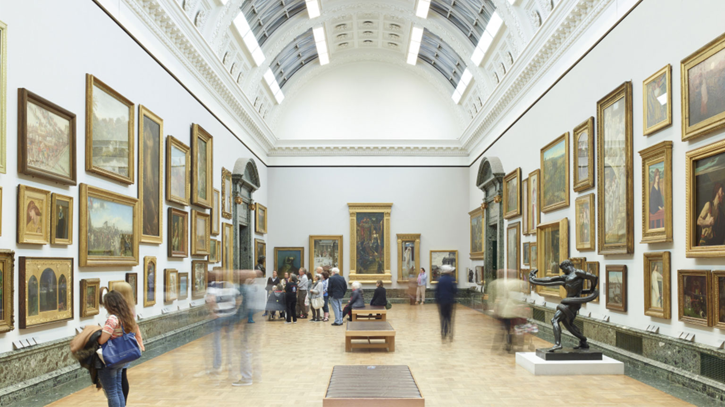
Nicky Phillips
Early Career
After leaving school, she trained at the London Art School before moving to Florence, Italy. However, she returned to London a few years later because she wanted to be close to The National Gallery and The Tate art gallery.

Slide 5
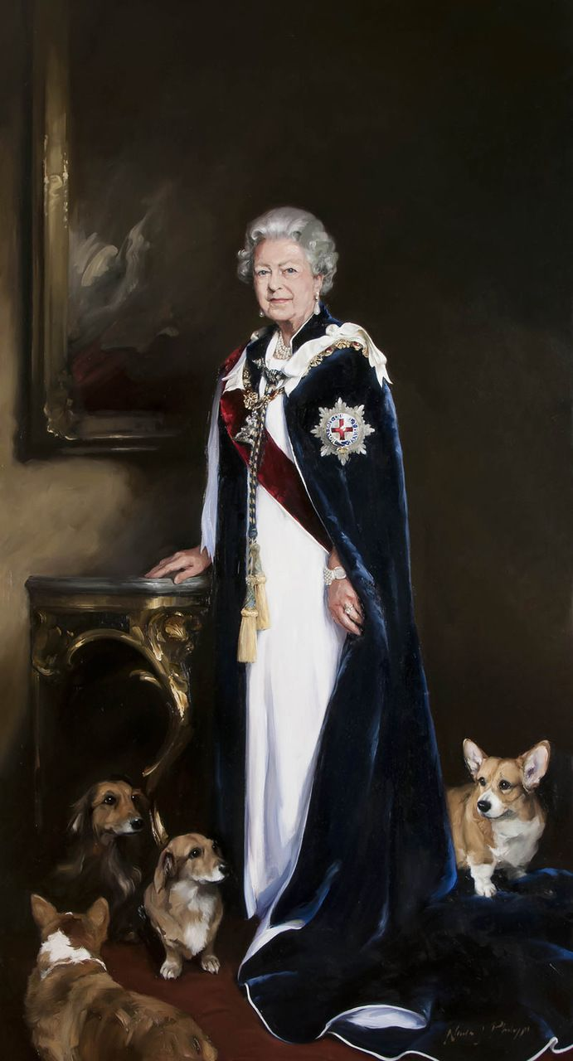
Nicky Phillips
Royal Portraits
In 2010, Nicky Phillips was commissioned to create a double portrait of TRH Princes William and Harry. In 2013 Nicky was approached by Royal Mail to paint a portrait of HM Queen Elizabeth II for the first-class stamp series celebrating the 60th anniversary of her Coronation, the first time Royal Mail had commissioned a painting. The full-length portrait depicts HM The Queen in her robes of the Order of the Garter, surrounded by her four dogs. It was at Buckingham Palace during one of her sittings that the idea of including the corgis (the Queen’s dogs) was born. The painting, gifted by Royal Mail, has been accepted by The Queen and is now on display as part of the Royal Collection in the Throne Room at Buckingham Palace.

