Slide 1

Learning Intention
To recognise that living things can be grouped in a variety of ways

Slide 2
Key vocabulary
Group A set of things that living things have in common e.g. animals that lay eggs
Variety A collection of different things
Organism A scientific word for ‘living thing’

Slide 3
Let’s recap our learning from last week
We learnt last week that all living things have 7 life processes to stay alive.
Movement – to move
Reproduction – to have babies/seeds
Sensitivity to surroundings – to adapt to different temperatures/places
Nutrition – feeding and taking water
Excretion – getting rid of gases and waste
Respiration – breathing
Growth- growing – for exmaplebaby to adult see to a plant

Slide 4
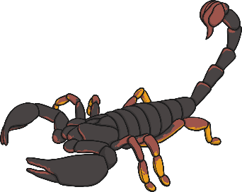
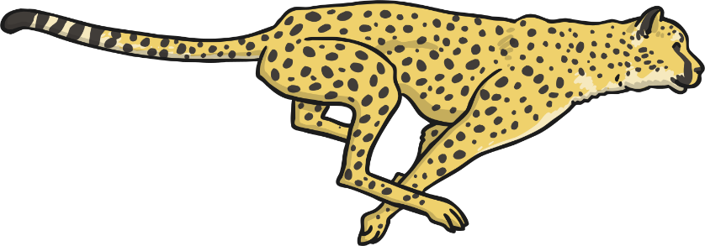
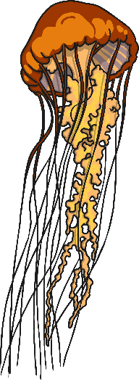
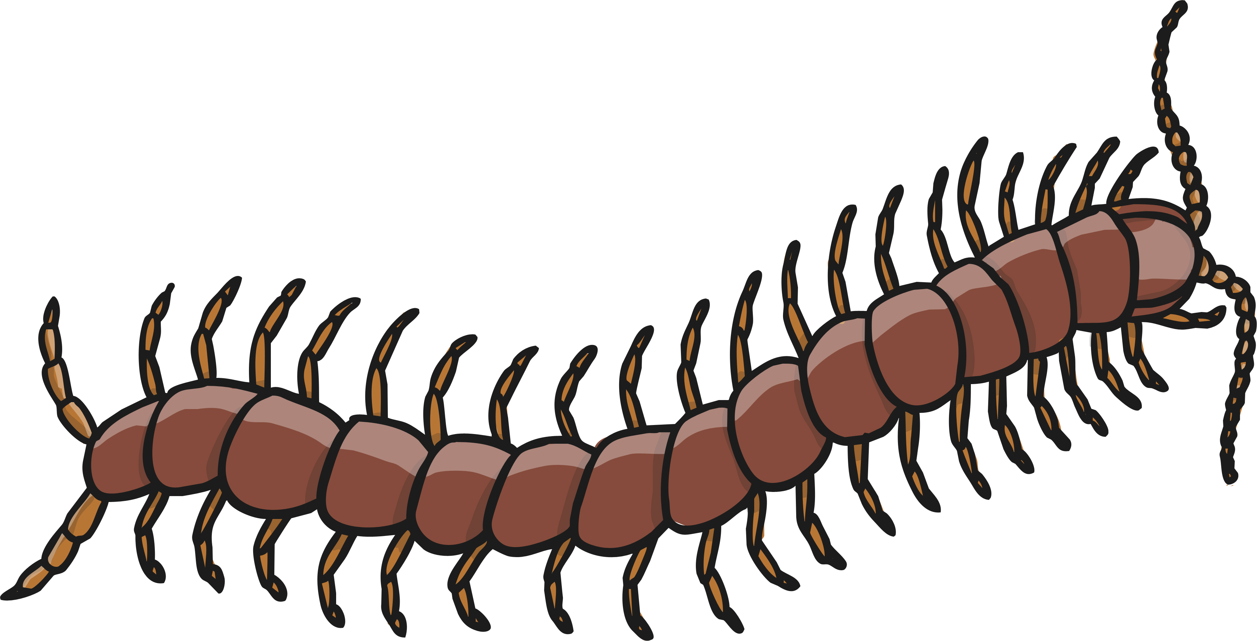
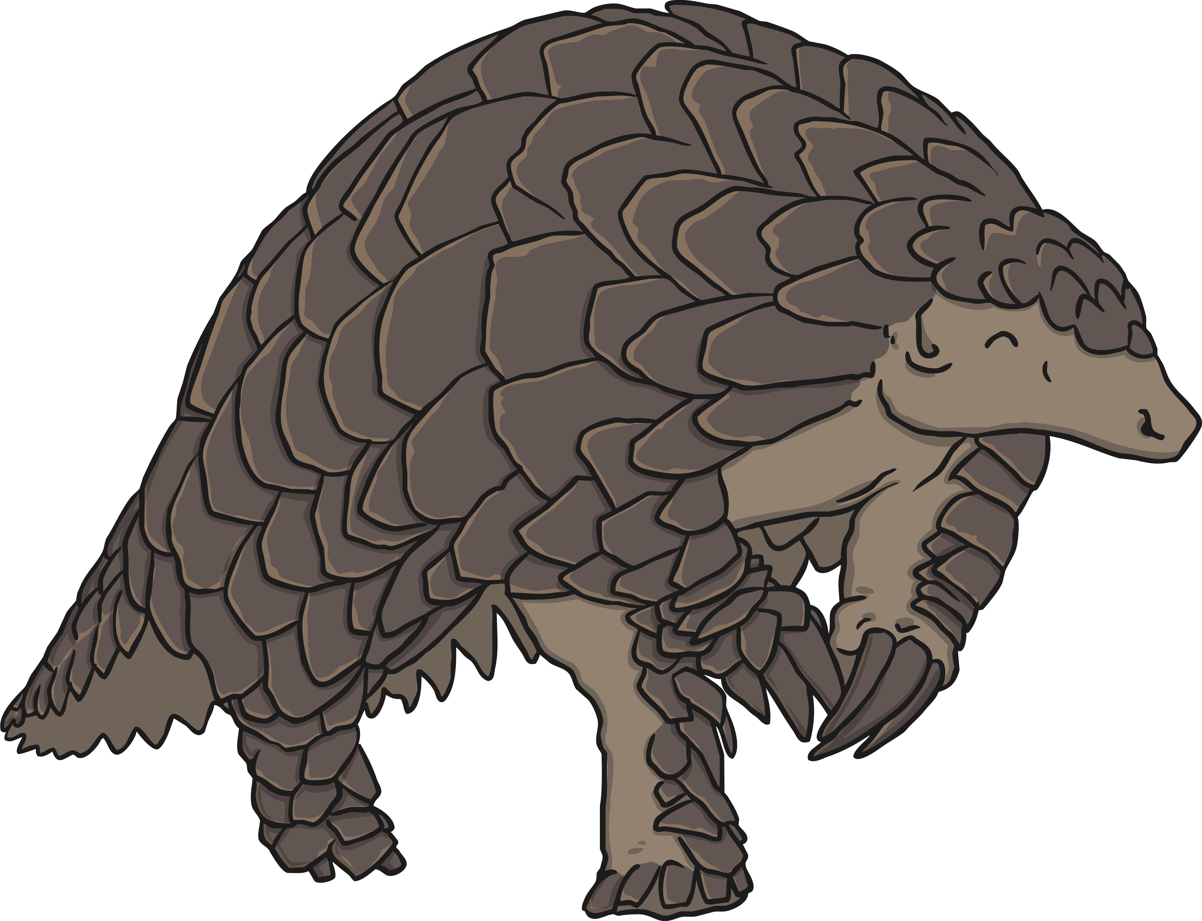
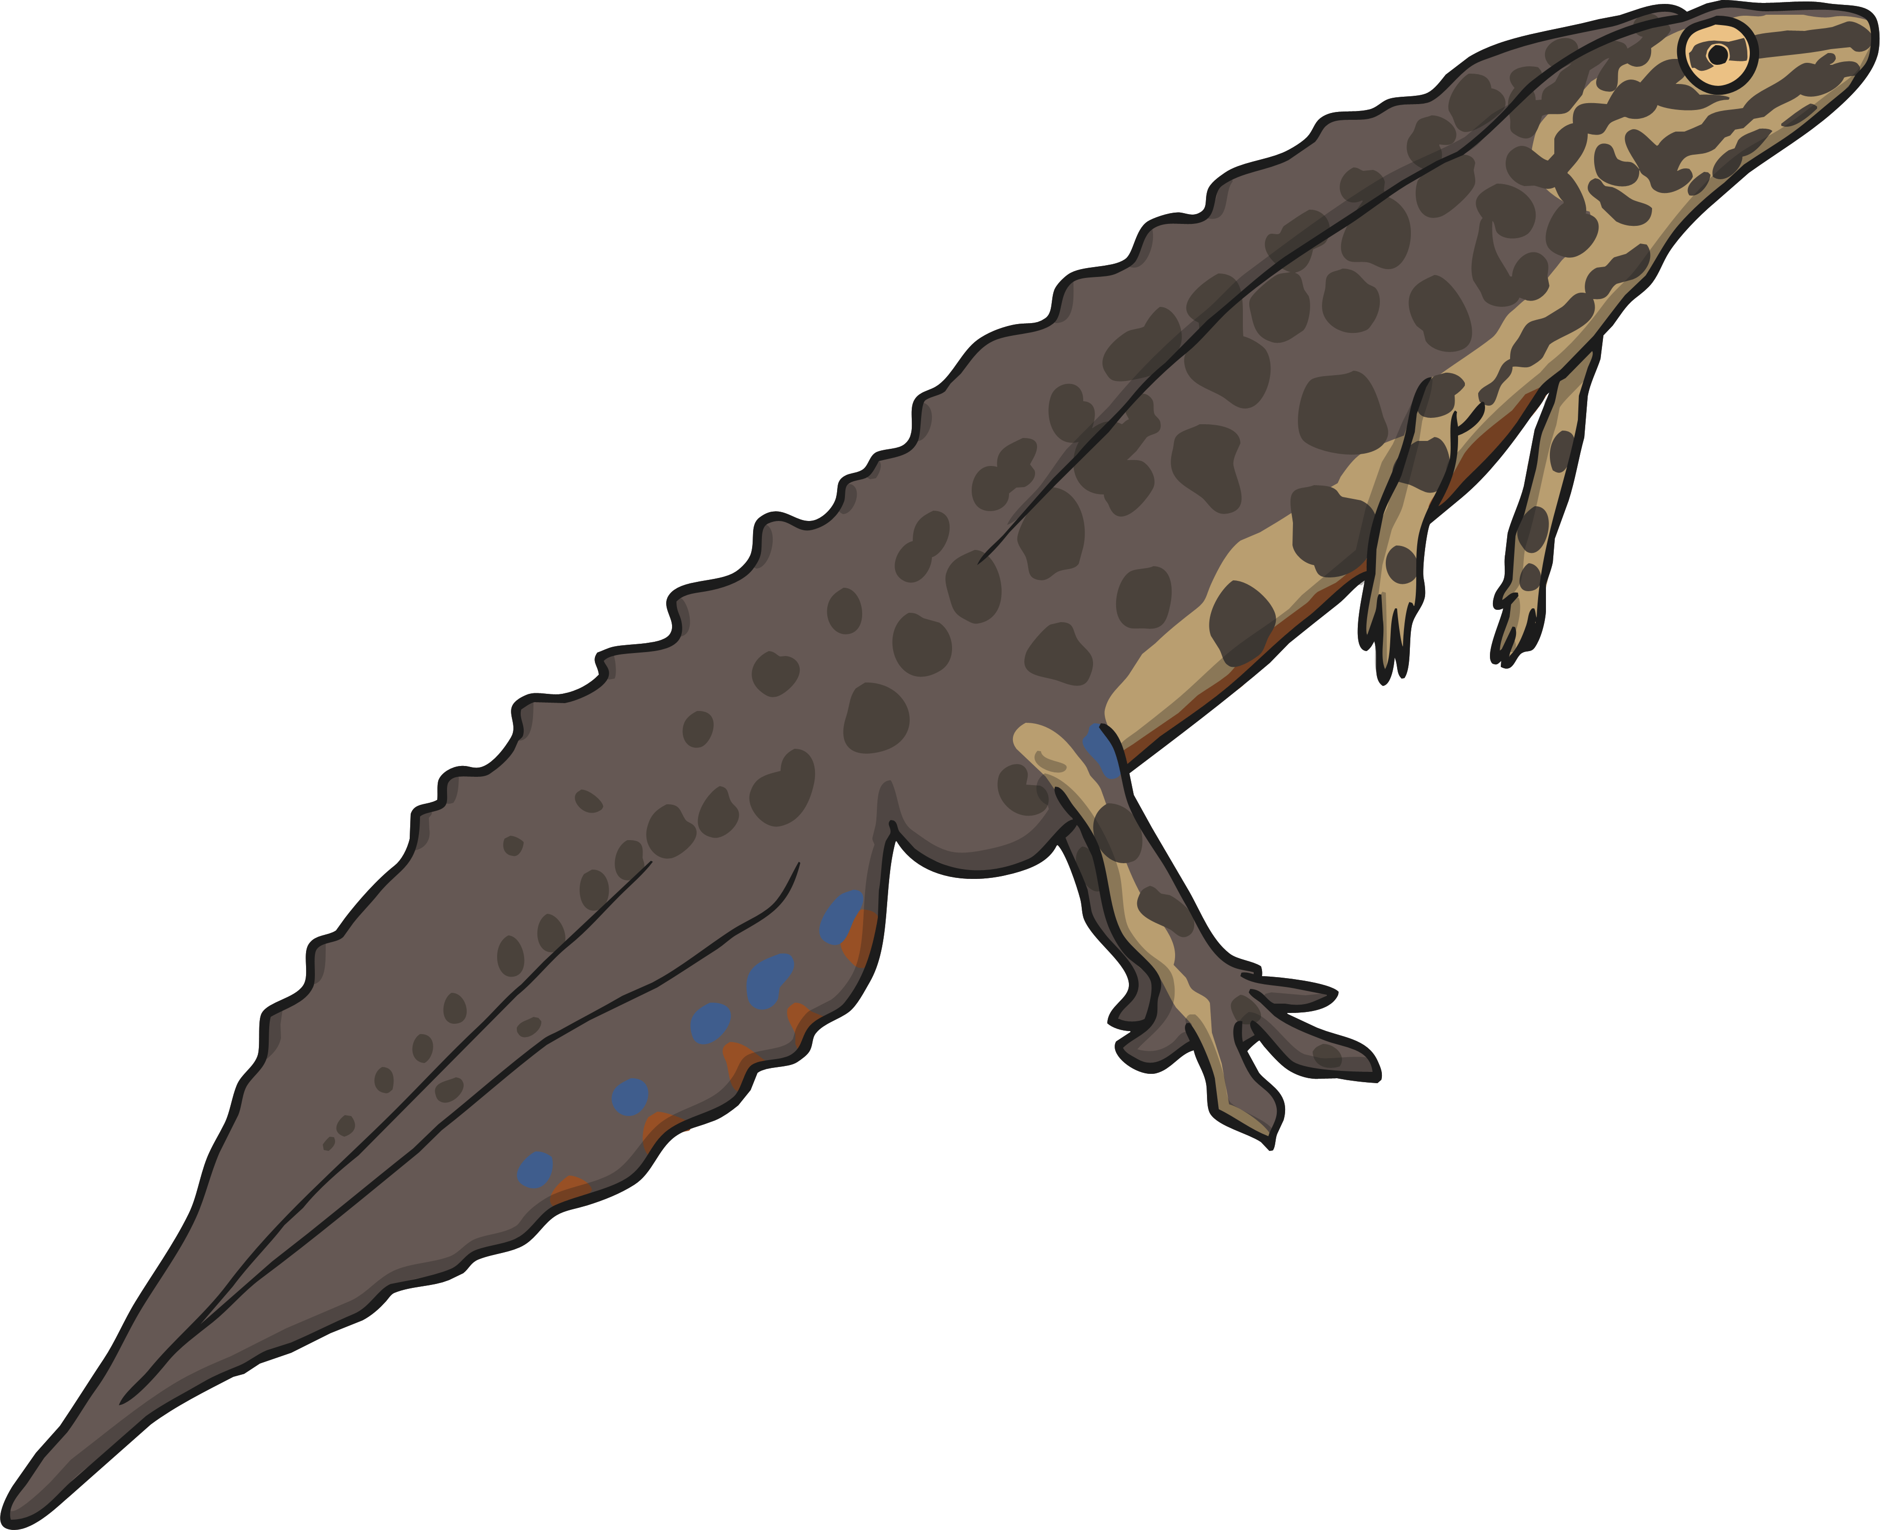
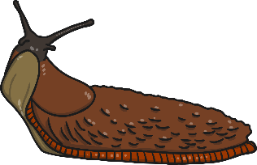
All living organisms share these characteristics. This is how we know they are alive!
Living things have lots of other similarities, and many differences too. We can use these similarities and differences to sort the living things into groups.

Slide 5
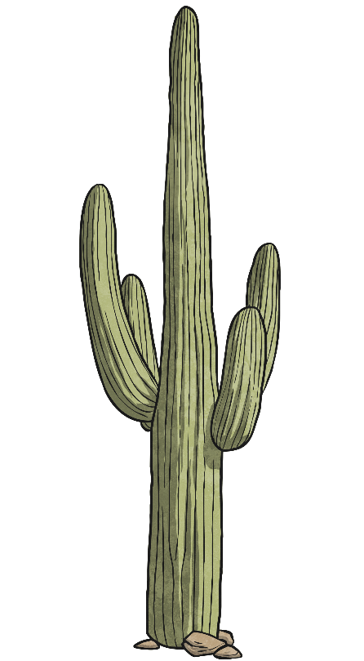

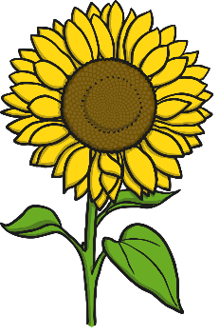
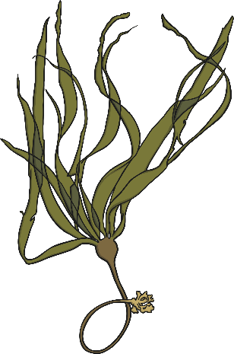
How can we group these organisms?

Slide 6


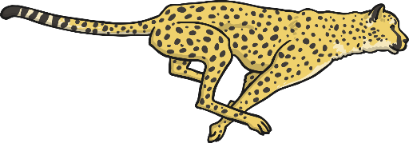
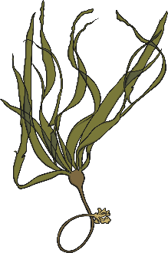



Here the organisms have been sorted into two groups. We have used a diagram to represent these groups.
Can an organism be in both groups at the same time?
plants
animals

Slide 7

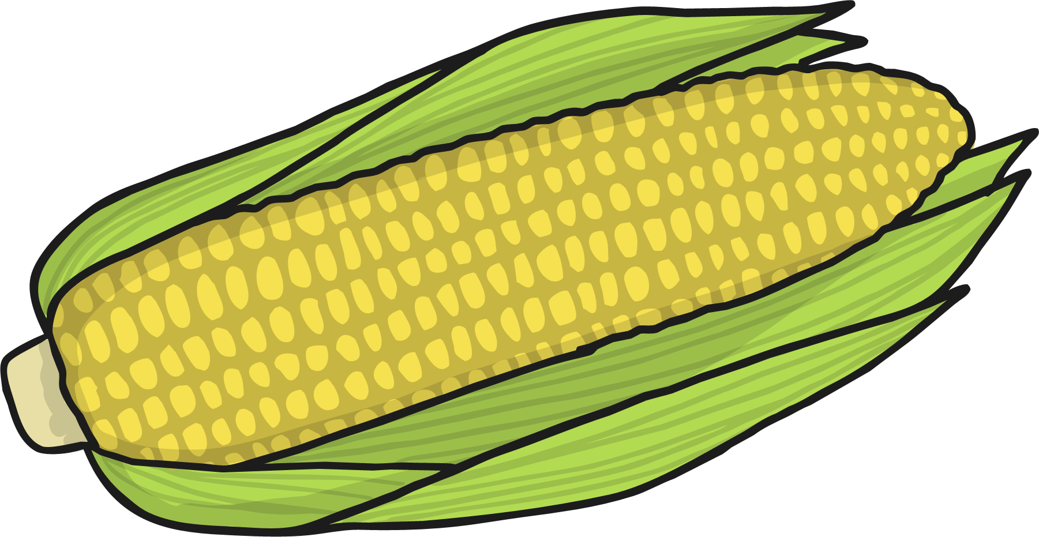

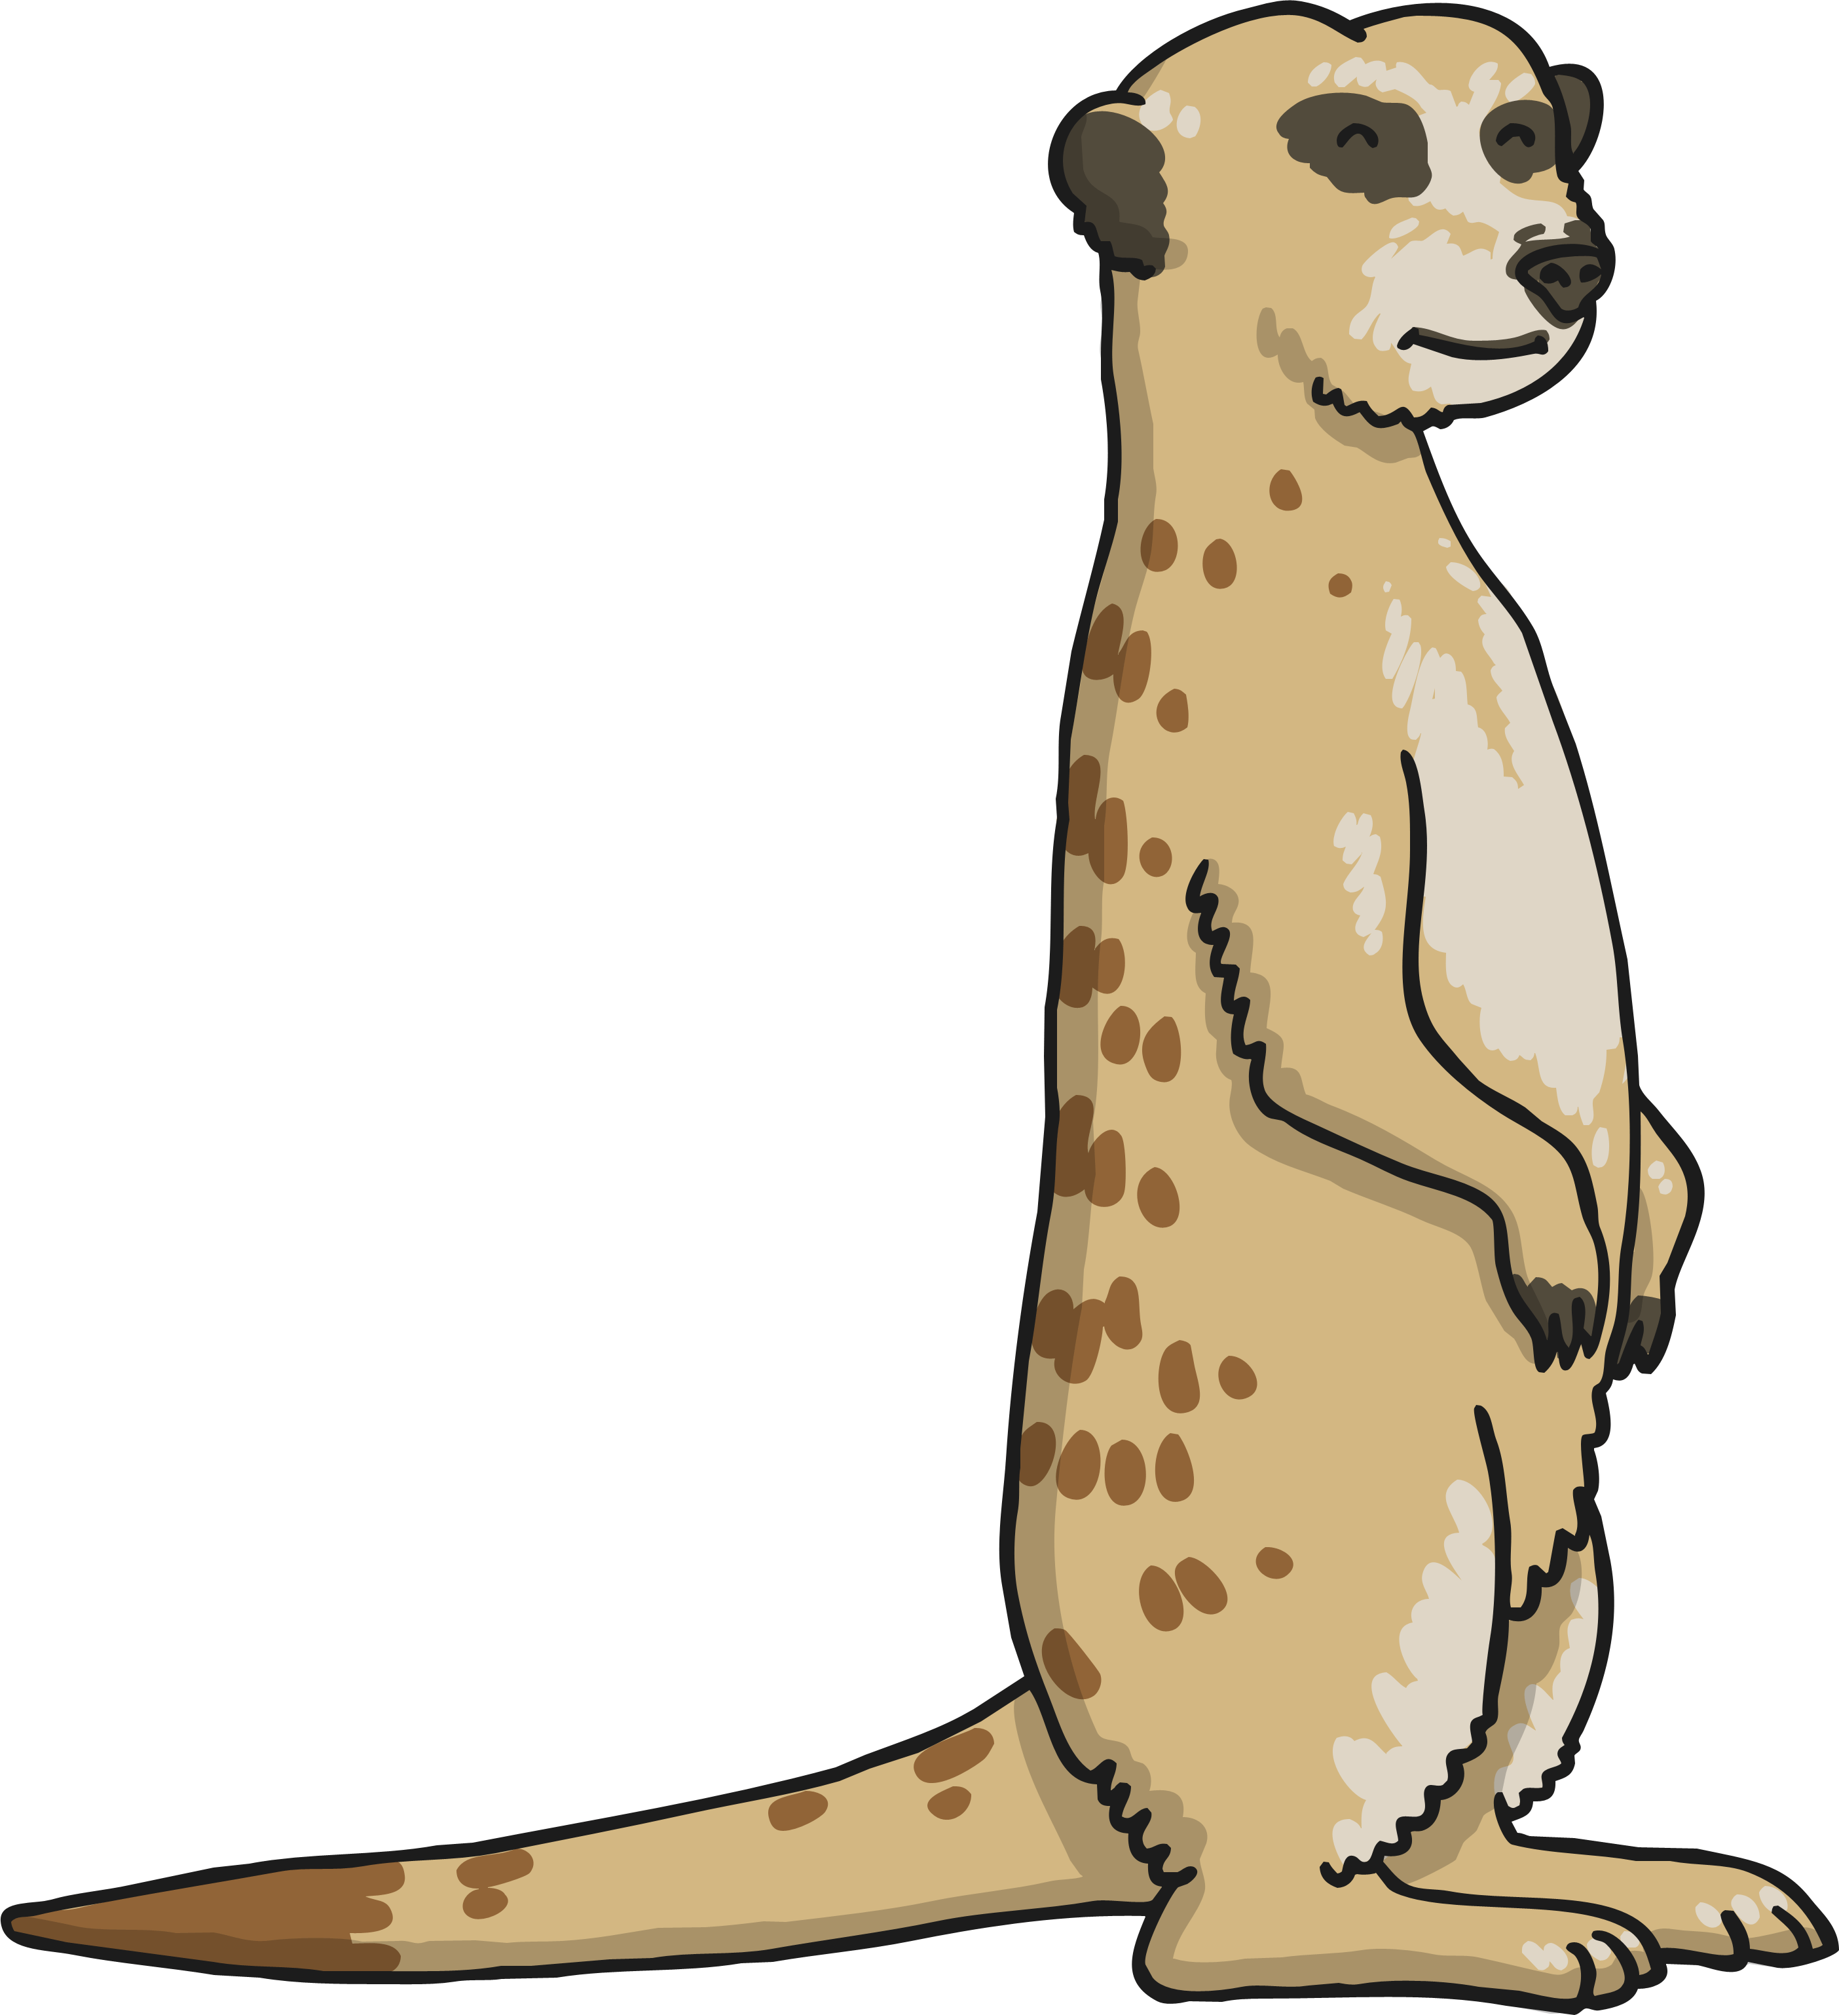
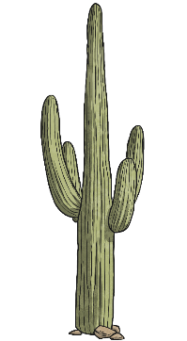
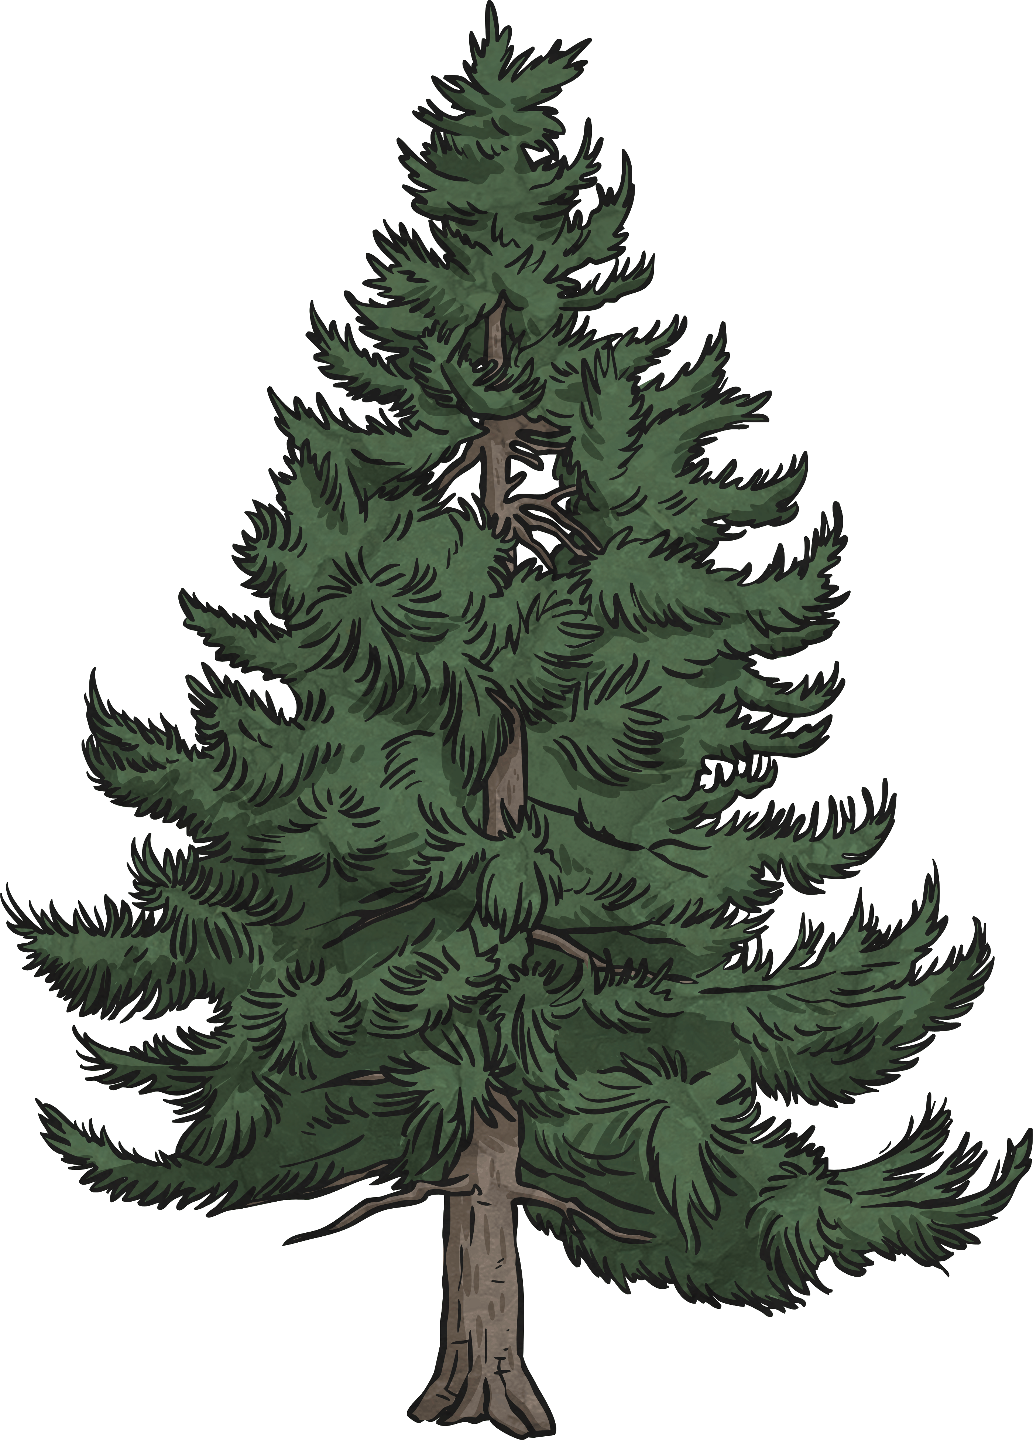

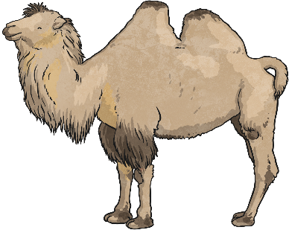
This is called a Venn Diagram. We can use these to group things.
Where does a cactus go in this diagram?
It goes in the middle because it is both a plant and it lives in the desert
plants
lives in the desert

Slide 8
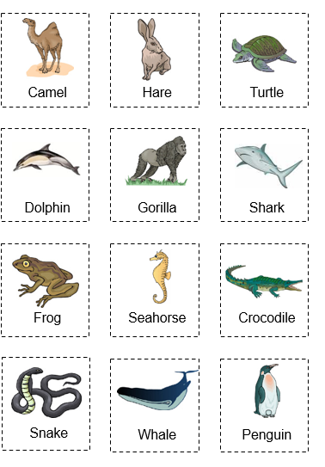
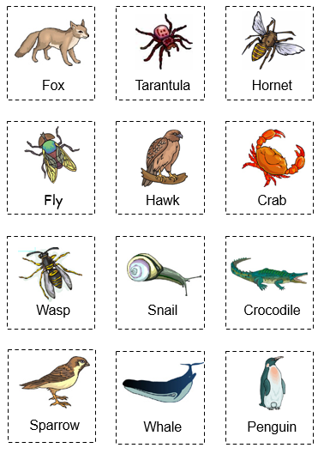
Now it’s your turn
Your task today is to create a Venn diagram and group organisms in different ways.
Here are some images that can help you.

