Slide 1
Learning intention: to place people from history on a timeline.

Slide 2
Today
We are going to be looking at the Royal families family tree.
A family tree is a type of chart or diagram representing different generation in a family.
A family tree can include names, birth dates, marriage dates and pictures.

Slide 3
The Queen and Prince Philip
The Queen’s name is Elizabeth Alexandra Mary. Her royal title is Queen Elizabeth ΙΙ. She is the head of the Royal Family.
She is married to Philip Mountbatten.
Prince Philip is the Queen’s husband. His royal title is the Duke of Edinburgh. He can not be King because he was not born into the Royal family.
They have 4 children; Charles, Anne, Andrew and Edward.

Slide 5
Prince Charles and Camilla Duchess of Cornwall
Prince Charles is the Queen’s oldest son. His royal title is the Prince of Wales. When the Queen dies, Prince Charles will become king and head of the Royal Family. Prince Charles has 2 sons: Prince William and Prince Harry.
Camilla is married to Prince Charles.
When Prince Charles becomes king, she will be known as the queen consort.
Camilla has 2 children of her own and is step-mother to Prince Charles’ sons, Prince William and Prince Harry.

Slide 7
Prince William and Catherine, Duchess of Cambridge
William royal title is Duke of Cambridge. He is second in line to the throne after his father, Prince Charles. He is married to Catherine, Duchess of Cambridge. Catherine is sometimes known as Kate. Her royal title is Duchess of Cambridge. They have three children- Prince George, Princess Charlotte and Prince Louis. When Prince William becomes king, Kate will become queen consort.

Slide 9
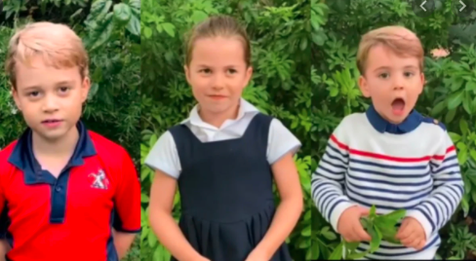
Princes George, Princess Charlotte and Prince Louis
After his father, Prince William, Prince George is next in line to the throne. That makes him 3rd in line.
Princess Charlotte is currently 4th in line for the throne after Prince George. If Prince George has children, they will take her place in the line and push her further down.
Prince Louis is 5th in line to the throne. Like Princess Charlotte, if Prince George has children they will push him further down the line.

Slide 11
Prince Harry and Meghan Markle
Prince Harry royal title is Duke of Sussex. He is married to Meghan, Duchess of Sussex. He is currently 6th in line to the throne after his father, brother, nephews and niece.
Meghan’s royal title is Duchess of Sussex. She is married to Prince Harry. Meghan was born in America but is now a British citizen. Prince Harry and Meghan decided not to work as a member of the Royal family, and now live in America.

