Slide 1

Describing a setting and character

Slide 2
When we describe a setting or character, we need to use adjectives.
Adjectives are describing words. They tell us what something looks likes, smells like, feels like or tastes like.

Slide 3
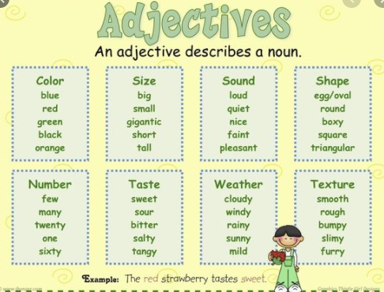
Here are some examples of adjectives you might use.

Slide 4
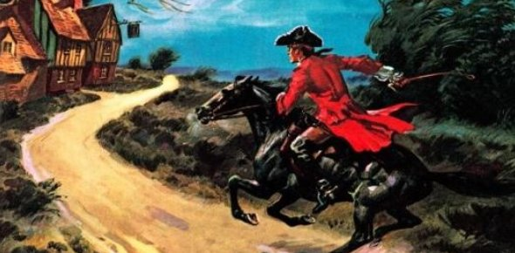
What adjectives could you use to describe this picture? I’ve given you two examples to get you started.
Dark
Old

