Slide 1

Maths
Dividing by 10

Slide 2
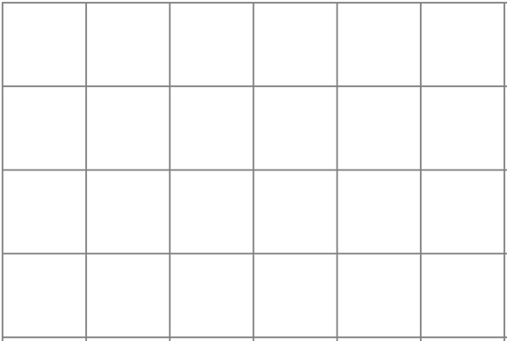


460 ÷ 10=
46
Th
H
T
O
$$\frac{1}{10}$$
$$\frac{1}{100}$$
4
6
0
4
6
0

Slide 3
1900 ÷ 10 =
190
Th
H
T
O
$$\frac{1}{10}$$
$$\frac{1}{100}$$
1
9
0
0
1
9
0
0

Slide 4
65.2 ÷ 10=
6.52
Th
H
T
O
$$\frac{1}{10}$$
$$\frac{1}{100}$$
6
5
2
6
5
2

Slide 5
7.8 ÷ 10 =
0.78
Th
H
T
O
$$\frac{1}{10}$$
$$\frac{1}{100}$$
7
8
0
7
8

