Slide 1
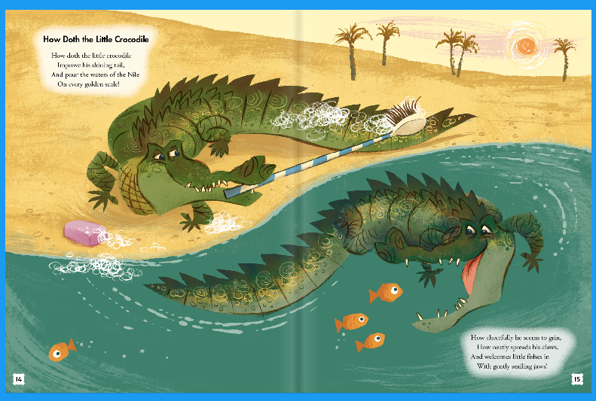
Learning Intention –
To identify how language
And structure contributes
to meaning.
Read the poem How doth the
Little Crocodile and answer
the questions to go with it.

Slide 2
How doth the little Crocodile?
How doth the little crocodile
Improve his shining tail,
And pour the waters of the Nile
On every golden scale!
How cheerfully he seems to grin,
How neatly spreads his claws,
And welcomes little fishes in,
With gently smiling jaws!

Slide 3
Questions to answer
1. What does the poet say about the crocodile?
2. What word would you use to described the tone of the poem?
3. How is personification used to describe the crocodile? Remember personification is when you describe something which is non-human with human characteristics.
4. The crocodile smiles to mask his true intention. What is his true intention?
5. This is a moralistic poem. What is meant by the word moralistic? What is the moral in this poem?

