Slide 1
Year 1
1 more and 1
less to 30

Slide 2
Using a number line
1 more
1 less

Slide 3
1 more
1 more than 14 is 15

Slide 4
1 more
1 more than 21 is

Slide 5
1 more
1 more than 26 is

Slide 6
1 more
1 more than 13 is

Slide 7
1 more
1 more than 19 is

Slide 8
1 less
1 less than 12 is 11

Slide 9
1 less
1 less than 20 is

Slide 10
1 less
1 less than 27 is

Slide 11
1 less
1 less than 10 is

Slide 12
1 less
1 less than 25 is

Slide 13
1 less
1 less than 30 is

Slide 14
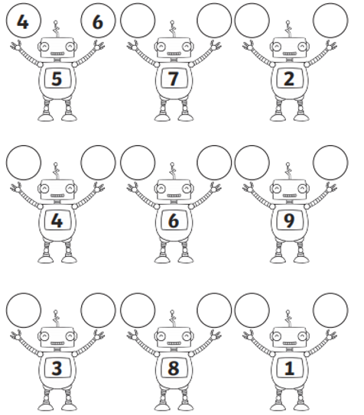
Have a go at the worksheet:

Slide 15
Slide 1 – Hello year 1, today we will be recapping 1 more and 1 less to 30.
Slide 2 – Remember when we find 1 more than a number we have to jump forwards on our number line and when we find 1 less we have to jump backwards on our number line.
Slide 3 – Lets do the first one together, I want to find out what is 1 more than 14. So I find 14 on my number line and I do 1 jump forward, 1 jump forward to 15. So 1 more than 14 is 15.
Slide 4 – Use your number line to work out what is 1 more than 21.
Slide 5 - Use your number line to work out what is 1 more than 26.
Slide 6 - Use your number line to work out what is 1 more than 13.
Slide 7 - Use your number line to work out what is 1 more than 19.
Slide 8 – This time we are going to work out what is 1 less than numbers. Remember when we work out 1 less we have to jump backwards because our number gets smaller. Lets do the first one together, 1 less than 12. So I find 12 on my number line and do 1 jump backwards, 1 less than 12 is 11.
Slide 9 - Use your number line to work out what is 1 less than 20.
Slide 10 - Use your number line to work out what is 1 less than 27.
Slide 11 - Use your number line to work out what is 1 less than 10.
Slide 12 - Use your number line to work out what is 1 less than 25.
Slide 13 – Last one, use your number line to work out what is 1 less than 30.
Slide 14 – Have a go at the worksheet.

