Slide 1
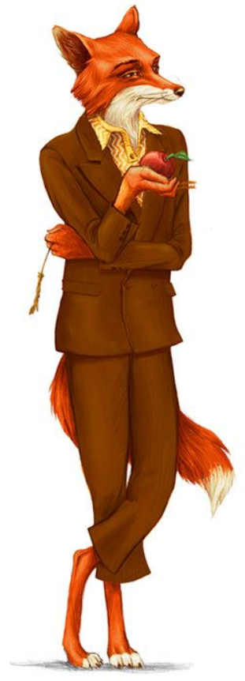
Fantastic Mr Fox Chapter 3 The Shooting
What do you think this chapter is going to be about?
Discuss with an adult.

Slide 2
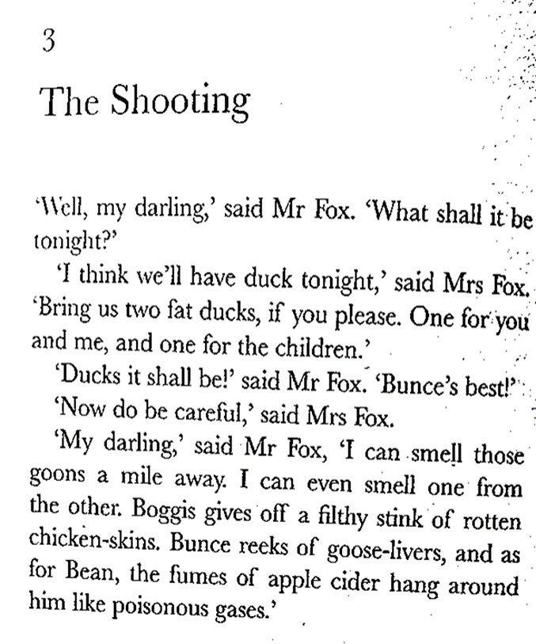

Slide 6
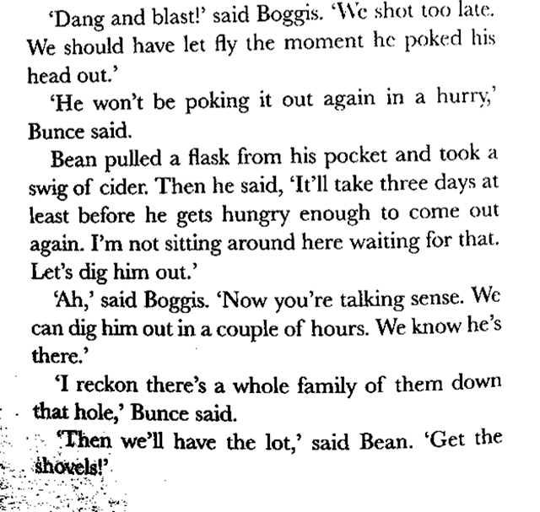

Slide 7
What has happened?
Discuss with an adult what has happened in this chapter.
What do you think might happen next?
What do you think Mrs Fox will think when she sees Mr Fox without a tail?
What are the farmers planning to do?

Slide 8
Task Create a wanted poster, titled WANTED – THE OWNER OF THIS TAIL.
Explain what Mr Fox looks like, how he acts and where he can be found. Include details of his crimes and the reward.
Use the chapter to help you. The section when he is leaving his hole tells you lots about how he acts. clever
Word bank
Confident twitches trots careful fur careless
Paws bushy stump stealing farmers clever
On the next slide are some ideas to help you.

Slide 9
