Slide 1
Learning intention – Describe a character and setting

Slide 2
Today you will create two characters and a setting that will be used in your own version of the poem ‘The Highway Man’. You need to create a villain, someone who sacrifices themselves for the villain and an alternative setting, where the story may have taken place.

Slide 3
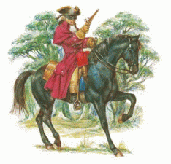
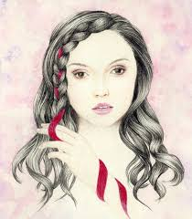
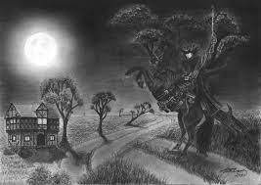
In the Highway Man:
The Villain (the bad guy) – The Highway Man
The person who sacrifices themselves – Bess
The setting – a dark, windy night in a town

Slide 4
When choosing your characters remember to include:
What they look like – hair colour, clothing, strong or weak.
What type of person they are – loving, caring, kind, mean.
What is their character like – hard working.

Slide 5
When choosing your setting remember to include:
Time of day
Weather
What you can see?
How does it feel? – cold, spooky, bright, warm.

Slide 6
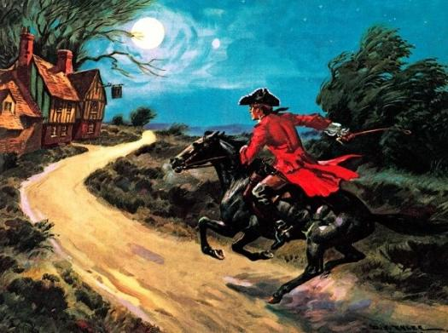
The Highway Man character description example
The Highwayman rides through the night looking for glowing, yellow gold to rob. He wears a long, dark red coat made of velvet and a round, black hat on his head. He is strong and brave and loves the landlord’s daughter Bess.

