Slide 1
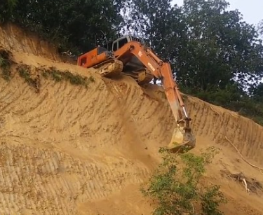

Fantastic Mr Fox
Chapter 6
The Race
What do you think this chapter may be about?
Do you think the farmers will catch the foxes?

Slide 2
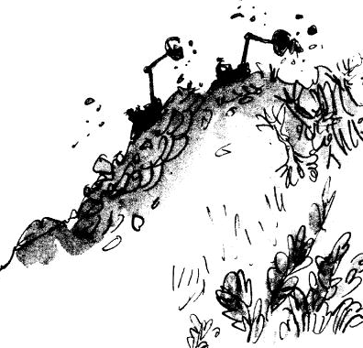
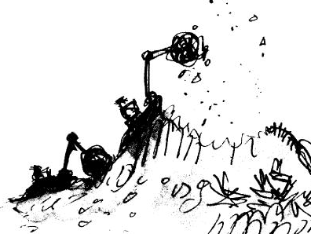
Chapter 6
The Race
Now there began a desperate race, the machines against the foxes. In the beginning, the hill looked like this:
After about an hour, as the machines bit away more and more soil from the hilltop, it looked like this:

Slide 3
Sometimes the foxes would gain a little ground and the clanking noises would grow fainter and Mr Fox would say, ‘We’re going to make it! I’m sure we are!’ But then a few moments later, the machines would come back at them and the crunch of the mighty shovels would get louder and louder. Once the foxes actually saw the sharp metal edge of one of the shovels as it scraped up the earth just behind them.
‘Keep going, my darlings!’ panted Mr Fox. ‘Don’t give up!’
‘Keep going!’ the fat Boggis shouted to Bunce and Bean. ‘We’ll get him any moment now!’

Slide 4
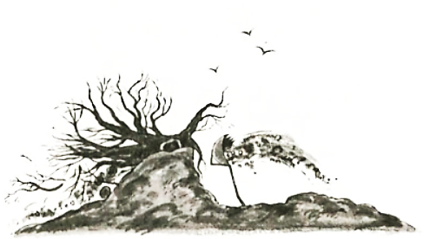
‘Have you caught sight of him yet?’ Bean called back.
‘Not yet,’ shouted Boggis. ‘But I think you’re close!’
‘I’ll pick him up with my bucket!’ shouted Bunce. ‘I’ll chop him to pieces!’
But by lunchtime the machines were still at it. And so were the poor foxes. The hill now looked like this…
The farmers didn’t stop for lunch; they were too keen to finish the job.
‘Hey there, Mr Fox!’ yelled Bunce, leaning out of his tractor. ‘We’re coming to get you now!’
‘You’ve had your last chicken!’ yelled Boggis. ‘You’ll never come prowling around my farm again!’

Slide 5
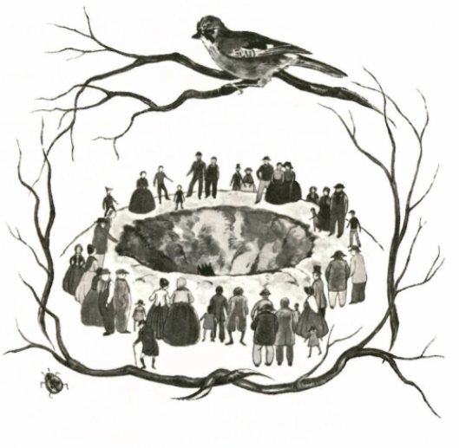
A sort of madness had taken hold of the three men. The tall skinny Bean and dwarfish pot-bellied Bunce were driving their machines like maniacs, racing the motors and making the shovels dig at a terrific speed. The fat Boggis was hopping about like a dervish and shouting, ‘Faster! Faster!’
By five o’clock in the afternoon this is what had happened to the hill…
The hole the machines had dug was like the crater of a volcano. It was such an extraordinary sight that crowds of people came rushing out from the surrounding villages to have a look. They stood on the edge of the crater and stared down at Boggis and Bunce and Bean.

Slide 6
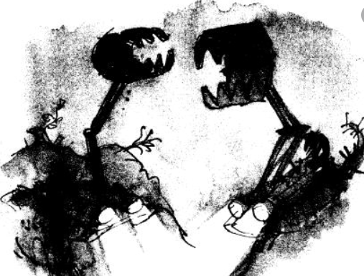
‘Hey there, Boggis! What’s going on?’
‘We’re after a fox!’
‘You must be mad!’
The people jeered and laughed. But this only made the three farmers more furious and more obstinate and more determined than ever not to give up until they had caught the fox.

Slide 7
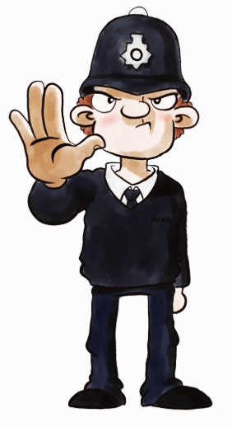
Task
You are one of the farmers, you can choose.
A police officer comes along and sees you using your diggers.
What can you tell him to stop him arresting you for destroying the environment. Write out and complete these sentences.
We are trying to catch _______________who has been _____________our ______________ , ___________, ___________ and ____________. His house is underneath this huge ________ . We have tried ____________ him out with shovels but he ___________a tunnel. We are sure he won’t __________ from us now we are using these mechanical ___________.
Word bank
Diggers Mr Fox ducks digging tree geese turkeys dug escape stealing chickens

