Slide 1
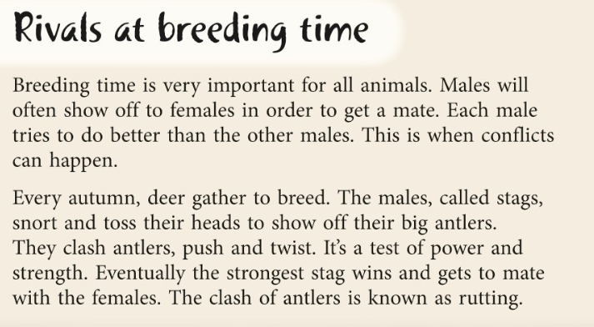
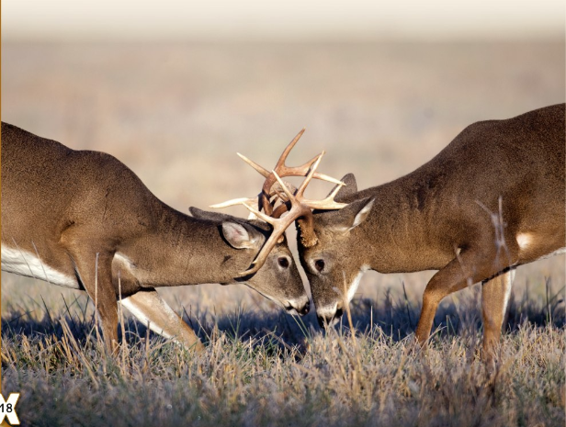
1. Deer gather to breed every summer.
2. Male deer are called stags.

Slide 2
3. Female birds of paradise perform dances for the male birds.
4. Narwhals are a type of seal.

Slide 3
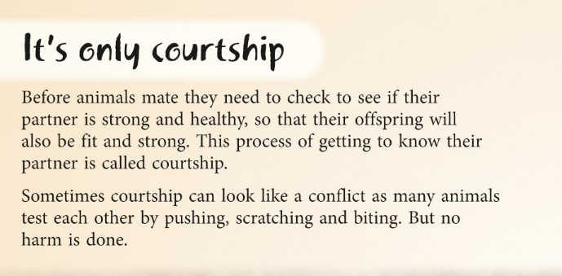
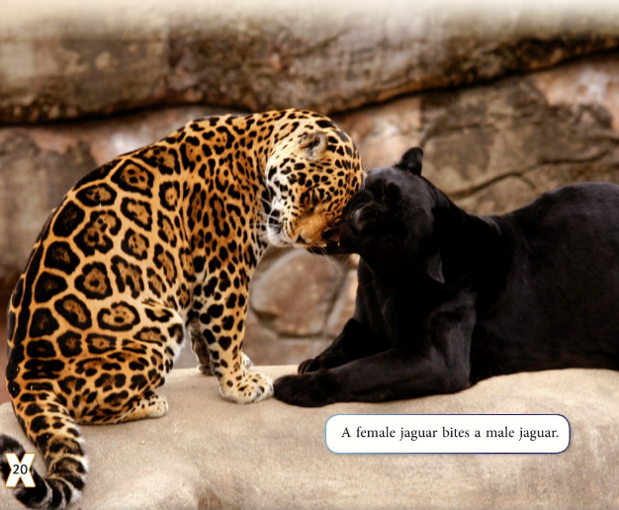
5. Often animals mate before they get to know each other.

Slide 4
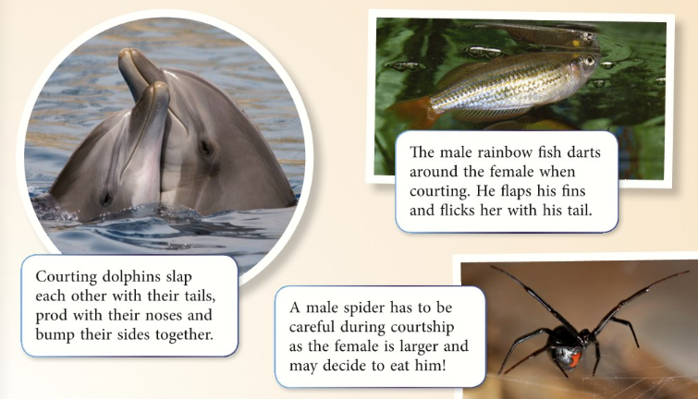
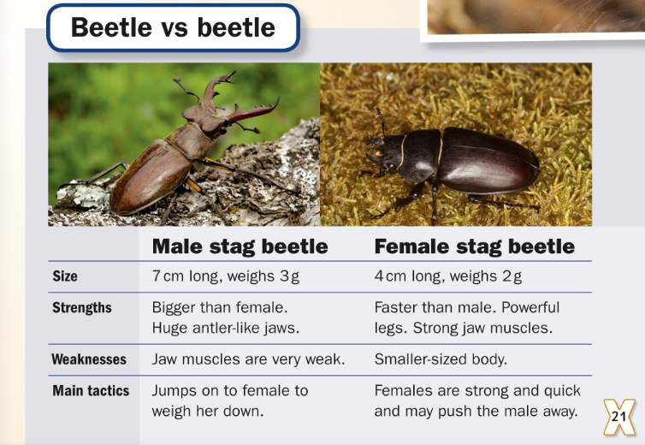
6. Sometimes female spiders are eaten by the male.
7. Female stag beetles usually weigh around 2g.

Slide 5
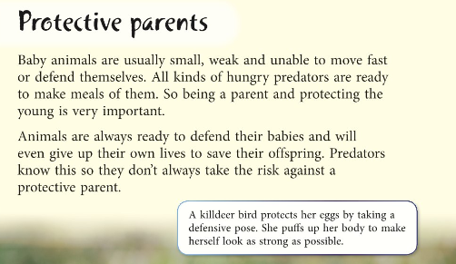
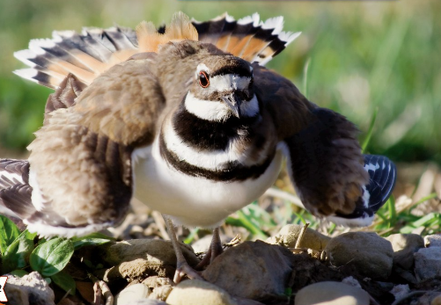
8. Animal parents are selfish and don’t care about their young.

Slide 6
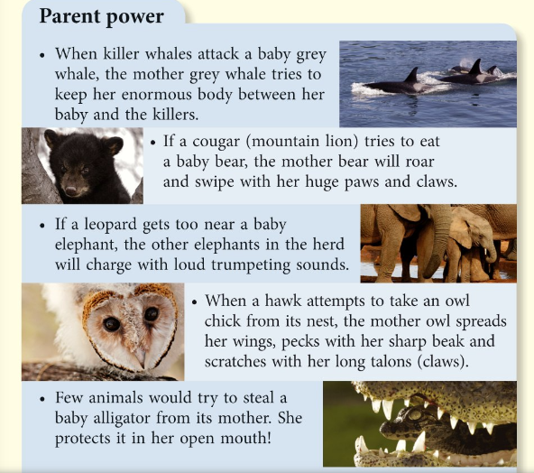
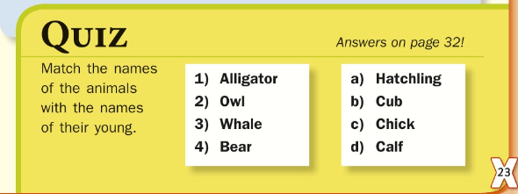
9. A group of elephants is called a herd.
10. Owls keep their chicks safe by keeping them in their mouth.

