Slide 1
Set 1 Sounds v

Slide 2
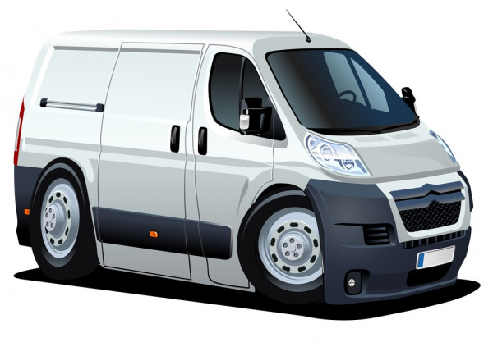

Slide 6
